Slide 1
Module 5 Financing your Community Regeneration Ambitions
www.restart.how
This programme has been funded with support from the European Commission
This project has been funded with support from the European Commission. This publication [communication] reflects the views only of the author, and the Commission cannot be held responsible for any use, which may be made of the information contained therein.

Slide 2
Intro
Financing your Community Regeneration Projects - during and post Covid19
MODULE 5 OVERVIEW
01
Top Tips for Success in Writing a Grant Application
It’s time to talk money. In this module we demystify funding opportunities and help steer you towards some exciting community regeneration funding opportunities.
You will also learn top tips in grant writing and pitching and how to leverage the funding power of many through crowd funding and innovative community share mechanisms. And as always you will have the opportunity to learn from others through our spotlights and case studies.
02
Pitch perfect – how to pitch your idea to potential funders
03
Innovative Community Fundraising and Crowdfunding – leveraging the power of many
04
Community Regeneration Grants available at Local, National and European levels

Slide 3
INTRODUCTION: FINANCING YOUR COMMUNITY REGENERATION PROJECTS
During and post Covid19

Slide 4
How COVID19 has impacted Community Grants and Funding
In many European countries, public grant/community funding available changed in response to the crisis. Funds moved into emergency responses and away from development projects.
In years to come, we can expect many more changes to happen. Competition for funds is expected get more intense and well thought out projects might find it more difficult to get funding.
Finding grant funding is about making connections. It is about getting to know what funding is out there and deciding whether it suits you or not.
Government and other funders have been offering emergency support, and funding will move into capacity building to help groups evolve in a sustainable way.
Source: UK National Council for Voluntary Organisations

Slide 5
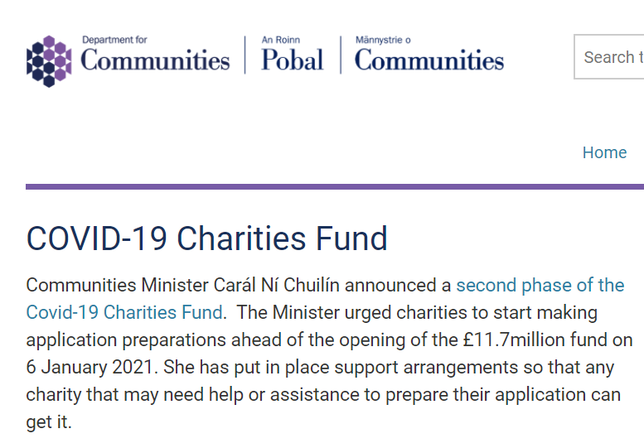
C
COVID-19 support NI – Government funding is available to help organisations
Department For Communities NI

Slide 6
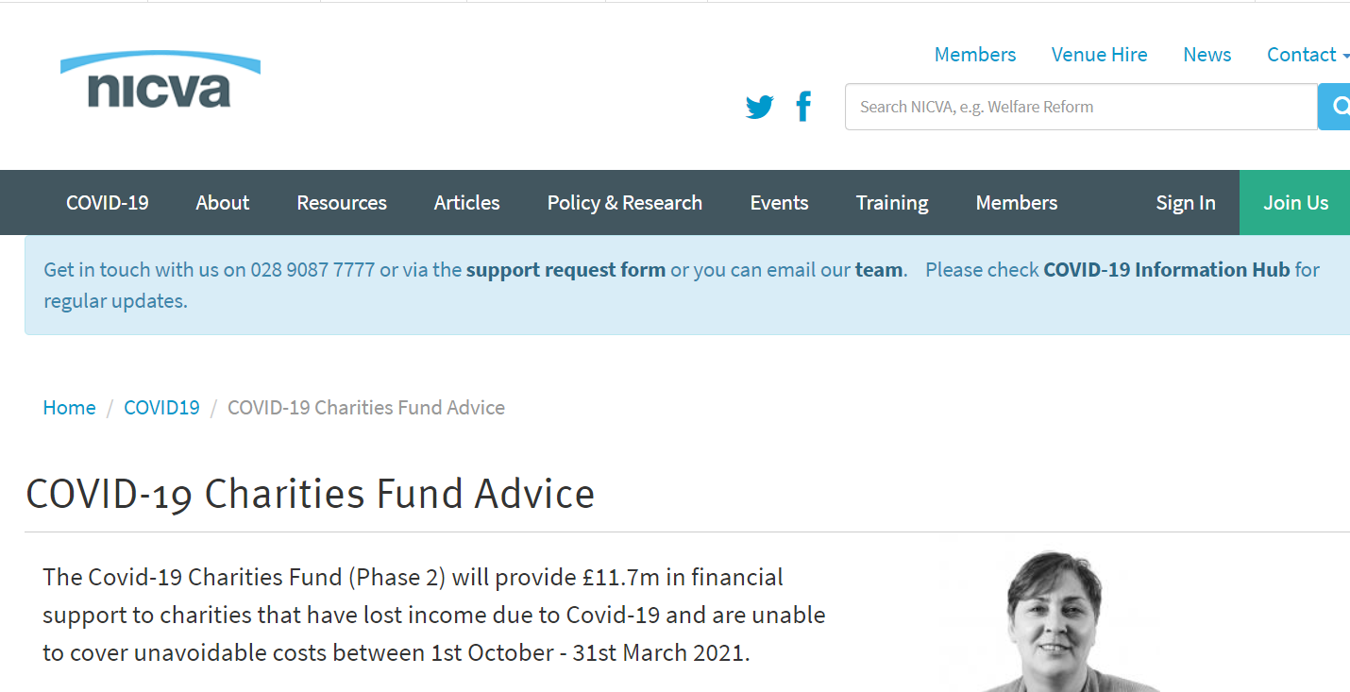
C
Advice and support on funding is being offered by NICVA
Covid Funding Advice

Slide 7
SECTION ONE: Top Tips for Success in Writing a Community Grant Application
Orla Casey from the RESTART+ Ireland is a Community Regeneration Funding Expert, in this section she shares 18 top tips for success

Slide 8
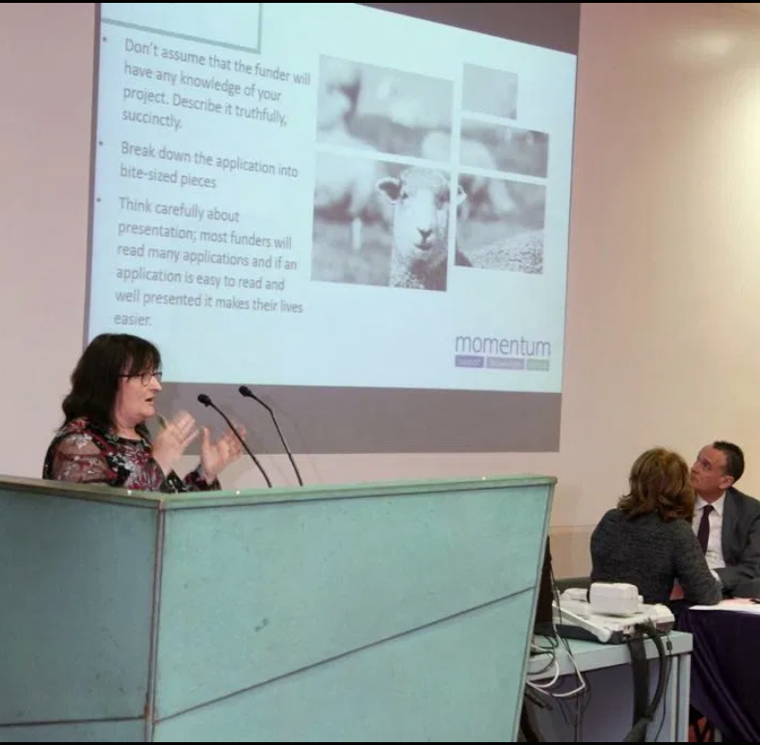
Top Tips from a Community Regeneration Funding Expert
Orla Casey is at the forefront of community regeneration in Ireland and work closely with over local authorities and hundreds of communities to bring their community regeneration projects to life.
She has heled these groups raise millions of euros in project funding and finance and she shares 18 of her top tips for Success in Writing a Community Grant Application in the section which follows.
Orla Casey is a member of RESTART+ Ireland Team, a funding expert (www.momentumconsulting.ie) and a director of Leitrim Food Enterprise Zone CLG.

Slide 9
SUCCESS in SECURING FUNDING is a bit like making a cake!
For any community group or committee, the challenge of pulling together finance for projects can be quite daunting.
For smaller community regeneration projects you may just need one finance source but for larger scale projects multiple finance sources and funders may be required. The way you approach funding depends on ingredients (you and your project) and you need follow a recipe.
Following the recipe is easy when you have a set of guidelines and that is what we will try to provide for you in this module!

Slide 10
Before you start…
Take a moment to review and focus on your community regeneration project priorities.
What are your priorities for next 1 – 3 years? 3 – 5 years?
Survival, regeneration or growth ?
New opportunities ?
Same activities but improved?
Same catchment area or further afield?
Same management structures?
Same modes of delivery / supports?
Any digitisation changes etc?
All of these questions will help you define the ingredients for your successful funding application.

Slide 11
Did you know?
Nationally, funders estimate that between 50 and 60% of all applications they receive are immediately turned down because they are ineligible and do not meet clearly laid out guidelines.
“We are deluged with large numbers of poorly targeted and poorly executed applications, making it difficult for trustees to identify those organisations most worthy of support” – ACT, Association of Charitable Foundations

Slide 12
Tip 1: Forget about the money! (At least initially…) & define your project
The primary concern of funders is that your project is well planned and that it will truly make a difference. In making an effective application important questions to start with include:
What are you trying to achieve?
New community space or service?
Purchase new community equipment?
Further develop an ongoing community project or asset?
Provide community training?

Slide 13
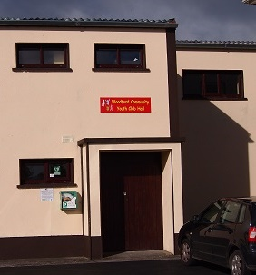
Tip 1: EXAMPLE Forget about the money! (At least initially…) & define your project
EXAMPLE – WOODFORD YOUTH HALL, CO. GALWAY: APPLICATION FORM EXTRACT – the problem and solution are presented very clearly at the outset
Woodford Youth Hall, once a thriving hub of youth activity and engagement, faces restricted activities and even closure due to an unsafe roof which in urgent need of redevelopment.
With a rejuvenated committee in place (2018), the promoters wish to complete building refurbishment to launch a new programme of youth activities for it’s growing population.
In addition to roof repairs (removal, disposal and replacement of a double skin asbestos roof), this redevelopment will see the installation of acoustic panels (to increase the music and dance use of the Hall) and the purchase of special needs sensory play equipment which will be used by the very active Woodford Parent and Toddler Group who meet weekly at the hall.

Slide 14
Tip 2: Show how your project aligns to your purposed funders aims
It is essential that you address how does your project fulfil the funder’s aims? Link your project to the funder’s key criteria and show how your project furthers their aims and objectives. This means that you need to research your funding target thoroughly. Why? As we mentioned in the intro up to 50% of applications received by funders do not meet their published criteria.
As a very basic minimum you should read the guidelines published by the funder. Consider the funder’s motivation, the format for applying, the level of funding, submission deadlines, eligibility and the decision making process.

Slide 15
Tip 2: EXAMPLE Show how your project aligns to your purposed funders aims. EXTRACT.. show alignment with precision and with facts
Woodford village has undergone a community rejuvenation led by the Town and Village Renewal Programme, with physical improvements in streetscape and environment seeing new families relocate to the village. The Youth Hall serves a catchment area of six feeder primary schools- Derryoober, Woodford, Ballinakill, Drim, Moyglass and Derrybrien; and one secondary school - Mercy College Woodford with upwards of 360+ young people in the direct catchment area.
The Hall requires urgent roof replacement and addition of new youth facilities so that it can offer a strong comprehensive youth service for the catchment area that builds on the existing services. It will allow plans for a rejuvenated youth club (and contribution to Comhaile na N’og). It responds fully to GRD Strategic Action 5.2 and will offer a youth wellbeing and recreation hub.
APPLICATION FORM EXTRACT

Slide 16
Tip 3: Sell the benefits of your community regeneration project
What are the real and positive differences the funded project will make in your community?
Who in the community stands to benefit and how?
How does the project meet the communities needs and how were these needs uncovered?
What is the economic impact of the project? (Note - You can use our Local Economy Impact Exercise from Module 4 as a basis for this)
Make sure to answer these questions in both a qualitative and quantitative manner in your funding applications. You could also bring in some storytelling here to paint a vivid picture

Slide 17
Tip 3: Sell the benefits of your community regeneration project – use visual impact where you can

Slide 18
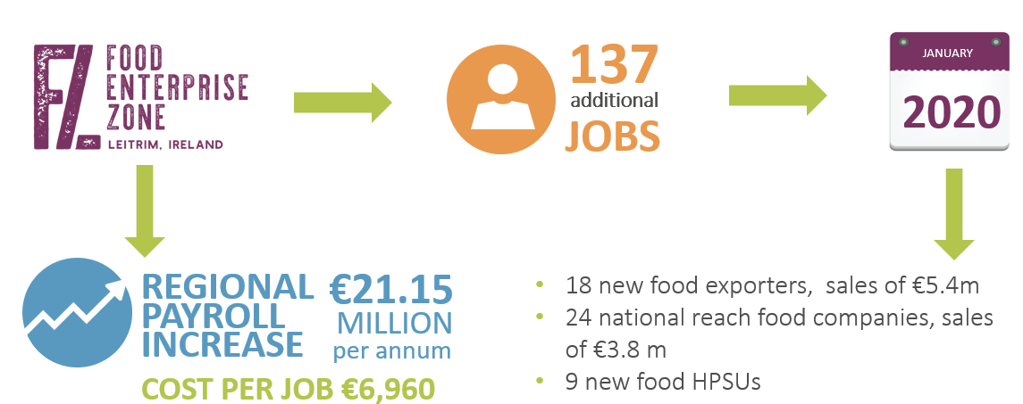
Tip 3: Sell the benefits of your community regeneration project – what does the project meant to the community – this is especially vital for economic regeneration projects.

Slide 19
Tip 4: Build on your credibility and be professional!
One of the primary reasons why applications get funded is that the funders are convinced that the applicant organisation is:
well organised
has a good track record and
is a capable promoter to carry out the proposed project
To convince the funders of this, you need to approach the process of creating the funding application in a professional manner.

Slide 20
Tip 5: Share your passion for the project and remember people give to people…
“People will forget what you said. People will forget what you did. But people will never forget how you made them feel.” - Maya Angelou
If you are excited about a project’s potential – share that excitement. If you believe in it – share that belief.
Remember that funders are people too and they come from communities with problems that might be very like the one you are trying to provide a solution too.
People give to people – so always remember the human element when crafting a funding application.

Slide 21
Tip 6: Ask yourself, ‘Why wouldn’t they fund this?
Often a good way to strengthen your funding application is to try and ‘pick holes’ in it.
So ask yourself, ‘Why wouldn’t they fund this?
Having identified the weaknesses you can then work on putting them right.
This is a great exercise to do with your community committee as others might find holes/gaps that you didn’t realise were there.

Slide 22
Tip 7: Budget – know your finances
Prepare your budget with great care
Be thorough in your project financial planning, costing your expenditure in line with the tender process highlighted by the funder,
Be convincing you have your match funding in place
Know your overhead costs
Have your last year’s audited accounts ready
Financial projections – get a financial mentor or a volunteer to help

Slide 23
Tip 8: Pay particular attention to the sustainability section
As we’ve learnt in earlier modules, sustainability is key. With this in mind, you should prepare answers which address:
How will impact continue?
Risks (internal, external)
How will you implement:
monitoring
evaluation
reporting

Slide 24
More Top Tips for Success in Writing a Community Grant Application
Tip 9: Don’t assume that the funder will have any knowledge of your organisation or project. Describe your background and capabilities with conviction and describe your project truthfully and succinctly.
Tip 10: Break down the writing of the application into bite-sized pieces. So many people start well but fade as the application form progresses. Stay strong throughout!
Tip 11: Think carefully about the presentation of your application – appearances matter. Most funders will read many applications and if an application is easy to read and well presented it makes their lives easier.

Slide 25
More Top Tips for Success in Writing a Community Grant Application
Tip 12: Do not over-promise - you will one day have to deliver.
Tip 13: It always takes a lot longer to put an application for funds together than you think !
Tip 14: Remember it is a competitive process – your best foot forward, be competitive.
Tip 15: Write in an interesting way that captures the energy & spirit of your project (journalist style)

Slide 26
More Top Tips for Success in Writing a Community Grant Application
Tip 16: The power of evidence of need. It is not sufficient to say: “we know … we think….” back it up with relevant research
Tip 17: Show that your project is additional – not competing with others
Tip 18: And last, but not least, definitely talk to the funding agency before you apply

Slide 27
SECTION TWO: PITCH PERFECT
How to pitch your idea to potential funders and also use pitches in a community fundraising setting

Slide 28
WHY AND WHEN WILL YOU NEED TO PITCH
Sometimes when you are seeking funding, you may have to present or pitch the project idea to funders or even to businesses in your community as you seek their financial support.
If you have seen TV shows like Dragons Den you will have an idea the pitching process involves, and what needs to be done to secure support.
In the section that follows, we share some key insights into creating a near perfect pitch that community regeneration projects can benefit from

Slide 29
What is a PITCH ?
A pitch is typically a short and concise presentation which provides all relevant and realistic information on WHY the funders or community should financially back the project.
The best pitches are those that tell a story and are delivered with passion, knowledge of the subject matter and confidence. They create an emotional connection and draw people in to be vested/invested in the project.
Finding out who is best storyteller in your project will be key to your pitch success.
This Photo by Unknown Author is licensed under CC BY-SA

Slide 30
PITCH PERFECT INGREDIENTS
Use strong and/or compelling visuals. People only retain 10% of what they hear
Your solution/ project
Compelling story/need
Your Community support
How it meets funding priorities
Evidence the project will succeed – what impact will it make
Know your project costs
Choose your committee’s strongest presenter, regardless of their position.
Provide a little background on the communities development history and the current leadership team

Slide 31
In 2013 Sutton Community Farm Crowdfunding Campaign raised £17,172 from the community. This pitch video was vital in helping their fledging enterprise expand.

Slide 32
SECTION THREE: INNOVATIVE COMMUNITY FUNDRAISING AND CROWDFUNDING
In this section, we delve into new ways to attract funding.
Leveraging the power of many

Slide 33
Community Shares
Community shares are an innovative funding mechanism that can be used to regenerate all types of community projects including
Transformation of community facilities
Finance renewable energy schemes,
Support local food growing,
Fund new football clubs,
Restore heritage buildings,
and above all, build stronger, more vibrant, and independent communities.

Slide 34
Community Shares
They are becoming increasingly popular in the UK thanks to an organisation called Community Shares | . Since 2009, almost a 120,000 people have invested over £100m to support 350 community businesses throughout the UK.
Community Shares Step-by-Step is an online tool that enables you to work towards launching a community share offer. It is designed to help anyone considering raising community shares at any stage of development, from those investigating the idea for the very first time, to those who are on the verge of issuing an offer.
The Community Shares Handbook

Slide 35
Stockwood Community Benefit Society (Stockwood CBS) was established to ensure the long-term community ownership of Rush Farm, a biodynamic-organic farm and the co-located Stockwood Business Park. Since 2013, £431,000 has been raised. The society has 144 members

Slide 36
WHAT IS CROWDFUNDING?
Crowdfunding is a powerful funding approach which communities can use to build financial and collaborative support to develop and create their own projects.
Crowdfunding is a form of fund-raising, that is based on the theory that if lots of people are willing to donate a small amount of money towards a project, then the project is likely to be successful. This is an old idea, that has been revolutionised by the Internet and is now a common tool that is used to help fund a project, collect money for a good cause. Crowdfunding campaigns are usually delivered via an online platform supported by social media.
Source: Exeter City Futures
This Photo by Unknown Author is licensed under CC BY-ND

Slide 37
Crowdfunding stands for a variety of different ‘fundraising’ models. It can take the form of:
EQUITY LENDING when people lend money to individuals or organisations in exchange for company shares
PRE-SELLING
when people donate towards the creation of a specific product, such as CD, design, gadget etc.
Not very common for communities
Common for communities
Also quite common
Sometimes for larger projects
CHARITY is when people donate to an individual, project or organisation while receiving no financial or material return in exchange
PEER-TO-PEER LENDING is borrowing from a number of lenders via an online platform, each lender lending a (small) amount in return for financial compensation

Slide 38
Choosing a Crowdfunding Platform
Different platforms apply different charges depending on the model you chose. The Costs:
Platform Hosting Fee: Some platforms, although not all, charge an initial cost just for hosting your campaign. This cost varies from €0-300 and will be charged to all projects, be that successfully fundraised or not. Ask platforms what fee applies to them before starting the campaign.
Success fee: The majority of crowdfunding platforms will take a percentage of the total amount raised. The percentage varies from platform to platform and ranges between 3% and 12% of total raised.
Payment processing fees: Look out also for a service fee for every transaction made. Usually this fee is on average 3%. For instance, for every €100 donation/investment, only €97 reaches the campaign.
Check each platform carefully to assess the real costs behind same. In the next slides we introduce you to some of the most common platforms.

Slide 39
Examples of Crowdfunding Platforms for Communities
Spacehive
Spacehive is a civic-crowdfunding platform focusing on supporting projects that make local places better. Spacehive link projects to local councils, businesses and grant makers willing to fund them.
Spachive operates an ‘all or nothing’ model, meaning that if a financial target is not hit, none of the pledges from the crowd are collected.
Visit: Spacehive - Crowdfunding For Local Projects

Slide 40
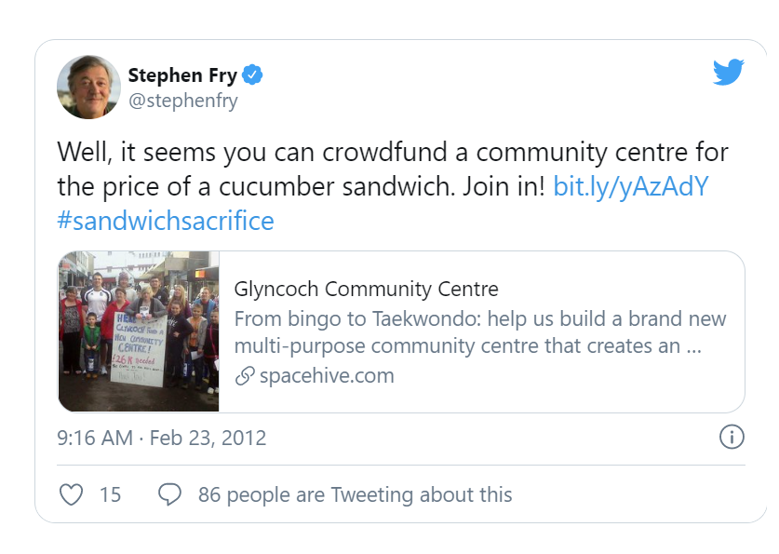
Glyncoch Community Centre needed £30,000 but raised £792,021 on Spacehive
Crowdfunded Communities
The town of Glyncoch, South Wales, had been fighting for seven years to build a much-needed community centre. They had raised 95% of their funding goal but on March 30th, 2012 their grants were set to expire.
Read More: Glyncoch Community Centre – About Spacehive
And so the community turned to Spacehive in an effort to crowdfund the remaining £30,000. 5 weeks after launching their Spacehive campaign the community centre received backing from 107 people and businesses, including celebrity actor Stephen Fry, the local mayor and Tesco Charity Trust bringing their pledge total to £792,021!!
CASE STUDY

Slide 41
Crowdfunding Platforms for Communities
Crowdfunder UK
Crowdfunder is the UK’s No. 1 rewards-based platform convening personal, community, business and commercial projects in one place.
Extra funding can be accessed from their creative and culture, community and social enterprise, innovation, business and local authority partners. Crowdfunder offers two options; all or nothing or keep what you have raised.
Crowdfunder UK - Where Ideas Happen | Crowdfunder UK

Slide 42
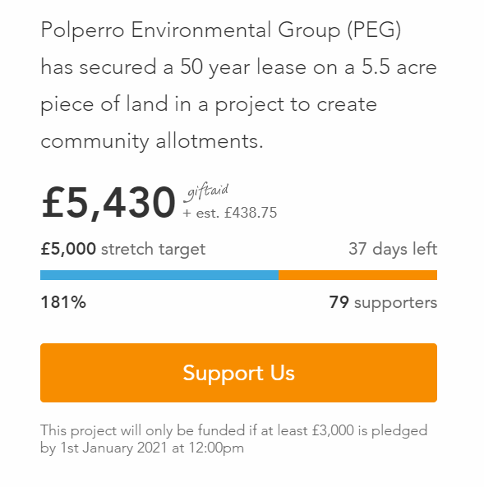
A Crowdfunding Campaign for Community Allotments and Orchard for Polperro, Cornwall, UK
Crowdfunded Communities
The vision:
We hold a 50 year lease on a 5.5 acre piece of land we call ‘Kellow Farm Allotments’. The land is wild and overgrown on a sweeping slope of hillside. We are aiming to clear the land, create terraces and make allotments available for members and families of our community as well as reclaiming and growing the old orchard a the far end of the plot. The production of local food has, for many years, been held as a positive, healthy, resilient and sustainable way to live and we now have the opportunity to offer these opportunities to our community.
CASE STUDY
Read More: A Community crowdfunding project in Polperro by Polperro Environmental Group (crowdfunder.co.uk)

Slide 43
SECTION FOUR: COMMUNITY REGENERATION GRANTS
What’s available at at Local/National and European levels?

Slide 44
LOCAL/NATIONAL GRANTS/FUNDS
Local and National funding is a starting point for community regeneration projects.
NORTHERN IRELAND
We now introduce you to funding opportunities typically available in Northern Ireland each year and key sources of funding information.
(note – correct as of November 2020, please check availability, opening dates etc)

Slide 45
For flexible community funding, the National Lottery Community Fund
The Community Fund
Awards for All NI

Slide 46
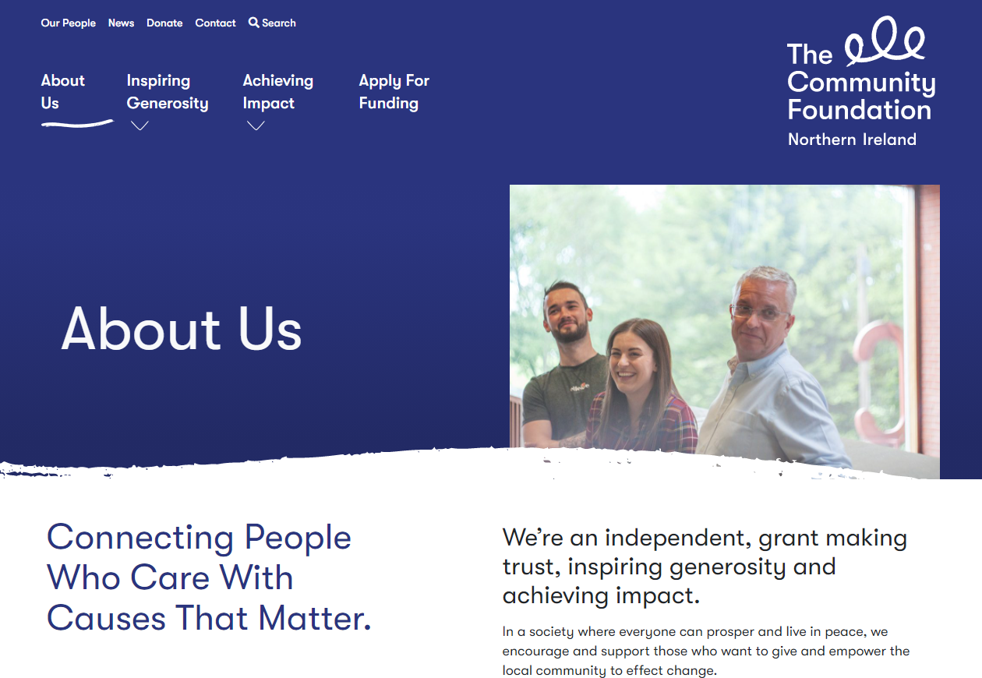
The Community Foundation NI
The Community Foundation NI is part of a UK wide network of community foundations that distribute 65 funds to groups and organisations across NI, making contributions to education, health, housing, the arts, social justice, employment, peace and reconciliation. They like to take risks and help smaller, community-led organisations that work directly with people who are at the margins of society. Funding through the Foundation ranges between £250 to £1m.
The big issues and themes they are currently focussed on include building sustainable communities, community voice, and people on the edges.

Slide 47
Where to find the information about open funding opportunities ? PLUG IN TO ADVICE AND SUPPORT
There are many other UK grant making organisations that might be able to provide funding for your projects. There are places you can go to stay up to date on funding opportunities and to get guidance and support.

Slide 48
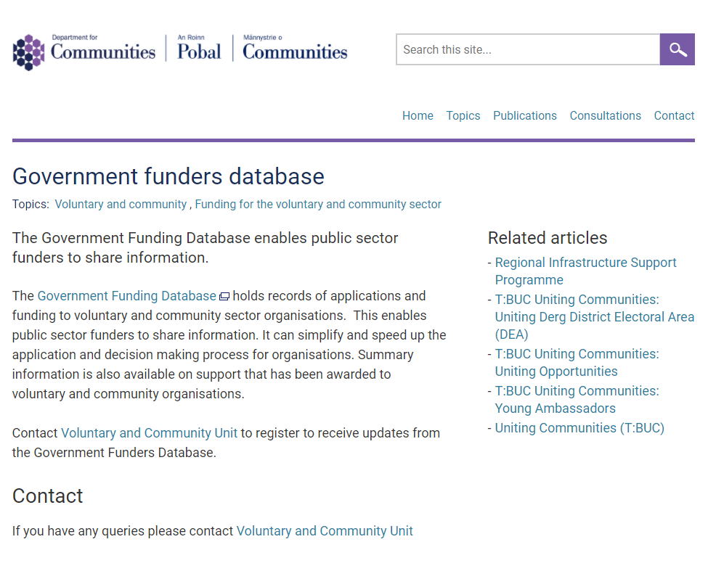
Government Funders Database
There are a lot of regional and national government departments that offer funding for lots of different reasons. The Government Funding Database helps you to find your way through these. It also gives summaries of projects that have been funded, so you can get a clearer idea of what they are looking for and whether it suits your plans.

Slide 49
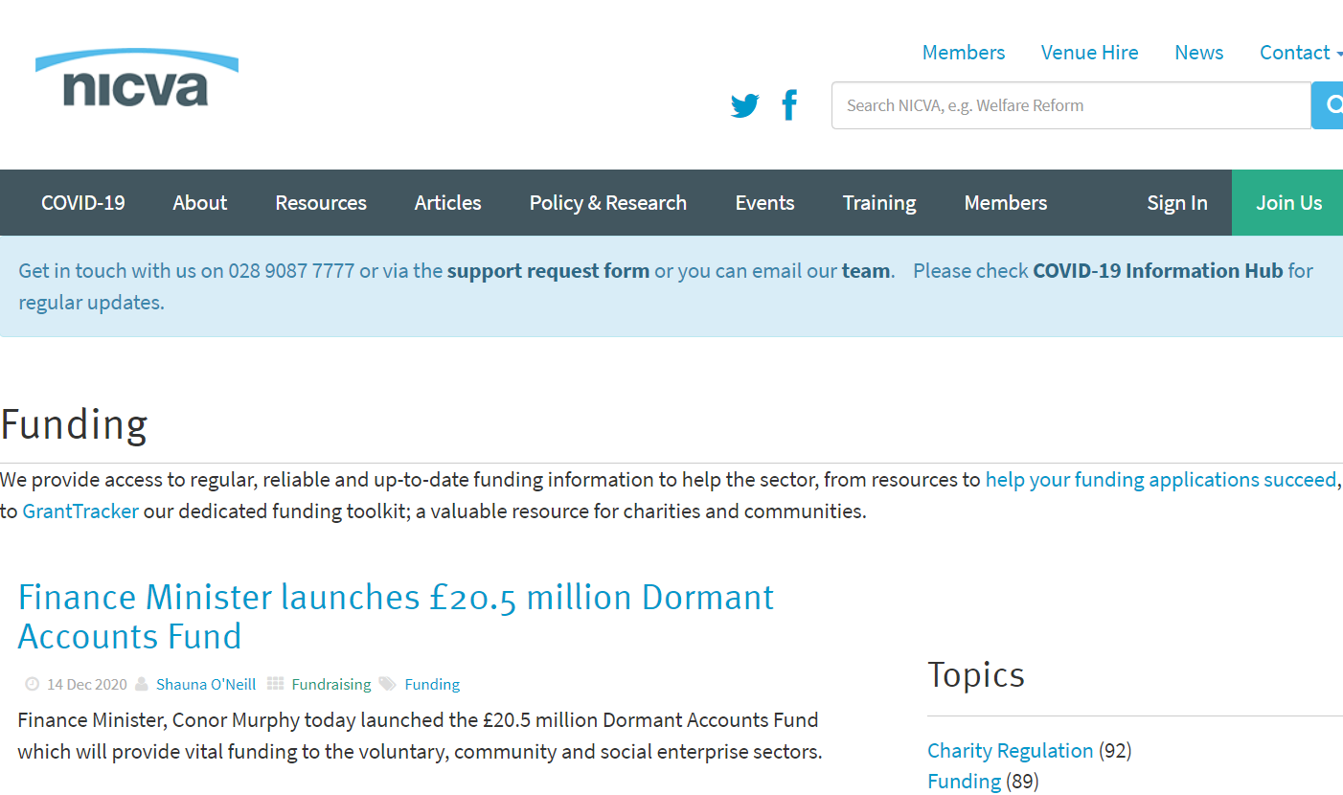
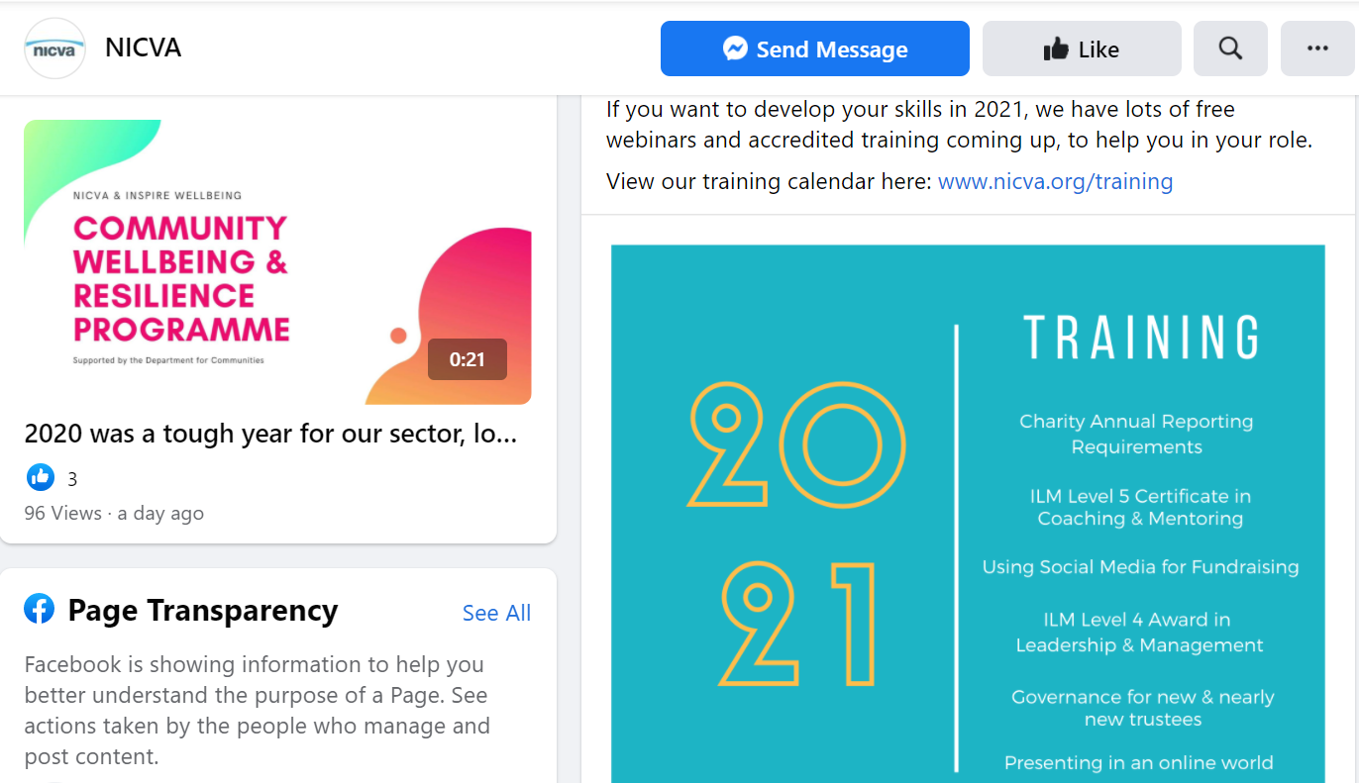
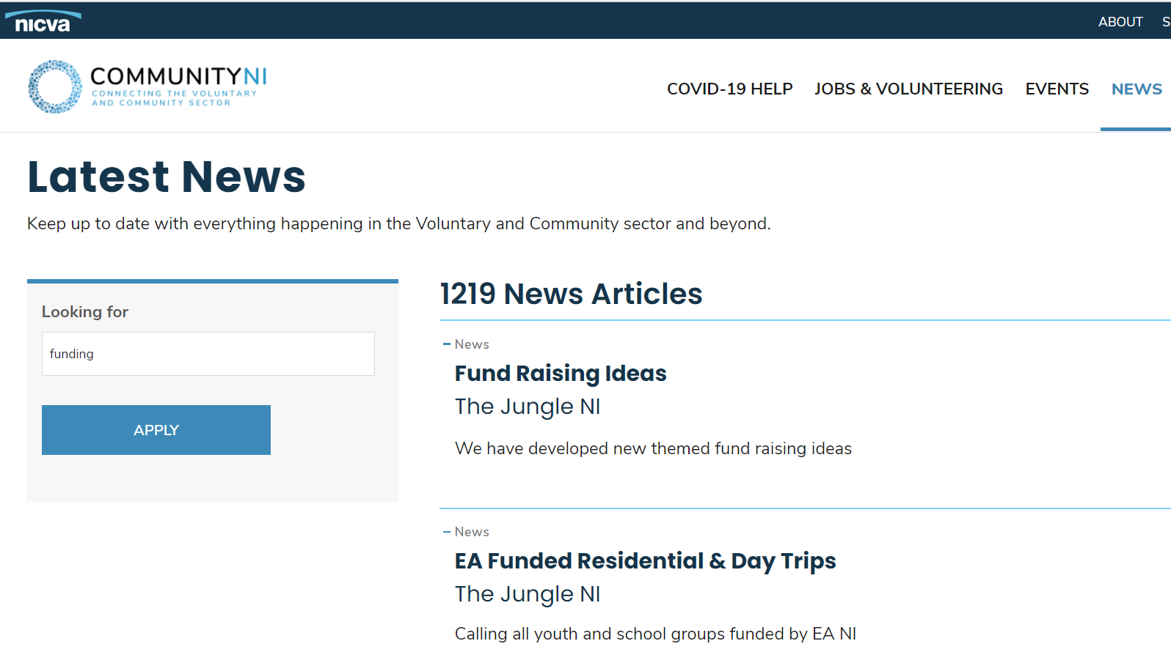
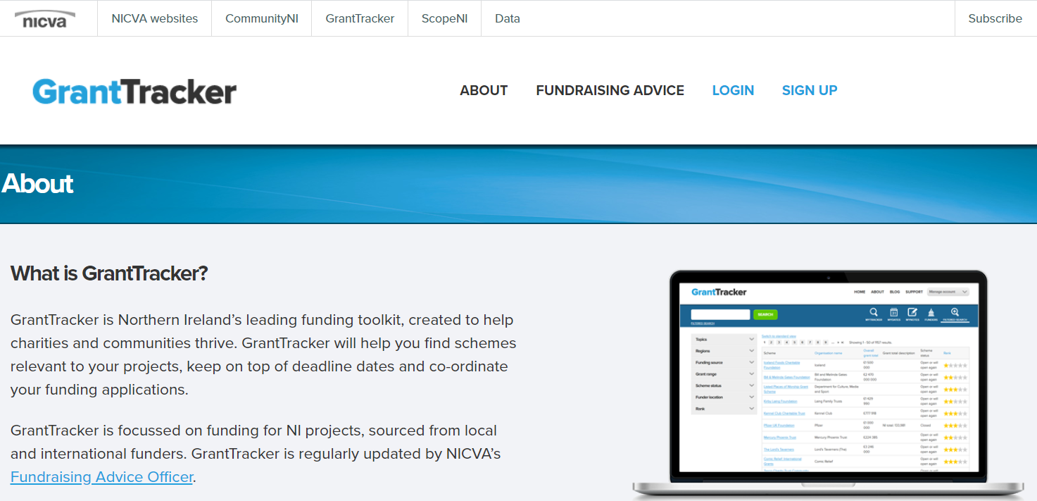
NICVA – Northern Ireland Council for Voluntary Action
NICVA offers Northern Ireland specific support and information on a range of grant makers who fund Northern Irish groups, including major trust funds. NICVA membership is free for small groups, who also get a reduced rate for subscriptions to their grant database.
NICVA main website
NICVA Facebook Page
NICVA - Community NI website
Notes:
ADD NICVA, NCVO and SUBSCRIPTION SERVICES

Slide 50
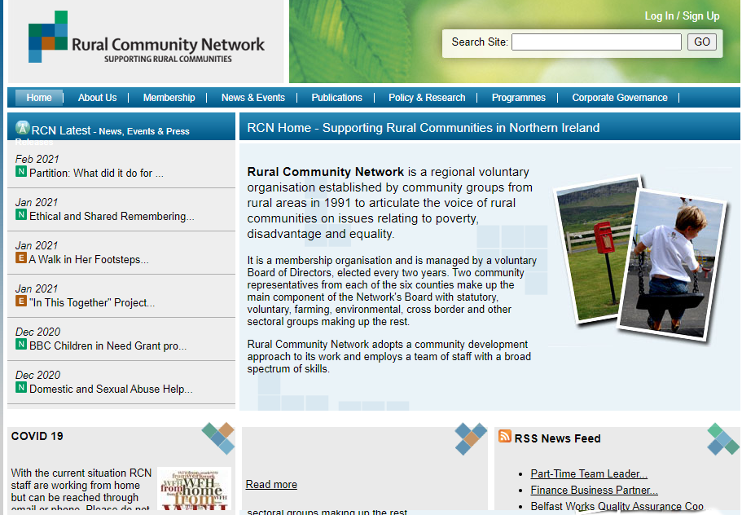
Rural Community Network
The Rural Community Network is a regional voluntary organisation working across Northern Ireland. It was established to represent and serve the needs of small rural groups. It is a membership organisation with a low annual fee of £20 for small groups. Their Facebook page is a great source of regular funding updates.
RCN Facebook Page

Slide 51
NCVO Funding Central
The NCVO is a national membership organisation supporting 15,000 groups across England. It offers information services that cover major UK grant makers. Membership is free for small organisations.
NCVO Funding Central
Notes:
INSERT SLIDE HERE – WHERE TO FIND FURTHER INFORMATION

Slide 52
SUBSCRIPTION GRANTFINDING SERVICES
Grants Online
Monthly subscriptions available
Grantfinder

