Slide 1
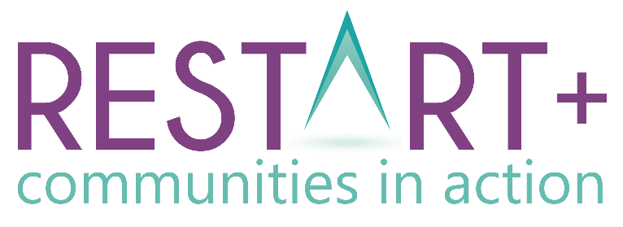
Module 4 Turning Community Regeneration Ideas into Action
www.restart.how
This programme has been funded with support from the European Commission
This project has been funded with support from the European Commission. This publication [communication] reflects the views only of the author, and the Commission cannot be held responsible for any use, which may be made of the information contained therein.

Slide 2
Intro
Turning Community Regeneration Ideas into Action – How change happens
MODULE 4 OVERVIEW
01
Activating your Communities DNA – its characteristics, assets and sources of strength
Having learned the benefits of sustainable community regeneration in modules 1-3, you are now ready to start taking some community action of your own.
In Module 4, we examine what is needed to turn your community regeneration ideas into projects. We explore your community DNA, partnership building as well as marketing and communication.
In our final section, we provide templates and resources to help you put your community regeneration ideas into action.
02
Leveraging support and commitment from your community and community diaspora
03
Building key Public, Private and Community Partnerships
04
The Resources you need – people power, finances and more
KEY ACTION PACK 4:
Useful exercises and templates to putting your community regeneration ideas into action

Slide 3
INTRO: Turning Community Regeneration Ideas into Action
Community Regeneration Plans can help make community change happen – in this section we explore 7 key steps in developing a strategic approach

Slide 4
What is a Community Regeneration Plan?
A Community Regeneration Plan is an overall framework for action which indicates, in general terms, how the proposed community regeneration will be achieved.
A good Community Regeneration Plan should address the challenges and problems faced by the community and should offer solutions.

Slide 5
Community Regeneration Plan
A Community Regeneration Plan should outline the 360-degree approach from the starting point (challenges to be addressed), the steps to solutions, through to implementation and follow-up.
Let’s review the 7 steps you will need to take to bring your community regeneration project to life..

Slide 6
Key Elements of a Community Regeneration Plan
Step 1: Forming a project committee
Developing a community project should never be a one-person job. You need to gather a group of competent individuals to participate in the planning process. This will help you distribute the workload accordingly to complete each task on time.
Identify community champions – who will help extend your reach into the community and will be the energy that help sustain planned interventions?
Having more minds work on the project will open up more opportunities and ideas. Your project will be stronger by engaging with people in your community honestly and openly and being prepared to listen to what they have to say and genuinely respond to it.
The Skills/Competencies Audit you completed in Module 1 will help you with this task

Slide 7
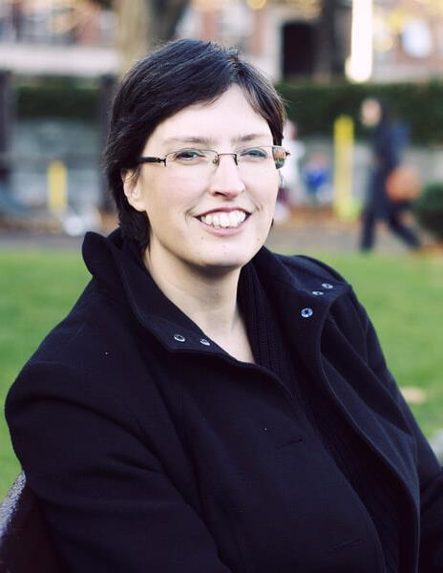
KEY INSIGHTS
Sometimes all a successful committee needs is a shared vision and passion
Ruth Garvey-Williams is one of the founding members of The Exchange (www.exchangeinishowen.ie) an award-winning Irish voluntary-run community centre and registered charity committed to innovating creative projects to benefit their community.
“It was July 2012 and with representatives from six community groups and social enterprises, “The Exchange” committee was formed - the name chosen both to remember what was past and describe the future. None of us had any idea what we were getting ourselves into and most of us had no idea what we were doing. Governance. Company registration. Insurance. Grant applications. Policies. Health and Safety... (but) Bernie Doherty gave voice to our core values: Community, Innovation, Wellbeing - the three pillars that would form the foundation and focus of our partnership.”

Slide 8
Key Elements of a Community Regeneration Plan
Step 2: Deciding on your community regeneration project
What are the challenges facing your community at the moment?
What will be the specific needs of your community in the near future?
Try to come up with a brave, new radical solution – one that will set your community apart and make your project easier to finance.
Be sure to actively involve your community in determining their futures by doing this you can inspire more people to be engaged for the long term.
The Articulating Community Challenge you completed in Module 1 will help you with this task

Slide 9
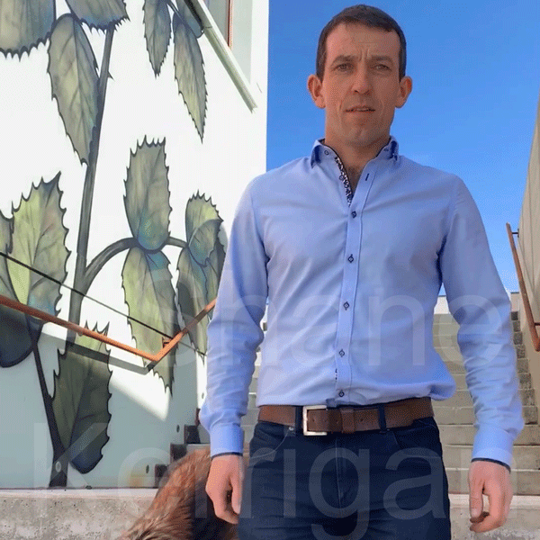
KEY INSIGHTS
Finding the right idea can take some soul searching
Shane Kerrigan bought an unfinished development in the centre of Manorhamilton and 14 months later with the help of an expert team, he turned it into a new state of the art tourist and cultural hub called W8 (www.w8centre.ie )
Shane admits there was a “lot of soul searching” involved in trying to decide the final format for the multi-phase development.
“I grew up here and I could see a need for something of this kind of development (W8) and I really felt that we could make a positive difference to the town and the area,” he said.

Slide 10
Key Elements of a Community Regeneration Plan
Step 3: Setting Goals for your Community Regeneration project
Goal-setting will help keep your community committee focused on the desired outcomes.
Once you have your goals established, you can then start defining the tasks that need to be completed in order for the project to deliver.
In Module 3, we learned about Kiltylive – the online social media campaign launched by Kiltyclogher village, Ireland to attract one new family to their village in an attempt to keep their school open. They exceeded their goal by 800% within six weeks as 8 new families moved to the village.

Slide 11
Key Elements of a Community Regeneration Plan
Step 4: Proposed Project Costs and Researching Funding Mechanisms
Most community regeneration projects need funding to get off the ground.
Small scale projects may be able to be funded from existing community funds or local fundraising, but large-scale projects will need funding from multiple sources to get off the ground.
We will look at financing your projects in much more detail in Module 5

Slide 12
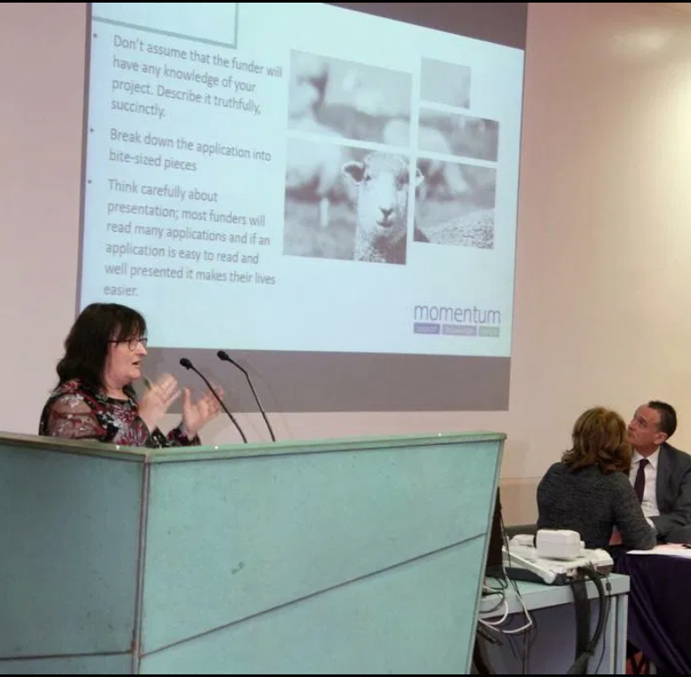
KEY INSIGHTS
Advice from a Community Regeneration Funding Expert
“Finding funding to develop your infrastructure, properly run your services, cover core costs, train staff and volunteers, and become a sustainable organisation is one of the biggest challenges facing any community, and it is an ongoing challenge.
Make sure you only apply for funds that really match your project and ensure your submission is in exactly the right format. See Module 5 for a guide to funding success”.
Orla Casey is a funding expert (www.momentumconsulting.ie) and a director of Leitrim Food Enterprise Zone CLG

Slide 13
Key Elements of a Community Regeneration Plan
Step 5: Creating a project timeline
A project timeline will keep everyone focused and on track.
You can use a simple tool like a Gantt chart (see template at the end of this module) or online tracking tools to make a list of the necessary steps to complete before the proposed deadline.
For large scale projects, be mindful that raising finance could take up to 2/3 of the project timeline and be an ongoing focus!

Slide 14
Key Elements of a Community Regeneration Plan
Step 6: Project Implementation
A project timeline will keep everyone on the same page.
You can use a simple tool like a Gantt chart (see template at the end of this module) to make a list of the necessary steps to complete before the proposed deadline.
The timeline would also serve as a reference to make sure you’re on the right track.
For large scale projects, be mindful that raising finance could take up to 2/3 of the project timeline!

Slide 15
Key Elements of a Community Regeneration Plan
Step 7: Project Evaluation
Lots of community projects may sound compelling and seem worthwhile, but it is hard to know if they actually achieve their goals without collecting data and conducting an evaluation.
Evaluation provides a window into whether, why and how projects and programs achieve their goals. Evaluation is also essential to ensure that community resources and funds are utilised in an efficient way and to achieve the greatest possible impact.
Evaluating your projects is often a funding requirement. It is also a good practice to uncover any required project refinements/enhancements.
We will look at key success factors and evaluating your projects in much more detail in Module 6

Slide 16
SECTION ONE: ACTIVATING YOUR COMMUNITY DNA
Tapping into your unique characteristics, assets and sources of strength

Slide 17
Your community's DNA, characteristics, assets and sources of strength
In module 1, we looked at the characteristics of great communities and how great communities know their strengths and opportunities and how to combine these to create a sustainable vision or plan for the future.
We learned how each community's unique combination of assets form its DNA and a foundation on which to build its future.
In the section which follows, we will delve deeper and explore the DNA of some communities and how they have utilised it to build strong community regeneration projects.

Slide 18
CONTINUING A STRONG LEGACY OF FOOD PRODUCTION
The Food Hub and Leitrim Food Enterprise Zone – testaments to a DNA in Food Heritage in Ireland
In Module 1, you learned about the Food Hub and how the Lairds jam factory was transformed in 2004 by Drumshanbo Community Council into a unique strategic infrastructure & training resource dedicated to the food sector.
Building on the success of the Food Hub and Drumshanbo’s strong food legacy, a new innovative project was instigated in 2018 and now has secured funding and is in its realisation stage (2021).
Drumshanbo has truly embraced its food legacy as part of its DNA and it continues to explore projects in the food sector which can further develop the local economic regeneration and prosperity of their community.
The Leitrim Food Enterprise Zone is Ireland's first food enterprise zone, a new visionary concept and innovative approach which will act as a premium location magnet for new food start-ups and relocating food businesses.
CASE STUDY

Slide 19
FOCUS ON THE WELLBEING NEEDS OF THEIR COMMUNITY
COMMUNITY WELLBEING AT ITS HEART
- THE EXCHANGE INISHOWEN, DONEGAL
Founded in 2013, The Exchange Inishowen is an award-winning voluntary-run community centre and registered charity dedicated to supporting and developing their local community, empowering social enterprise and small businesses, encouraging positive mental health & wellbeing and promoting culture & heritage. The Exchange is committed to innovating creative projects to benefit the local community.
Mindful of their dispersed population and high dependency age profile of their local community, The Exchange has the promotion of community wellbeing at its heart.
For example, each year since 2014, they have provided a delicious three-course home-cooked Christmas Dinner with live entertainment for people who are on their own, coping with bereavement or changed circumstances or those who'd like to experience a different kind of Christmas. Read more: www.exchangeinishowen.ie
CASE STUDY

Slide 20
TOURISM CAMPAIGN BASED ON THE HISTORICAL FOUNDATIONS OF THE TOWN
#EVERYBODYlovesENNIS - ‘Visionary’ plan to boost Ennis’ post-Covid recovery
The #EVERYBODYlovesENNIS plan focuses on the development of tourism and economic activity in Ennis and the role it will play is regenerating the tourism industry across Co. Clare. Ennis contains 21% of the county’s bedstock and is an important factor in attracting and retaining visitors to the county.
Project research led to a new focus for the marketing of Ennis emphasising the role of its people, community and strong cultural base.
‘‘The historical foundations of Ennis as an island presents a fascinating story for visitors, while the historic town boundary takes the form of an attractive heart shape. This will form the basis for a new branded approach for the town and a new energy behind the profiling and promotion of the town.”
CASE STUDY
Source: Clare Champion

Slide 21
NATURE AS AN COMMUNITY ASSET
BALLYHOURA, IRELAND – A NATURE AND ADVENTURE LOVERS PARADISE
Situated at the crossroads of Munster, Ireland on the borders of counties Tipperary, Limerick and Cork, Ballyhoura Country is an area of undulating green pastures, woodlands, hills and mountains.
For adrenaline seekers experience all the thrills of the hills as you go mountain biking on the Ballyhouras, Ireland’s very first dedicated mountain biking centre, with over 90 km of world-class purpose-built trails, or book in for action-packed activities at Ballyhass Lakes including kayaking, rock climbing, archery or even axe throwing.
Ballyhoura Development CLG has championed and funded the development of many of regions community groups. For example, Ballyhoura Beo which is a Community Service Program which aims of Ballyhoura Beo is to promote outdoor recreation sports and environmental education. Ballyhoura Beo is a social enterprise and is not for profit. All monies raised are reinvested into community amenities and future events.
CASE STUDY
Source: Ballyhoura Development

Slide 22
Aigas Community Forest, Scotland – a community run social enterprise
NATURE AS AN COMMUNITY ASSET
Aigas Community Forest is a community run social enterprise managing the 260ha Aigas Forest as a productive, working forest providing social, economic and environmental benefits for residents of and visitors. On March 5th 2015, the purchase of the Aigas woodland from Forestry Commission Scotland by the community was completed and after six years of planning and fundraising Aigas Community Forest was officially open for business. The community felt compelled to get involved in the management of the wood having witnessed how it was poorly managed over a 20 years period. They completed studies which demonstrated that the woodland could be run as a profitable enterprise while also providing benefits for the community in a sensitively managed manner from a nature conservation standpoint.
The project is an excellent example of sustainable community intervention and regeneration with social, economic and environmental benefits.
CASE STUDY
Source: Aigas Community Forest

Slide 23
NATURE AS AN COMMUNITY ASSET
Restart+ Northern Ireland brings you this interview with Lough Neagh Development Trust. Lough Neagh is the biggest body of fresh water on the island of Ireland and the lough itself and the lands around the banks provide a way of living for many communities.

Slide 24
SECTION TWO:
5 TOOLS TO LEVERAGE SUPPORT AND COMMITMENT FROM YOUR COMMUNITY AND DIASPORA

Slide 25
LEVERAGING SUPPORT AND COMMITMENT FROM YOUR COMMUNITY AND DIASPORA
The success of your project depends largely on how well you are able to engage your community. Community/stakeholder input can help you shape your project vision, ensure you are responding to local needs, and help you to build support for your development ideas. Ideally, your community should be involved from a very early stage; this will help you to form lasting relationships with community members, and ensure your development will be an addition to the community that everyone can be proud of. In this section, we explore 5 tools you can use to leverage and engage your community/diaspora in projects.

Slide 26
TOOL 1: EMPATHY AND DESIGN THINKING
Empathy is one of the most important skills any community leader can have and it is a powerful thing when used in conjunction with Design Thinking.
Design thinking is a problem solving approach that puts people first. Design thinking in a community setting works by developing an understanding of community problems through engaging with those affected – the community members. Its approach to solving problems is participatory, involving the users in finding solutions.
Let’s look at how Design Thinking differs to Business Thinking and Creative Thinking and is a powerful middle ground.

Slide 27
Community Regeneration Mindset: Design Thinking is optimum
Business Thinking
Design Thinking
Creative Thinking
Left Brain
Rational and Structured
Focused on analysis
Dealing with well-defined problems
A problem is something to get out of the way
Mistakes are not tolerated
Analyse > decide
Focused on parts of the problem
Using both sides of the brain to solve problems
Switching at will between rational & structured to a more emotional & intuitive Iterating between analysis and synthesis
Dealing with ill-defined problems
A problem is the start of the process
Mistakes are learning experience
Analyse > Ideate > prototype > evaluate > decide
Zooming in and out, taking the problem apart to reassemble it in a different way
Right Brain
Emotional and intuitive
Focused on synthesis
Dealing with undefined problems
There is no problem
There is no mistakes
Perceive > ideate > decide
Holistic Focus

Slide 28
TOOL 2: STORYTELLING FOR COMMUNITY FACILITATION
Stories are important — they carry the memory of a community. Storytelling is a powerful catalyst for connecting people to each other and places. These types of connections are essential ingredients for positive change through community and economic development. Stories are a useful lens for collectively examining and formulating the necessary steps to actualize the next generation of our communities.
Storytelling can be used to great effect to leverage community engagement in regeneration planning. Instead of starting off discussions with the standard questions of vision, goals, needs and issues, we could ask people to share stories AND as community members to swap stories about why your community is important to them.
Source: K&A

Slide 29
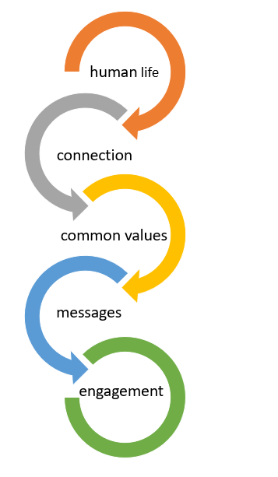
Why storytelling works?
Stories define the very essence of human life
You begin to feel a connection
Common values are identified and messages are communicated
Themes like family, love, friendship, overcoming challenges and others are common to every nation – global reach potential
Even if they previously had no interaction with your community group/committee before, a compelling story can give your community members an incentive to become more engaged and get involved

Slide 30
Appreciative Inquiry Storytelling Technique
Appreciative Inquiry Storytelling Technique does not ask what a community should be like. Instead, it asks residents to remember the best times in their community, and determine how to emulate those times for the future.
Collected community stories must be actively used in your project, not just "mapped" and listed as possible resources.
Ask residents more than just "yes or no" questions.
Be prepared to explain why you are asking about the community. NOTE: It shouldn't be that you are there to "fix" the place
Stories will help you to know what has worked in the community.
Look for patterns in the stories and apply these patterns to the way your project matures.

Slide 31
How to tell a great story…
There are four key things to do to tell a great story
Base it on a character your audience can empathize with or around a community dilemma your audience can relate to
Build tension whether through curiosity, intrigue or actual danger.
Offer the right level of detail. Too little and the story is not vivid; too much and it gets bogged down.
End with a satisfying resolution, whether it’s funny, moving or revealing.

Slide 32
TOOL 3: BOTTOM-UP APPROACHES
Bottom-up approaches emphasise the participation of your local community in development initiatives. Bottom-up approaches enables community members to set goals and the means of achieving them.
They also ensure community ownership, and commitment and accountability to the development project as it seeks development from below. Bottom-up approaches have great potential to leverage support from your local community as they are included in the process from the very beginning. Marrying your bottom-up approaches to key top down (local government etc) community development plans makes for a strong project.

Slide 33
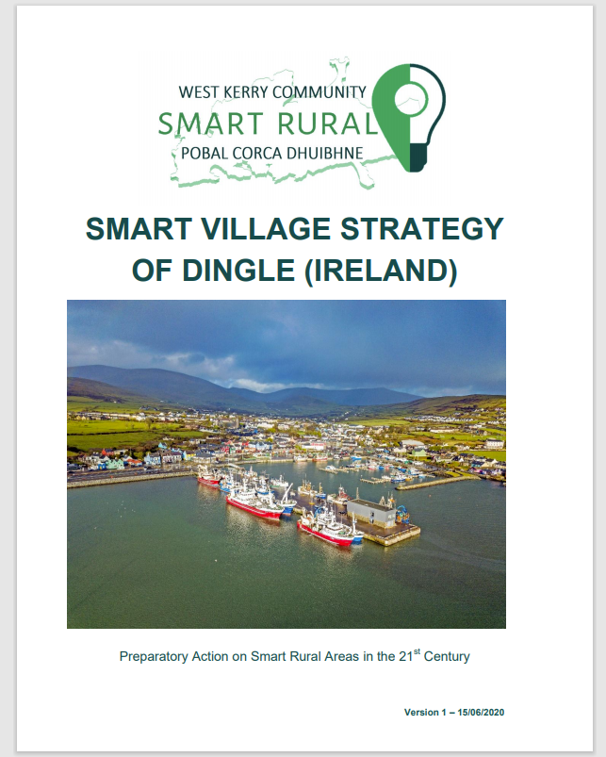
Best practices in Community Strategy Planning – Bottom Up Approach
North East and West Kerry Development (NEWKD) applied a bottom-up approach in the creation of their Smart Village Strategy of Dingle.
Extensive community-level consultations took place over a six-month period, during which there were public meetings, engagements with civil society organisations, widespread awareness-raising actions, group and citizen surveys and representations to statutory bodies.
Community organisations were directly empowered in the process, and civil society will have a pivotal role in leading and directing the project over the coming years.
Read: Dingle’s Smart Village Strategy

Slide 34
TOOL 4: INCLUSION / FOCUS ON DIVERSITY
Inclusion is one of the most important elements of community development and regeneration. As we learned in Module 1, Great communities recognise that inclusion and a sense of belonging is important to one's quality of life. By fostering an inclusive and open ethos, your community group can benefit from a diversity of thinking and opinion and leverage more interest from the wider community.
Diversity implies different perspectives, and it is needed to help you think creatively, outside of the box and connect the dots. Diversity of thought can help your community group sway away from that which is too linear, from extrapolating too readily from the past and making simplistic assumptions about the future.

Slide 35
KEY INSIGHTS
The combination of different groups and creative individuals…facilitated a new era of innovation
“One of the simplest (and most popular) science experiments involves adding Mentos to Coke Cola with explosive results. Bringing people together is a risky business, especially if there are conflicting or competing agendas.
Yet in those early days at The Exchange, we somehow avoided pitfalls and instead saw the positives of dynamic interactions. The combination of different groups and creative individuals in a shared space facilitated a new era of innovation and experimentation, an exciting explosion of creativity.”
- Ruth Garvey-Williams is one of the founding members of The Exchange (www.exchangeinishowen.ie) an award-winning voluntary-run community centre and registered charity committed to innovating creative projects to benefit their community. Ruth has written a ten part series on The Story of the Exchange on Linkedin

Slide 36
TOOL 5: SOCIAL MEDIA/TECHNOLOGY
Taking advantage of both established and emerging digital tools can help maximise engagement and buy in for your community regeneration project.
During the COVID19 pandemic, technology enabled community groups to meet and continue their work. It also opened up some new opportunities for community members to connect and come together whilst apart. One such way was through #virtualvolunteering.
Technology can help your committee to connect with your community's diaspora overseas and leverage their support for projects back home.

Slide 37
Leverage support/community engagement innovatively via novel approaches like Virtual Volunteering
What is Virtual Volunteering? Virtual volunteering means volunteer tasks are completed in whole or in part, via the Internet and a home or work computer. With the ongoing COVID19 pandemic, many people are un/under-employed who might be interested in virtual volunteering.
Like many things in a post COVID19 world, Virtual Volunteering (like remote working) is expected to become the norm so now is for your community group to develop into a great place where people can volunteer virtually!

Slide 38
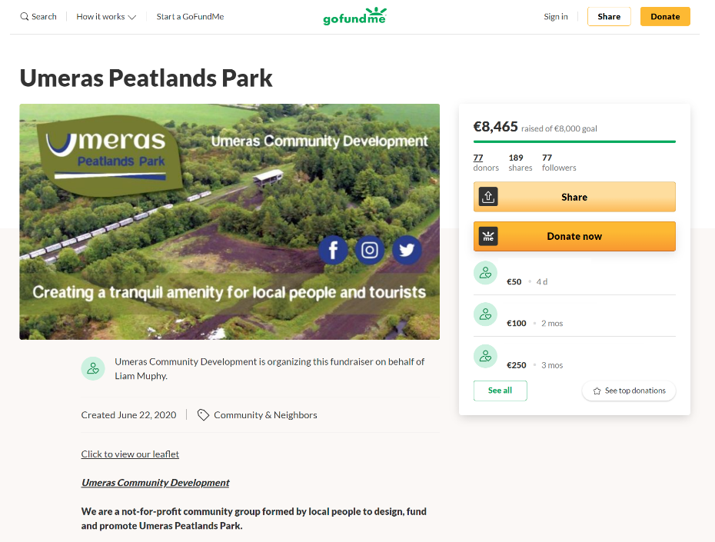
Technology can also be used to illicit financial/match funding support from community or diaspora members
The digital era and online crowdfunding platforms has made raising funds for your community regeneration projects quite easy to set up and run.
When COVID19 hit and the successive lockdown and social distancing rules ensued. Fundraising like everything else (work, communication etc.) too went online with technology not only being key to fundraising locally but also being a useful tool to leverage support for community diasporas across the world.
We will look at financing and crowdfunding your projects in much more detail in Module 5

Slide 39
SECTION THREE: BUILDING KEY PUBLIC, PRIVATE AND COMMUNITY PARTNERSHIPS
Spotlight on some key community development projects which were brought to life by a public, private and community partnerships

Slide 40
A PUBLIC, PRIVATE AND COMMUNITY PARTNERSHIPS WAS KEY TO MODAM’S SUCCESS
SOCIAL
ECONOMIC
MODAM is an initiative led by Arranmore Island Community Council in partnership with Donegal County Council, The Department of Rural and Community Development, Three Ireland and Grow Remote. Arranmore Island Community Council is a democratically elected committee working to promote the sustainability of the island. Modam is a key initiative designed to entice people to visit and move back to Island.
Located on the beautiful of Árainn Mhór Island (Arranmore), Ireland three miles off the Donegal coast on the Wild Atlantic Way, MODAM is Ireland's first offshore shared digital workspace with onsite accommodation, 11 desks and a dedicated meeting space. MODAM has been designed to suit both short and long term rental for remote work, projects or just a change of scenery.
CASE STUDY

Slide 41
This 9 minute video from Three Ireland details their involvement in making Arranmore the most connected island in the world

Slide 42
Leitrim Food Enterprise Zone, Ireland – brings together strong public, community, private balance
ECONOMIC
The Food Enterprise Zone has been constituted to reflect a strong public – community - enterprise balance.
It involves representatives of stakeholder organisations such as HEIs (Letterkenny and Sligo ITs), enterprise agencies (Local Enterprise Offices of Leitrim and Sligo), agriculture, food industry networks and clusters (e.g. Taste Leitrim network of 35 food companies and National Organic Training Skillnets),regional economic development bodies (Western Development Commission), community (financial support of Drumshanbo Credit Union) and industry (led by The Shed Distillery founder Pat Rigney).
The Leitrim Food Enterprise Zone public, private, community partnership enables the sharing of knowledge and best practice between stakeholders which will be converted into wider innovation in practice at regional/national level.
CASE STUDY

Slide 43
Scotland’s Business Improvement Districts - help local businesses to improve their communities
BUSINESS LED INNOVATION/ REGENERATION
In Scotland, Business Improvement Districts (BIS) are part of town, tourism and visitor areas, commercial districts, or specific themes (such as food and drink), in which businesses work together to invest in local improvements. The BIDs model is designed to help local businesses to improve their communities. BIDs can only exist if they get support from a clear majority of local businesses in a vote.
They operate for up to five years and are developed, managed and paid for by businesses through a compulsory BID charge. There are 37 BIDs in Scotland and the model has been used in different environments, including town centres, business parks, industrial estates and tourism initiatives. The Scottish Government funds Scotland’s Towns Partnership to provide a national support service for developing and established BIDs. You can learn more on the National Improvement Districts website: www.improvementdistricts.scot
CASE STUDY

Slide 44
The Giffnock Village BID was established in 2013 by local businesses who decided they needed a financial pot to levy and develop unique events such as the Giffnock Village Classic Car Spectacular

Slide 45
SECTION FOUR: THE RESOURCES YOU NEED
Your project may need to tap into a variety of community assets or resources to help bring it to life. Let’s take a look at some common ones..

Slide 46
COMMUNITY ASSETS
A community asset (or community resource, a very similar term) is anything that can be used to improve the quality of community life. You and everyone else in the community are potential community assets.
Everyone has some skills or talents, and everyone can provide knowledge about the community, connections to the people they know, and the kind of support that every effort needs - making phone calls, stuffing envelopes, giving people information, moving equipment or supplies - whatever needs doing.

Slide 47
PEOPLE POWER
Residents can be empowered to realize and use their abilities to build and transform the community. The stay-at-home mom or dad who organizes a playgroup. The informal neighborhood leader. The firefighter who risks his life to keep the community safe. These are all community assets.
The more people you can get motivated and aware of your efforts and your goals for your community, the more quickly and deeply change will come about.

Slide 48
PHYSICAL COMMUNITY ASSETS
This can be a physical structure or place -- a school, hospital, church, library, recreation center, social club. It could be a town landmark or symbol. It might also be an unused building that could be repurposed for a community regeneration purpose. Or it might be a public place that already belongs to the community -- a park, a wetland, or other open space.
Your new regeneration project might focus on improving an existing physical community assets or perhaps creating a new one.

Slide 49
COMMUNITY SERVICES
Community Services can be assets/resources that you can use to bring your regeneration project to life. They are the things that makes life better for some or all community members - public transportation, early childhood education center, community recycling facilities, cultural organization.
It can be a business that provides jobs and supports the local economy. Your new regeneration project might focus on improving an existing community service or perhaps creating a new one.

Slide 50
LOCAL ECONOMY
The local economy could be an asset your new community regeneration project can tap into and likewise your project could become an asset to your local economy.
Communities and their projects have economic power: the people they hire, the supplies they purchase, the skills they teach, and the resources they offer all affect the local economy.
Not sure about how your project impacts the local economy? See exercise 3 in the key action pack which follows

Slide 51
FUNDING/FINANCES
As we mentioned earlier, most community projects need funding to get off the ground.
Small scale projects may be able to be funded from existing community funds or local fundraising but large-scale projects may need funding from multiple sources to get off the ground.
In Module 5, we will delve deeper into the world of project funding and finance.

Slide 52
Turning Ideas into Action – useful exercises and templates
Key Action Pack 4
The Community Wheel
The Connecting Tool
Public, Private, Community Partnership/Associations Exercise
Local Economy Impact Exercise
The Community Wheel and the Connecting Tool are simple ways to present the resources available to you in the community and show the connection each has to your project. Let's look at each of these tools and how to use them:

Slide 53
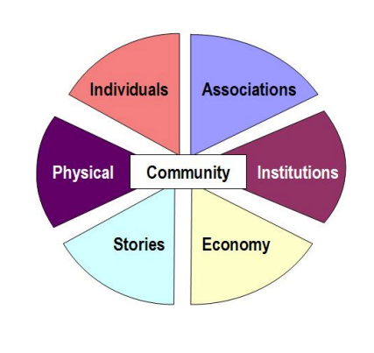
1. The Community Wheel
This tool captures the assets of a community along the six asset categories discussed so far in this course:
individuals/residents
associations
institutions
physical spaces
the local economy
stories of the community
Using the Community Wheel
Use the Community Wheel to write examples of the six types of assets found in the community of your project.
Download and print a copy of the Community Wheel tool to use for this exercise: TheCommunityWheel.pdf
Source: Visit Campus

Slide 54
2. The Connecting Tool
This tool can help you connect the community assets identified in the Community Wheel directly to the objectives of your project. For example: You may be trying to help a community transform a local park. In this case, "park" is at the center of the Connecting Tool. Next, assets listed on the Community Wheel are placed around the "park" objective. For each asset listed, record what the asset can do for the park project, and also how that asset will benefit from it.
Using the Connecting Tool
Using the Connecting Tool, place an objective of your project in the center, then identify the assets from your Community Wheel around that objective. Next, use the tool to record both the contributions and benefits each asset in the community has related to the specific project objective at the center.
Download and print a copy of the Connecting Tool for this exercise: ConnectingTool.pdf
Source: Visit Campus

Slide 55
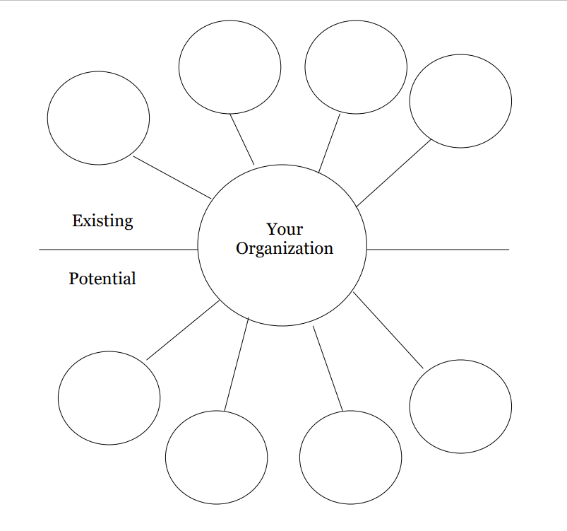
3. Public, Private, Community Partnership/Associations Exercise
Do you consider the vast asset of associations when you are working on your community projects?
How do you think about them beyond monetary resources?
Does your project have extensive relationships with the community's citizen associations?
Using the Association Exercise Tool
Use this tool to illustrate partnerships that you organization already has with associations in your community and to think about new partnerships which might be useful to your projects and your organization. Download and print a copy of the Tool for this exercise: AssociationPartnershipsTool.pdf
Source: Visit Campus

Slide 56
4. Local Economy Impact Exercise
Take a moment to go through the following activity: On a piece of paper, consider each statement below and rate your projects' involvement in the local economy. Use this five-point scale:
5 = Always | 4 = Most of the Time | 3 = Sometimes | 2 = Rarely | 1 = Never
Our project is designed to enhance the local economy.
Our project identifies and mobilizes the enterprise and job-related skills of local residents.
Our project identifies and directs local consumer spending toward enterprise development and support of local businesses.
Our project mobilizes the savings of local residents to reinvest in neighborhood economic development.
Our project involves local citizen associations and institutions in business and economic development efforts.
Our project employs local residents.
Our project provides economic resources to local associations.
Our project provides economic resources to local businesses.
Our project provides economic resources to nonprofits.
For those statements to which your response was less than 4 = Most of the Time, consider how your project might increase its engagement in those aspects of the local economy.

Slide 57
NEXT UP: Module 5
Financing your Community
Regeneration Projects
In Module 5, we will look at some key grants and supports you can access for your Community Regeneration Projects

Slide 58
Key references for Module 4
Community Tool Box
Visit Campus

