Slide 1




Module 5
Financing your Community Regeneration Ambitions
www.restart.how
This programme has been funded with support from the European Commission
This project has been funded with support from the European Commission. This publication [communication] reflects the views only of the author, and the Commission cannot be held responsible for any use, which may be made of the information contained therein.

Slide 2
Intro
Financing your Community Regeneration Projects - during and post Covid19
MODULE 5 OVERVIEW
01
Top Tips for Success in Writing a Grant Application
It’s time to talk money. In this module we demystify funding opportunities and help steer you towards some exciting community regeneration funding opportunities.
You will also learn top tips in grant writing and pitching and how to leverage the funding power of many.
As you have become accustomed to, the final section provide you with a pack of useful exercises and templates to help plan and execute funding and financing related actions for your community regeneration projects.
02
Pitch perfect – how to pitch your idea to potential funders
03
Innovative Community Fundraising and Crowdfunding – leveraging the power of many
04
Community Regeneration Grants available at Local, National and European levels
KEY ACTION PACK 5:
Useful exercises and templates to help you secure funding/finance for your projects

Slide 3

INTRODUCTION: FINANCING YOUR COMMUNITY REGENERATION PROJECTS
During and post Covid19

Slide 4

How COVID19 has impacted Community Grants and Funding
In many European countries, public grant/community funding available changed in response to the crisis. Funds moved into emergency responses and away from development projects.
In the years to come, we can expect many more changes to happen. Competition for funds is expected get more intense and well thought out projects might find it more difficult to get the funding they need.
Finding grant funding is about making connections. It is about getting to know what funding is out there and deciding whether it suits you or not.
Many larger funders stopped running their usual programmes and diverted money to new funds related to the crisis. Let’s take a look at some of those..
Source: UK National Council for Voluntary Organisations

Slide 5

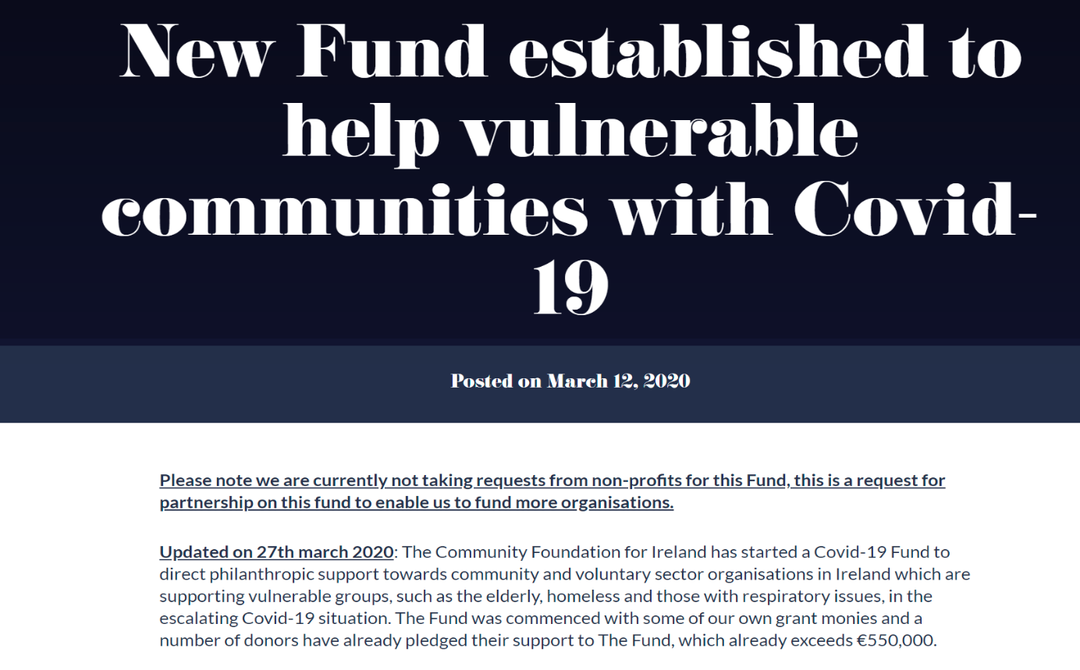
C
New Fund established to help vulnerable communities with Covid-19 (Ireland)
www.communityfoundation.ie/insights/news/new-fund-established-to-help-vulnerable-communities-with-covid-19
This Photo by Unknown Author is licensed under CC BY-SA

Slide 6



EXAMPLES OF SPECIFIC FUNDING CALLS TO RESPOND TO THE CRISIS
COMIC RELIEF: Apply For A Covid-19 Community Grant (England)
www.groundwork.org.uk/comic-relief-apply-for-a-covid-19-community-grant/
This Photo by Unknown Author is licensed under CC BY-SA

Slide 7
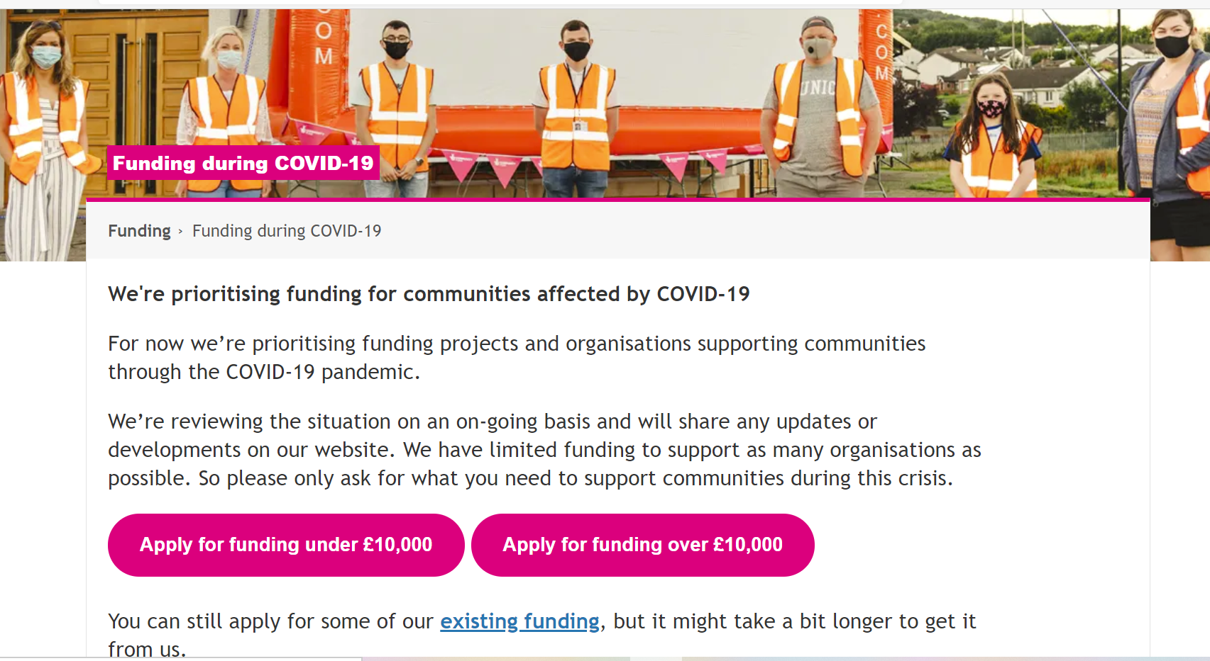
Community Fund - Funding during COVID-19 (UK)
https://www.tnlcommunityfund.org.uk/funding/covid-19

Slide 8
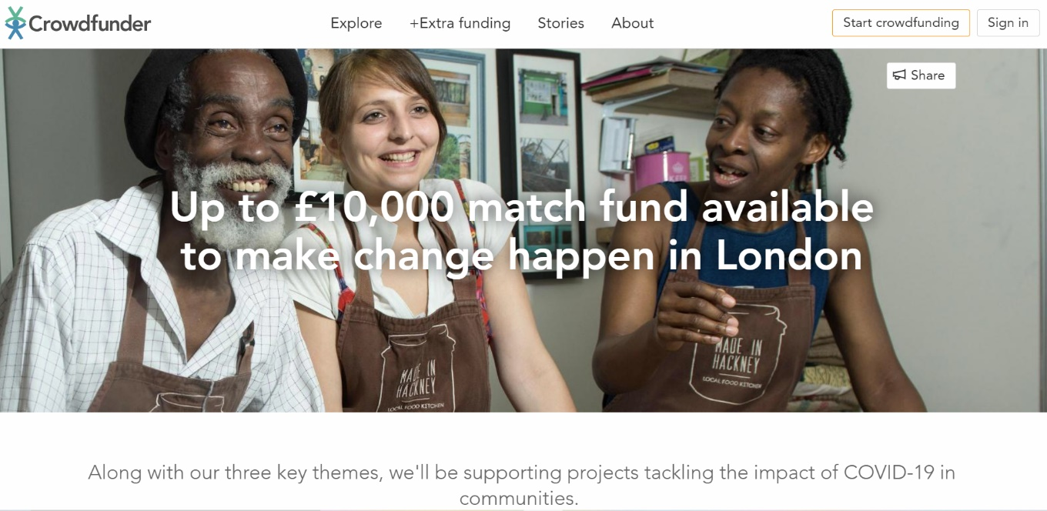
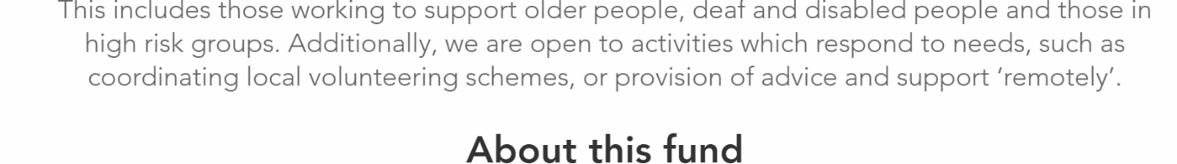
Crowdfunder Trust for London Connected Communities (UK)
Connected Communities Matchfund | Crowdfunder UK

Slide 9

SECTION ONE: Top Tips for Success in Writing a Community Grant Application
Orla Casey from the RESTART+ Ireland is a Community Regeneration Funding Expert, in this section she shares 18 top tips for success

Slide 10
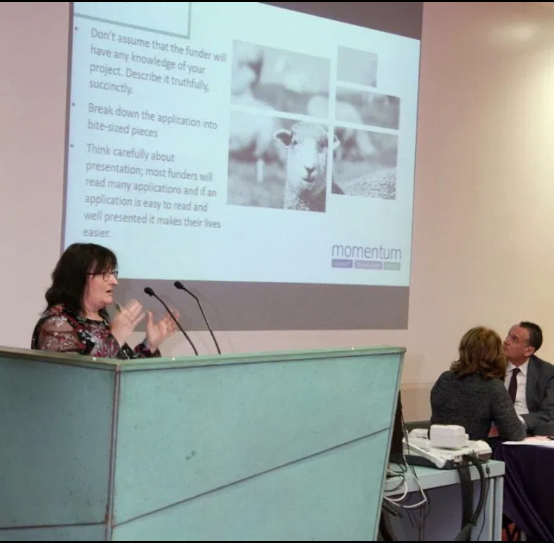
Top Tips from a Community Regeneration Funding Expert
Orla Casey is at the forefront of community regeneration in Ireland and work closely with over local authorities and hundreds of communities to bring their community regeneration projects to life.
She has heled these groups raise millions of euros in project funding and finance and she shares 18 of her top tips for Success in Writing a Community Grant Application in the section which follows.
Orla Casey is a member of RESTART+ Ireland Team, a funding expert (www.momentumconsulting.ie) and a director of Leitrim Food Enterprise Zone CLG.

Slide 11

SUCCESS in SECURING FUNDING is a bit like making a cake!
For any community group or committee, the challenge of pulling together finance for projects can be quite daunting.
For smaller community regeneration projects you may just need one finance source but for larger scale projects multiple finance sources and funders may be required. The way you approach funding depends on ingredients (you and your project) and you need follow a recipe.
Following the recipe is easy when you have a set of guidelines and that is what we will try to provide for you in this module!

Slide 12
Before you start…
Take a moment to review and focus on your community regeneration project priorities.
What are your priorities for next 1 – 3 years? 3 – 5 years?
Survival, regeneration or growth ?
New opportunities ?
Same activities but improved?
Same catchment area or further afield?
Same management structures?
Same modes of delivery / supports?
Any digitisation changes etc?
All of these questions will help you define the ingredients for your successful funding application.

Slide 13

Did you know?
Nationally, funders estimate that between 50 and 60% of all applications they receive are immediately turned down because they are ineligible and do not meet clearly laid out guidelines.
“We are deluged with large numbers of poorly targeted and poorly executed applications, making it difficult for trustees to identify those organisations most worthy of support” – ACT, Association of Charitable Foundations

Slide 14

Tip 1: Forget about the money! (At least initially…) & define your project
The primary concern of funders is that your project is well planned and that it will truly make a difference. In making an effective application important questions to start with include:
What are you trying to achieve?
New community space or service?
Purchase new community equipment?
Further develop an ongoing community project or asset?
Provide community training?

Slide 15
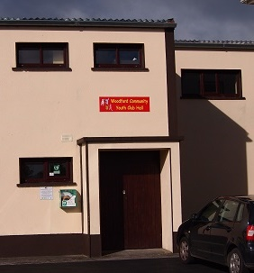
Tip 1: EXAMPLE Forget about the money! (At least initially…) & define your project
EXAMPLE – WOODFORD YOUTH HALL, CO. GALWAY: APPLICATION FORM EXTRACT – the problem and solution are presented very clearly at the outset
Woodford Youth Hall, once a thriving hub of youth activity and engagement, faces restricted activities and even closure due to an unsafe roof which in urgent need of redevelopment.
With a rejuvenated committee in place (2018), the promoters wish to complete building refurbishment to launch a new programme of youth activities for it’s growing population.
In addition to roof repairs (removal, disposal and replacement of a double skin asbestos roof), this redevelopment will see the installation of acoustic panels (to increase the music and dance use of the Hall) and the purchase of special needs sensory play equipment which will be used by the very active Woodford Parent and Toddler Group who meet weekly at the hall.

Slide 16
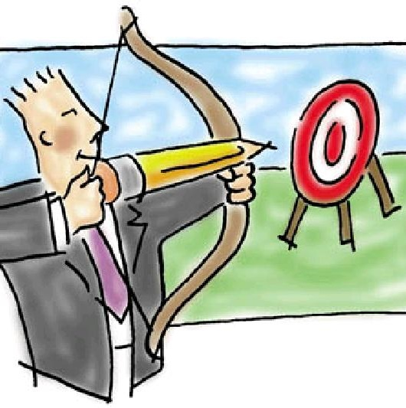
Tip 2: Show how your project aligns to your purposed funders aims
It is essential that you address how does your project fulfil the funder’s aims? Link your project to the funder’s key criteria and show how your project furthers their aims and objectives. This means that you need to research your funding target thoroughly. Why? As we mentioned in the intro up to 50% of applications received by funders do not meet their published criteria.
As a very basic minimum you should read the guidelines published by the funder. Consider the funder’s motivation, the format for applying, the level of funding, submission deadlines, eligibility and the decision making process.

Slide 17
Tip 2: EXAMPLE Show how your project aligns to your purposed funders aims. EXTRACT.. show alignment with precision and with facts
Woodford village has undergone a community rejuvenation led by the Town and Village Renewal Programme, with physical improvements in streetscape and environment seeing new families relocate to the village. The Youth Hall serves a catchment area of six feeder primary schools- Derryoober, Woodford, Ballinakill, Drim, Moyglass and Derrybrien; and one secondary school - Mercy College Woodford with upwards of 360+ young people in the direct catchment area.
The Hall requires urgent roof replacement and addition of new youth facilities so that it can offer a strong comprehensive youth service for the catchment area that builds on the existing services. It will allow plans for a rejuvenated youth club (and contribution to Comhaile na N’og). It responds fully to GRD Strategic Action 5.2 and will offer a youth wellbeing and recreation hub.
APPLICATION FORM EXTRACT

Slide 18

Tip 3: Sell the benefits of your community regeneration project
What are the real and positive differences the funded project will make in your community?
Who in the community stands to benefit and how?
How does the project meet the communities needs and how were these needs uncovered?
What is the economic impact of the project? (Note - You can use our Local Economy Impact Exercise from Module 4 as a basis for this)
Make sure to answer these questions in both a qualitative and quantitative manner in your funding applications. You could also bring in some storytelling here to paint a vivid picture

Slide 19
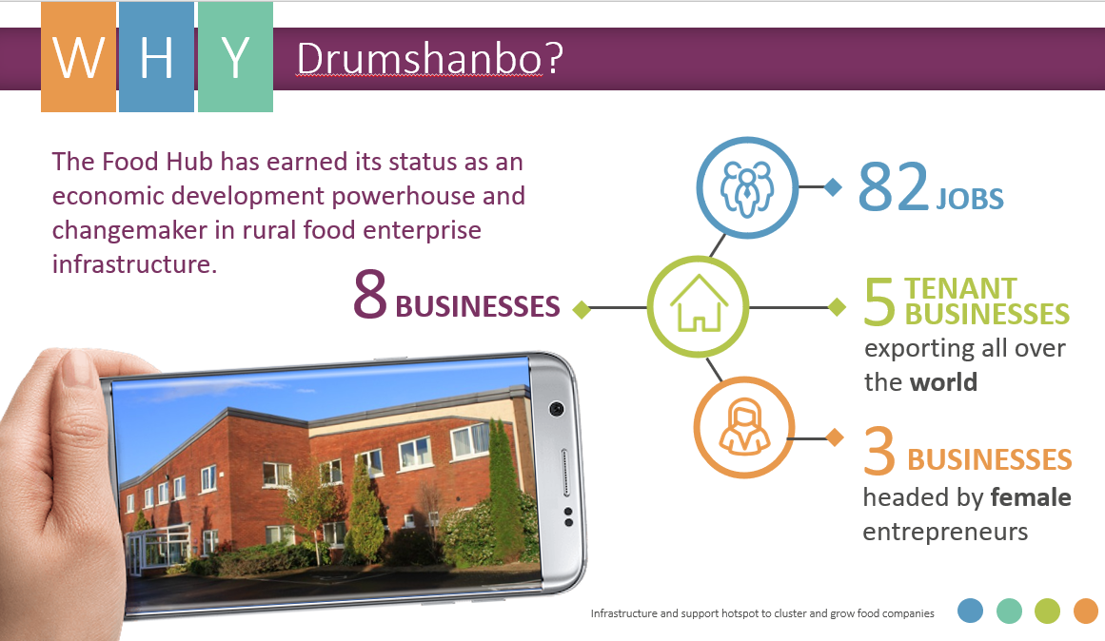
Tip 3: Sell the benefits of your community regeneration project – use visual impact where you can

Slide 20
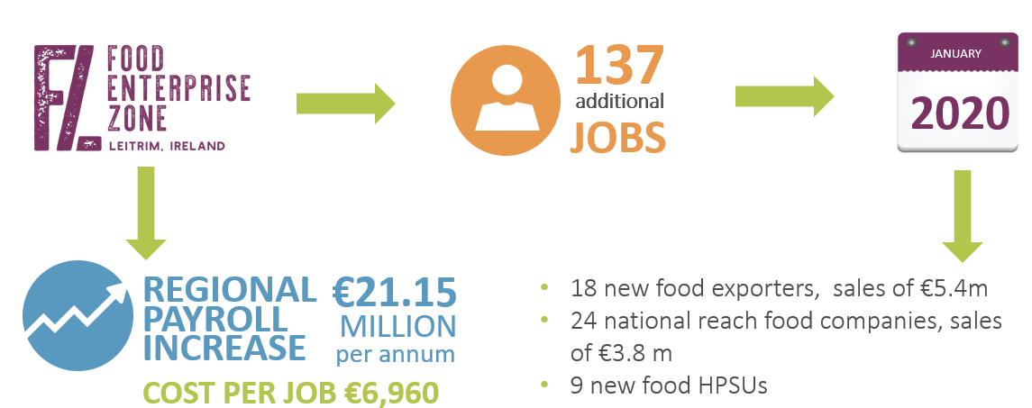
Tip 3: Sell the benefits of your community regeneration project – what does the project meant to the community – this is especially vital for economic regeneration projects.

Slide 21

Tip 4: Build on your credibility and be professional!
One of the primary reasons why applications get funded is that the funders are convinced that the applicant organisation is:
well organised
has a good track record and
is a capable promoter to carry out the proposed project
To convince the funders of this, you need to approach the process of creating the funding application in a professional manner.

Slide 22

Tip 5: Share your passion for the project and remember people give to people…
“People will forget what you said. People will forget what you did. But people will never forget how you made them feel.” - Maya Angelou
If you are excited about a project’s potential – share that excitement. If you believe in it – share that belief.
Remember that funders are people too and they come from communities with problems that might be very like the one you are trying to provide a solution too.
People give to people – so always remember the human element when crafting a funding application.

Slide 23

Tip 6: Ask yourself, ‘Why wouldn’t they fund this?
Often a good way to strengthen your funding application is to try and ‘pick holes’ in it.
So ask yourself, ‘Why wouldn’t they fund this?
Having identified the weaknesses you can then work on putting them right.
This is a great exercise to do with your community committee as others might find holes/gaps that you didn’t realise were there.

Slide 24

Tip 7: Budget – know your finances
Prepare your budget with great care
Be thorough in your project financial planning, costing your expenditure in line with the tender process highlighted by the funder,
Be convincing you have your match funding in place
Know your overhead costs
Have your last year’s audited accounts ready
Financial projections – get a financial mentor or a volunteer to help

Slide 25

Tip 8: Pay particular attention to the sustainability section
As we’ve learnt in earlier modules, sustainability is key. With this in mind, you should prepare answers which address:
How will impact continue?
Risks (internal, external)
How will you implement:
monitoring
evaluation
reporting

Slide 26
More Top Tips for Success in Writing a Community Grant Application
Tip 9: Don’t assume that the funder will have any knowledge of your organisation or project. Describe your background and capabilities with conviction and describe your project truthfully and succinctly.
Tip 10: Break down the writing of the application into bite-sized pieces. So many people start well but fade as the application form progresses. Stay strong throughout!
Tip 11: Think carefully about the presentation of your application – appearances matter. Most funders will read many applications and if an application is easy to read and well presented it makes their lives easier.

Slide 27
More Top Tips for Success in Writing a Community Grant Application
Tip 12: Do not over-promise - you will one day have to deliver.
Tip 13: It always takes a lot longer to put an application for funds together than you think !
Tip 14: Remember it is a competitive process – your best foot forward, be competitive.
Tip 15: Write in an interesting way that captures the energy & spirit of your project (journalist style)

Slide 28
More Top Tips for Success in Writing a Community Grant Application
Tip 16: The power of evidence of need. It is not sufficient to say: “we know … we think….” back it up with relevant research
Tip 17: Show that your project is additional – not competing with others
Tip 18: And last, but not least, definitely talk to the funding agency before you apply

Slide 29

SECTION TWO: PITCH PERFECT
How to pitch your idea to potential funders and also use pitches in a community fundraising setting

Slide 30

WHY AND WHEN WILL YOU NEED TO PITCH
Sometimes when you are seeking funding, you may have to present or pitch the project idea to funders or even to businesses in your community as you seek their financial support.
If you have seen TV shows like Dragons Den you will have an idea the pitching process involves, and what needs to be done to secure support.
In the section that follows, we share some key insights into creating a near perfect pitch that community regeneration projects can benefit from

Slide 31

What is a PITCH ?
A pitch is typically a short and concise presentation which provides all relevant and realistic information on WHY the funders or community should financially back the project.
The best pitches are those that tell a story and are delivered with passion, knowledge of the subject matter and confidence. They create an emotional connection and draw people in to be vested/invested in the project.
Finding out who is best storyteller in your project will be key to your pitch success.
This Photo by Unknown Author is licensed under CC BY-SA

Slide 32
PITCH PERFECT INGREDIENTS
Use strong and/or compelling visuals. People only retain 10% of what they hear
Your solution/ project
Compelling story/need
Your
Community support
How it meets funding priorities
Evidence the project will succeed – what impact will it make
Know your project costs
Choose your committee’s strongest presenter, regardless of their position.
Provide a little background on the communities development history and the current leadership team

Slide 33
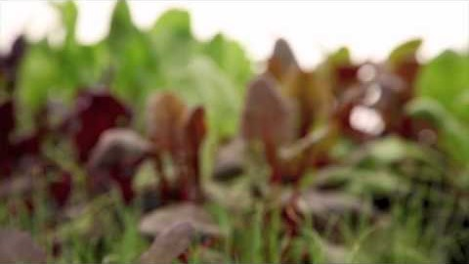
In 2013 Sutton Community Farm Crowdfunding Campaign raised £17,172 from the community. This pitch video was vital in helping their fledging enterprise expand.

Slide 34

SECTION THREE: INNOVATIVE COMMUNITY FUNDRAISING AND CROWDFUNDING
In this section, we delve into new ways to attract funding.
Leveraging the power of many

Slide 35

Community Shares
Community shares are an innovative funding mechanism that can be used to regenerate all types of community projects including
Transformation of community facilities
Finance renewable energy schemes,
Support local food growing,
Fund new football clubs,
Restore heritage buildings,
and above all, build stronger, more vibrant, and independent communities.

Slide 36
Community Shares
They are becoming increasingly popular in the UK thanks to an organisation called Community Shares | . Since 2009, almost a 120,000 people have invested over £100m to support 350 community businesses throughout the UK.
Community Shares Step-by-Step is an online tool that enables you to work towards launching a community share offer. It is designed to help anyone considering raising community shares at any stage of development, from those investigating the idea for the very first time, to those who are on the verge of issuing an offer.
The Community Shares Handbook

Slide 37
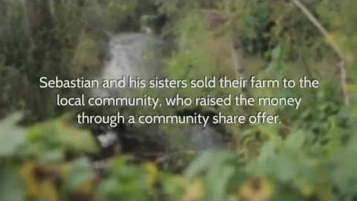
Stockwood Community Benefit Society (Stockwood CBS) was established to ensure the long-term community ownership of Rush Farm, a biodynamic-organic farm and the co-located Stockwood Business Park. Since 2013, £431,000 has been raised. The society has 144 members

Slide 38

WHAT IS CROWDFUNDING?
Crowdfunding is a powerful funding approach which communities can use to build financial and collaborative support to develop and create their own projects.
Crowdfunding is a form of fund-raising, that is based on the theory that if lots of people are willing to donate a small amount of money towards a project, then the project is likely to be successful. This is an old idea, that has been revolutionised by the Internet and is now a common tool that is used to help fund a project, collect money for a good cause. Crowdfunding campaigns are usually delivered via an online platform supported by social media.
Source: Exeter City Futures
This Photo by Unknown Author is licensed under CC BY-ND

Slide 39
Crowdfunding stands for a variety of different ‘fundraising’ models. It can take the form of:
EQUITY LENDING when people lend money to individuals or organisations in exchange for company shares
PRE-SELLING
when people donate towards the creation of a specific product, such as CD, design, gadget etc.
Not very common for communities
Common for communities
Also quite common
Sometimes for larger projects
CHARITY is when people donate to an individual, project or organisation while receiving no financial or material return in exchange
PEER-TO-PEER LENDING is borrowing from a number of lenders via an online platform, each lender lending a (small) amount in return for financial compensation

Slide 40
Choosing a Crowdfunding Platform
Different platforms apply different charges depending on the model you chose. The Costs:
Platform Hosting Fee: Some platforms, although not all, charge an initial cost just for hosting your campaign. This cost varies from €0-300 and will be charged to all projects, be that successfully fundraised or not. Ask platforms what fee applies to them before starting the campaign.
Success fee: The majority of crowdfunding platforms will take a percentage of the total amount raised. The percentage varies from platform to platform and ranges between 3% and 12% of total raised.
Payment processing fees: Look out also for a service fee for every transaction made. Usually this fee is on average 3%. For instance, for every €100 donation/investment, only €97 reaches the campaign.
Check each platform carefully to assess the real costs behind same. In the next slides we introduce you to some of the most common platforms.

Slide 41

Examples of Crowdfunding Platforms for Communities
Spacehive
Spacehive is a civic-crowdfunding platform focusing on supporting projects that make local places better. Spacehive link projects to local councils, businesses and grant makers willing to fund them.
Spachive operates an ‘all or nothing’ model, meaning that if a financial target is not hit, none of the pledges from the crowd are collected.
Visit: Spacehive - Crowdfunding For Local Projects

Slide 42
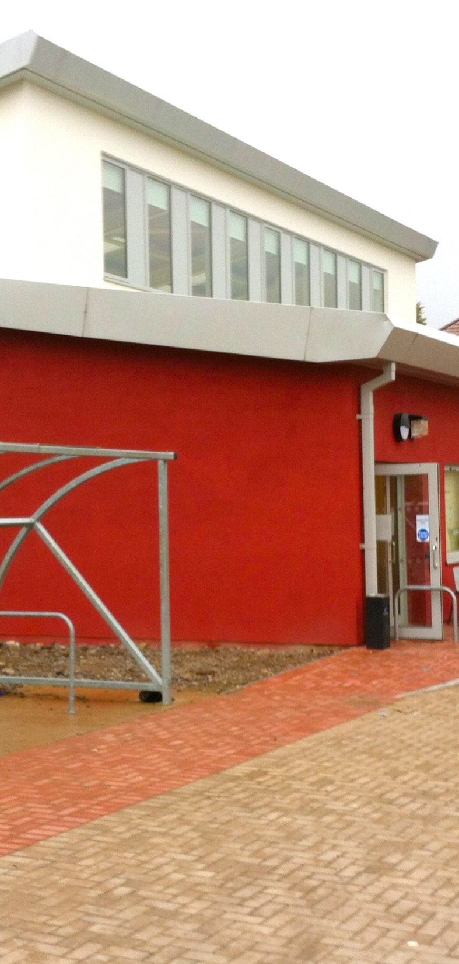
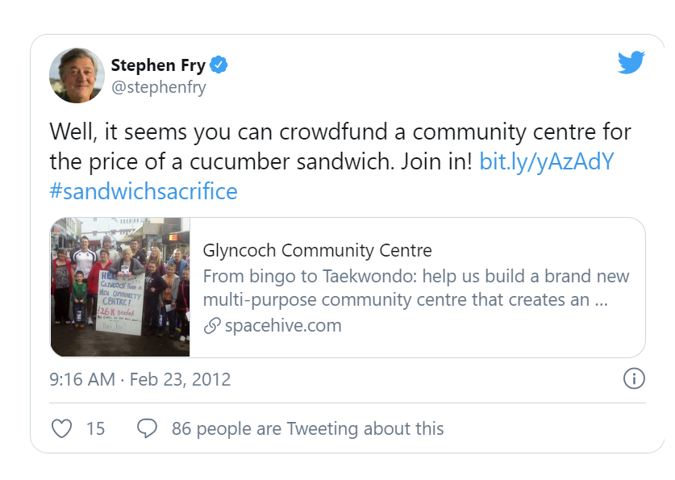

Glyncoch Community Centre needed £30,000 but raised £792,021 on Spacehive
Crowdfunded Communities
The town of Glyncoch, South Wales, had been fighting for seven years to build a much-needed community centre. They had raised 95% of their funding goal but on March 30th, 2012 their grants were set to expire.
Read More: Glyncoch Community Centre – About Spacehive
And so the community turned to Spacehive in an effort to crowdfund the remaining £30,000. 5 weeks after launching their Spacehive campaign the community centre received backing from 107 people and businesses, including celebrity actor Stephen Fry, the local mayor and Tesco Charity Trust bringing their pledge total to £792,021!!
CASE STUDY

Slide 43
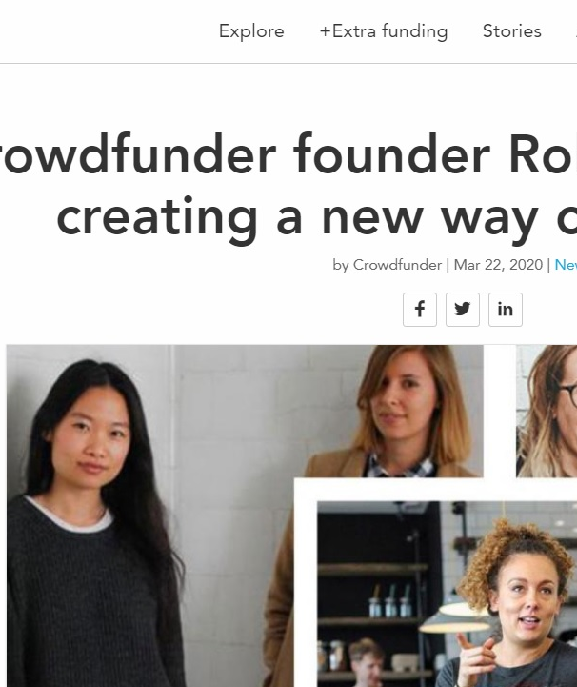
Crowdfunding Platforms for Communities
Crowdfunder UK
Crowdfunder is the UK’s No. 1 rewards-based platform convening personal, community, business and commercial projects in one place.
Extra funding can be accessed from their creative and culture, community and social enterprise, innovation, business and local authority partners. Crowdfunder offers two options; all or nothing or keep what you have raised.
Crowdfunder UK - Where Ideas Happen | Crowdfunder UK

Slide 44

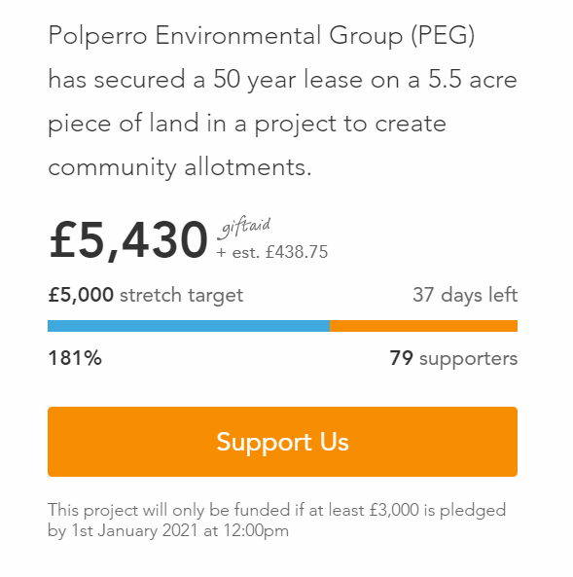
A Crowdfunding Campaign for Community Allotments and Orchard for Polperro, Cornwall, UK
Crowdfunded Communities
The vision:
We hold a 50 year lease on a 5.5 acre piece of land we call ‘Kellow Farm Allotments’. The land is wild and overgrown on a sweeping slope of hillside. We are aiming to clear the land, create terraces and make allotments available for members and families of our community as well as reclaiming and growing the old orchard a the far end of the plot. The production of local food has, for many years, been held as a positive, healthy, resilient and sustainable way to live and we now have the opportunity to offer these opportunities to our community.
CASE STUDY
Read More: A Community crowdfunding project in Polperro by Polperro Environmental Group (crowdfunder.co.uk)

Slide 45

SECTION FOUR: COMMUNITY REGENERATION GRANTS
What’s available at at Local/National and European levels?

Slide 46
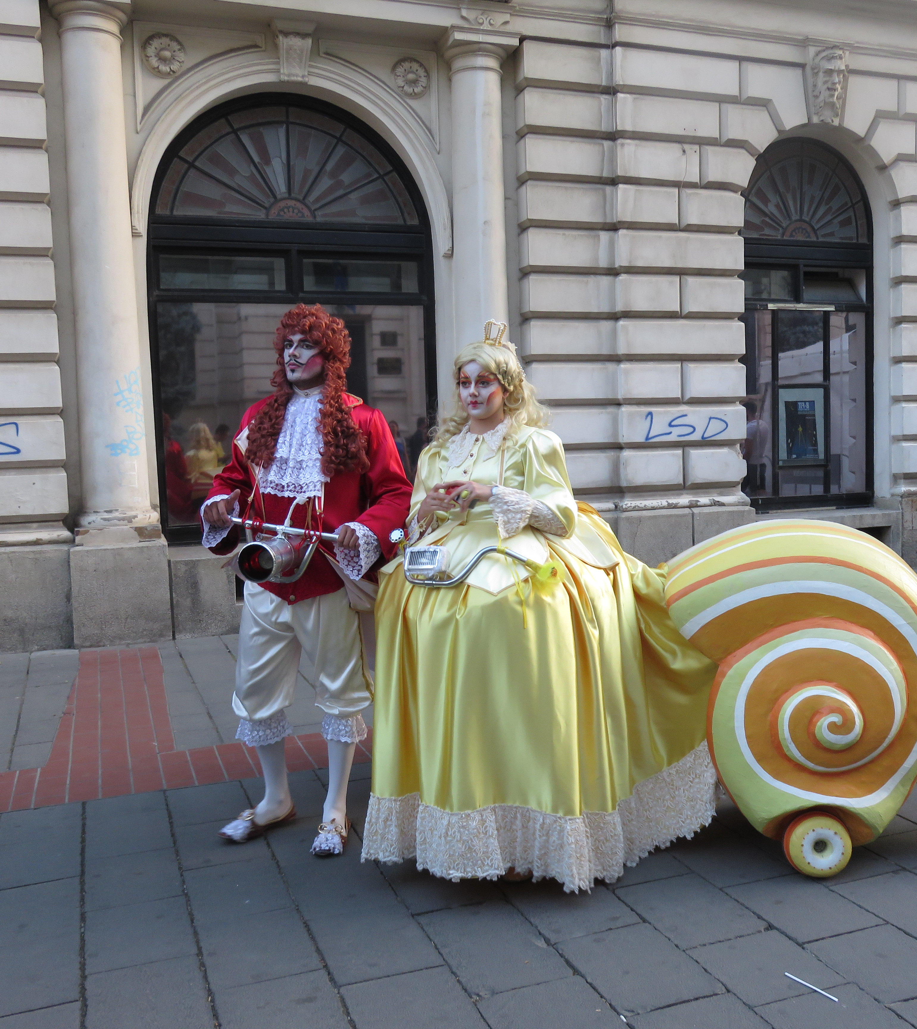
LOCAL/NATIONAL GRANTS/FUNDS
Local and National funding is a starting point for community regeneration projects.
IRELAND
We now introduce you to key funding opportunities typically available in Ireland each year.
(note – correct as of November 2020, please check each fund for availability, opening dates etc)

Slide 47
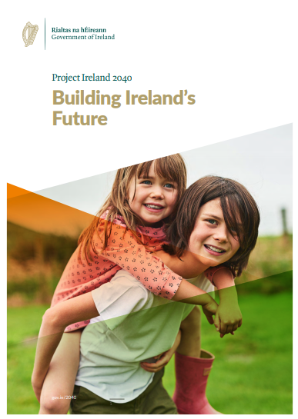
Project Ireland 2040
Project Ireland 2040 is the government’s long-term overarching strategy to make Ireland a better country for all of its people. The plan changes how investment is made in public infrastructure in Ireland, moving away from the approach of the past, which saw public investment spread too thinly and investment decisions that didn’t align with a well-thought-out and defined strategy.
Alongside the development of physical infrastructure, Project Ireland 2040 supports business and communities across all of Ireland in realising their potential. The National Development Plan and the National Planning Framework combine to form Project Ireland 2040.

Slide 48
URBAN REGENERATION DEVELOPMENT PROGRAMME
The Urban Regeneration and Development Fund (URDF) is a flagship element of Project Ireland 2040. Under the stewardship of the Department of Housing, Planning and Local Government, the Fund was established to support more compact and sustainable development, through the regeneration and rejuvenation of Ireland’s five cities and other large towns, in line with the objectives of the National Planning Framework (NPF) and National Development Plan (NDP).
This will enable a greater proportion of residential and mixed-use development to be delivered within the existing built-up footprints of our cities and towns and to ensure that more parts of our urban areas can become attractive and vibrant places in which people choose to live and work, as well as to invest and to visit.

Slide 49
URBAN REGENERATION DEVELOPMENT PROGRAMME
It is one of four funds set up under the National Development Plan 2018-2027, and is being implemented by the Department of Housing, Planning and Local Government. A total of €2 billion has been allocated to the URDF up to 2027, with €550 million available up to 2022 and €130 million is available for 2020.
Objective of the Urban Regeneration and Development Fund
Eligibility for the Urban Regeneration and Development Fund
How to apply for the Urban Regeneration and Development Fund

Slide 50
RURAL REGENERATION DEVELOPMENT PROGRAMME
The Rural Regeneration and Development Fund (RRDF) is a commitment of €1 billion by government to be invested in rural Ireland over the period 2019 to 2027.
The purpose of the fund is to support job creation in rural areas, address de-population of rural communities and support improvements in our towns and villages with a population of less than 10,000, and outlying areas.
The fund is supporting coordinated and integrated projects between government departments, State agencies, local authorities, other public bodies, communities and, where appropriate, philanthropic funders and/or the private sector, which will have an impact on sustainable economic and social development in rural areas.
Funding is being awarded through a competitive bid process

Slide 51
RURAL REGENERATION DEVELOPMENT PROGRAMME
Eligibility
Proposals are invited from Local Authorities, and other locally/regionally based organisations, such as Local Development Companies, as well as government departments and State agencies. For the purpose of accountability and oversight, the lead partner of all projects must be a State funded body, but collaboration with the private sector is encouraged.
Proposals may be made in respect of towns with populations of 10,000 or fewer and their outlying areas. A limited number of specified towns with a population of 10,000 or fewer will be eligible for support under the Urban Regeneration Fund ; however, funding will only be provided under one fund for any particular project.
A list of the funded projects to date is available here.

Slide 52

Where to find the information about open funding opportunities ? PLUG IN TO FREE RESOUCES
www.activelink.ie
The online network for Irish non-profit organisations
The website is updated daily and the latest information is
published and circulated once a week by email.
Sign up to receive same.
Excellent Facebook page
www.facebook.com/ActiveLinkIreland

Slide 53



https://www.wheel.ie/funding

Slide 54
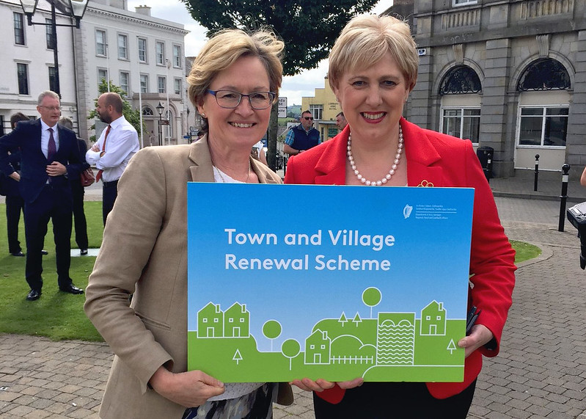
Town and Village Renewal Scheme - IRELAND
The Town and Village Renewal Scheme is an initiative under the Action Plan for Rural Development and is part of a package of national and local support measures to rejuvenate rural towns and villages throughout Ireland through the Government’s Project Ireland 2040 Rural Regeneration Programme.
The Scheme is funded by the Department of Rural and Community Development and administered by the Local Authorities.
Town and Village Renewal Scheme (www.gov.ie)

Slide 55
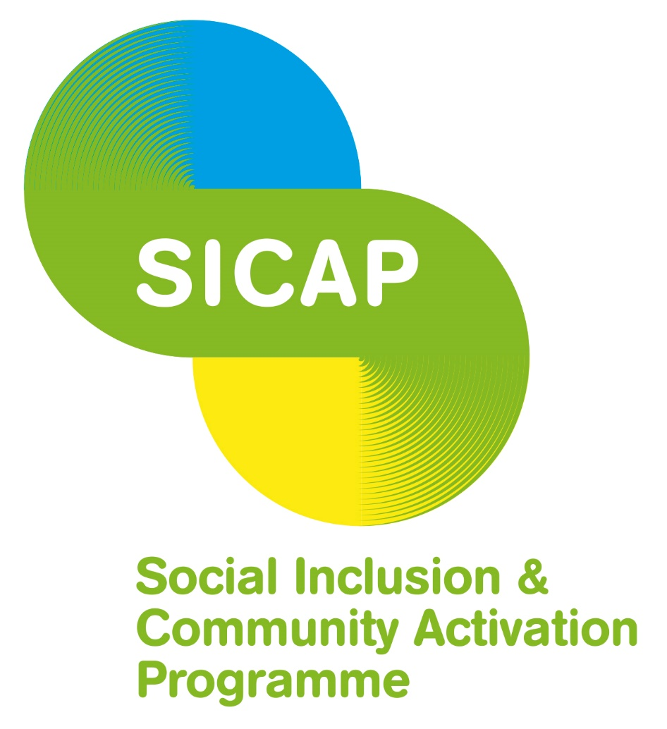
Social Inclusion and Community Activation Programme - IRELAND
SICAP’s vision is to improve the life chances and opportunities of those who are marginalised in society, living in poverty or in unemployment through community development approaches and targeted supports. SICAP aims to support people who are at a higher risk of social exclusion from disadvantaged groups and communities.
Target groups include children and families in disadvantaged areas, lone parents, new communities, people living in disadvantaged areas, people with disabilities, Travellers, Roma, young unemployed living in disadvantaged areas, NEETs.
Social Inclusion and Community Activation Programme - ESF

Slide 56
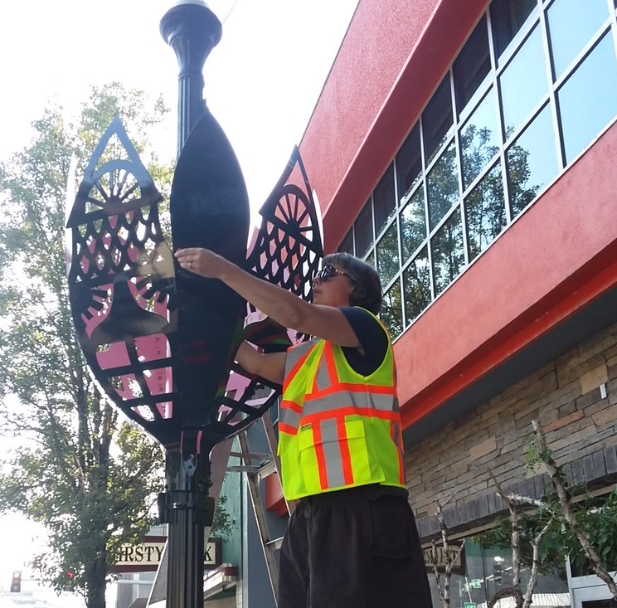
The Community Enhancement Programme (CEP) - IRELAND
The Community Enhancement Programme (CEP) provides capital funding to community groups across Ireland. This allows these groups to enhance facilities in disadvantaged areas. Typical enhancements under the CEP include:
IT and CCTV equipment
minor improvements to buildings
minor renovation of community centres
development of community amenities
purchase of equipment for community usage
improvements to town parks, common areas and energy-saving projects
Community Enhancement Programme (www.gov.ie)

Slide 57
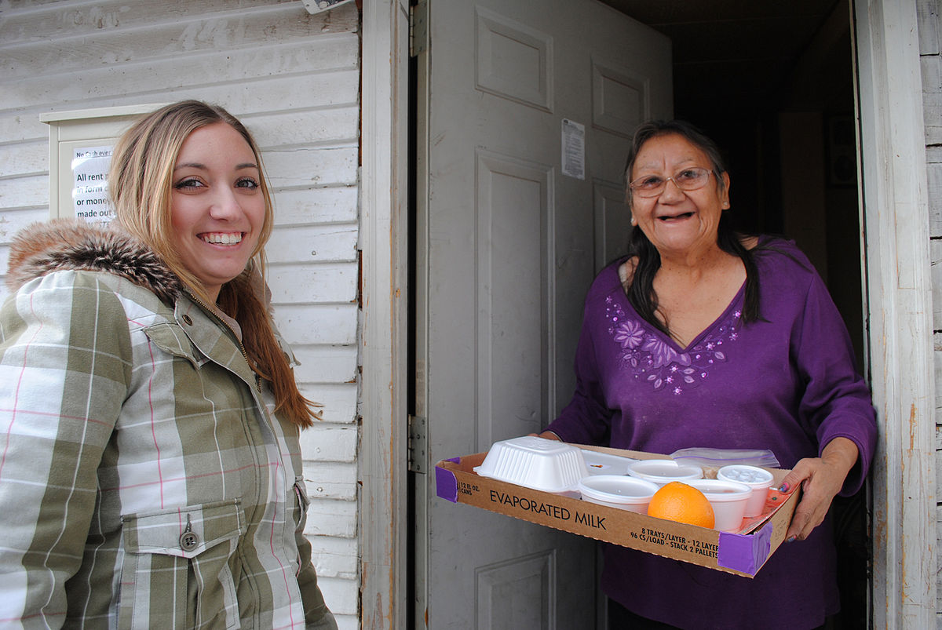
The Community Services Programme (CSP) - IRELAND
The Community Services Programme (CSP) provides a fixed contribution towards hiring additional staff for organisations to meet local service gaps and provide access to services and facilities that would otherwise generally be unavailable.
Three strands are supported under the programme:
Community Halls and Facilities (CSP Strand 1 and 1s)
Community Services for the Disadvantaged (CSP Strand 2)
Companies employing people who are distant from the labour market (CSP Strand 3)
Funding Local Community Staff (www.gov.ie)

Slide 58

WHERE TO FIND THE LATEST INFORMATION ?
The Community Foundation give out grants to non-profits and have an interesting and informative video on their website advising groups how to make an application.
They are also the foundation distributing the Comic Relief Ireland fund.
https://www.communityfoundation.ie/

Slide 59

EUROPEAN GRANTS/PROGRAMMES
Available across the EU, these grants are and have been instrumental in helping communities to regenerate, learn best practices and build their regeneration skills. In this section we will get to know:
LEADER Programme
European Social Fund Community Grants
This Photo by Unknown Author is licensed under CC BY-SA

Slide 60


LEADER Programme
LEADER is a local development method which has been used for 20 years to engage local actors in the design and delivery of strategies, decision-making and resource allocation for the development of their rural areas.
It is implemented by around 3,000 Local Action Groups (LAGs), covering 61 % of the rural population in the EU and bringing together public, private and civil-society stakeholders in a particular area.
The short video above explains how the EU via programmes like LEADERS seeks to promote community-led local development

Slide 61
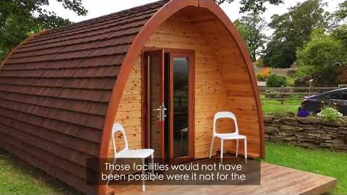
David Ross talks about how the EU Leader programme funding helped develop the tourism potential Drimoleague in Co. Cork and how new enterprises also developed from this.

Slide 62
European Social Fund - Community Grants
ESF Community Grants enable small Third Sector organisations to apply for small grants through simplified application arrangements. ESF Community Grants support a range of activities aimed at assisting the disadvantaged or excluded to move closer to the labour market by improving their access to mainstream ESF and domestic employment and skills provision. The grants will support a wide range of activities including:
Initial help with basic skills
Taster work experience including voluntary work
Training, advice and counselling
Jobsearch assistance including the provision of equipment and other assistance necessary to secure employment
Confidence building
First contact engagement activities
Community Grants | Network for Europe

Slide 63
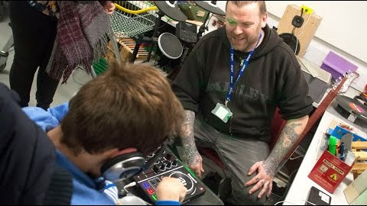
This short video highlights the work done by York based Tang Hall SMART with funding from the ESF Community Grants programme administered by Your Consortium, UK.

