Slide 1
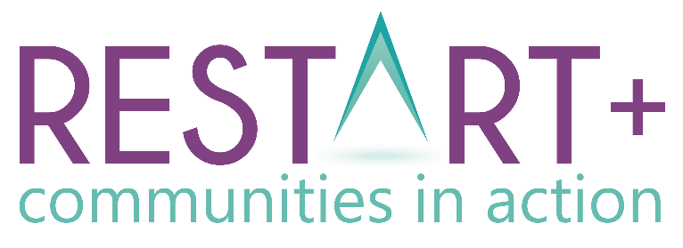
Module 2 Opportunities for Community Regeneration
www.restart.how
This programme has been funded with support from the European Commission
This project has been funded with support from the European Commission. This publication [communication] reflects the views only of the author, and the Commission cannot be held responsible for any use, which may be made of the information contained therein.

Slide 2
MODULE 2 INTRODUCTION
Intro
Spotlight on the UN SDG’s and how they relate to community regeneration
01
Opportunities and trends in Economic Sustainability
In Module 2, we delve a little deeper into community sustainability and explore opportunities and trends in economic, environmental and social sustainability.
We start with an introduction to the 17 UN Sustainable Goals which are key to community regeneration in the context of the global 2030 Agenda for Sustainable Development.
We end the module as we did in Module 1 with practical exercises and resources you can use to apply your community regeneration learning.
02
Opportunities and trends in Environmental Sustainability
03
Opportunities and trends in Social Sustainability
Key Action Pack 2
Finding the right opportunity for your community – useful exercises and templates

Slide 3
Introduction: SPOTLIGHT ON THE UN SUSTAINABLE DEVELOPMENT GOALS
What are they and how should they be used to inform sustainable community regeneration?

Slide 4
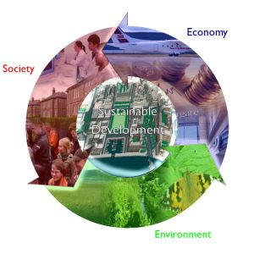
Where did the Sustainable Development Goals come from?
Back in the 1980s, the UN defined sustainable development as ‘meeting the needs of the present without compromising the ability of future generations to meet their own needs.’ They recognised the interrelatedness of social, environmental and economic development.
Three decades later, on 25 September 2015, the UN formally adopted the 2030 Agenda for Sustainable Development. At its core are the 17 Sustainable Development Goals (SDGs), a roadmap for achieving peace and prosperity for the world’s people and for our planet.

Slide 5
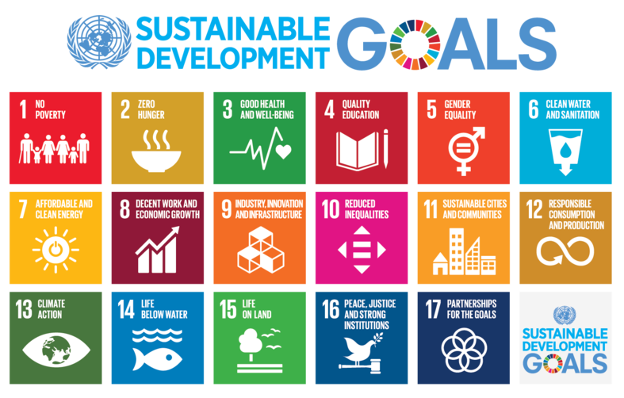

Slide 6
The UN are working hard to make the Sustainable Development Goals stick.. They’ve even commissioned a hip hop music video and song about them!

Slide 7
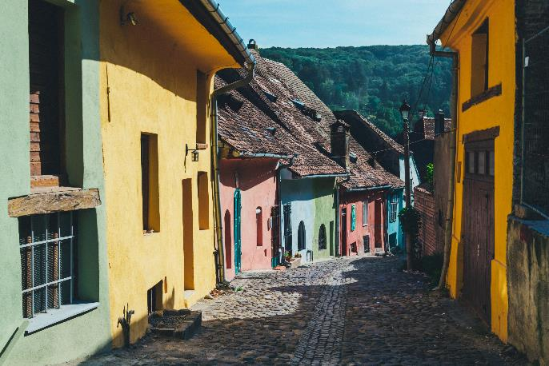
How can the Sustainable Development Goals inform Community Regeneration?
As we learned in Module 1, sustainable communities as those which are socially resilient, environmentally healthy and economically thriving.
In terms of sustainable development, every community and voluntary organisation, at its core, seeks to address some aspect of sustainability –
and /or
The SDGs can assist in this work by providing interconnected goals for communities to work towards. Communities across the globe have an active role to in achieving these shared objectives to create a more sustainable world that works for all by 2030.
ECONOMIC
SOCIAL
ENVIRONMENTAL

Slide 8
Why regenerate?
There is no planet B!
The SDG’s are a call to action for the Earth to unite in a shared vision to redesign the human impact on Earth from destruction to regeneration.
The Sustainable Development Goals represent a huge opportunity for all of us and could be easily framed to describe necessary improvements in your own community and region that would be worth collaborating towards.
Let’s look at the goals once again before we start exploring opportunities and trends for regeneration.

Slide 9
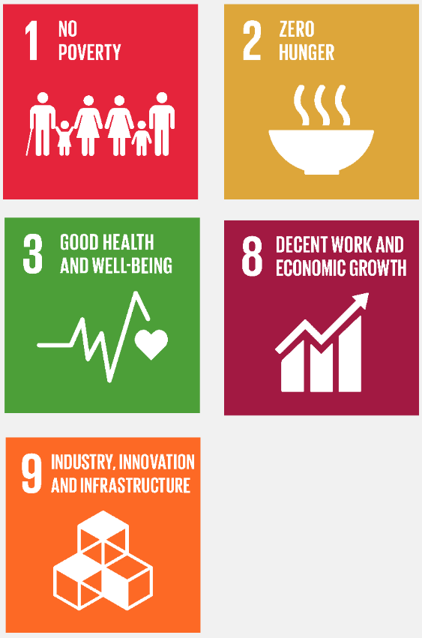
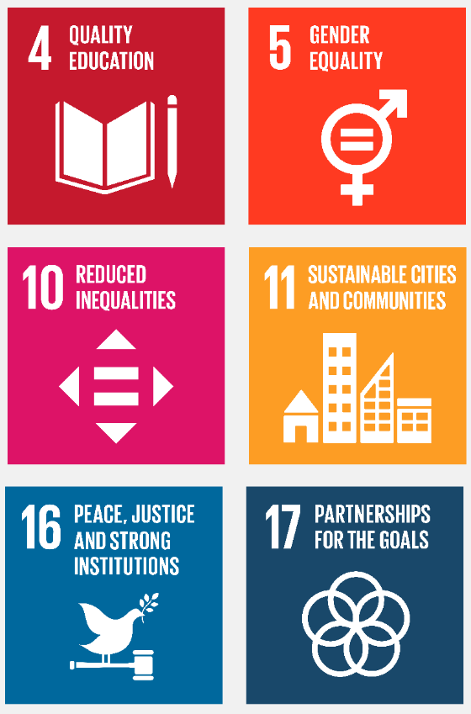
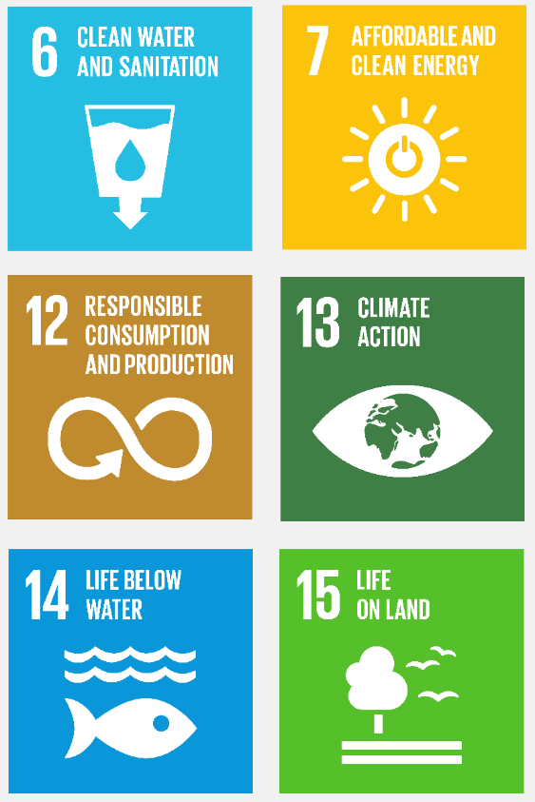
How the SDGs break down across our key regeneration headings ..
ECONOMIC
SOCIAL
ENVIRONMENTAL

Slide 10
SECTION 1: OPPORTUNITIES AND TRENDS IN
ECONOMIC SUSTAINABILITY
Economic Diversification, SMART cities, towns and villages, Power and potential of Social Innovation and Enterprise

Slide 11
Economic Diversification
Diversification makes community economies less vulnerable and gives them a better chance to achieve future stability and growth.
Economic diversification, or the spreading of the workforce across a variety of industrial sectors, is one solution to the problems facing many communities.
Economic diversification can come in the form of the introduction of a new industry or the innovative expansion of an existing industry.
Let’s take a look at some examples..

Slide 12
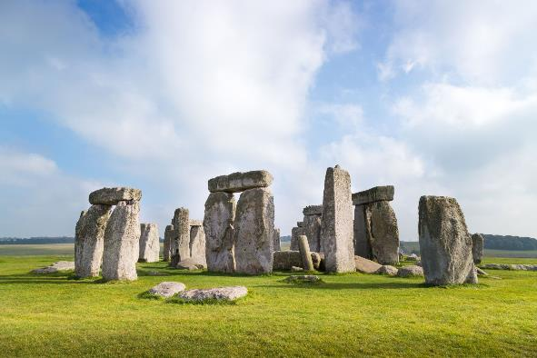
OPPORTUNITY
Heritage Led Economic Diversification
A key aspect of sustainability is the preservation of local and built heritage and working to preserve or improve a sense of place in regeneration activities. Preservation of heritage is not just important for heritage sake. Heritage assets (natural, built and industrial) offer great potential for economic and community regeneration.
Landscape heritage is a powerful resource to promote local economic activity from both the day and longer stay visitor economy.
In terms of regeneration project planning and support, there are many schemes and funding programmes* available to help communities become actively involved in the conservation and interpretation of their local archaeological and cultural heritage sites.
* We explore some of these in detail In Module 6

Slide 13
Brought to you by Restart+ Romania, this video introduces Iliuta Ion – Furrier from Dolhesti Village who discusses his work to keep traditional tailoring alive and the importance of passing on traditional heritage skills to the youth.

Slide 14
ARIGNA – Once a coal mine.. Now a award winning community tourism experience
Heritage led ECONOMIC
diversification
Developing a flagship and award winning heritage project in the Arigna Mountains of North Roscommon, Ireland has been a significant achievement for a local voluntary community group.
With a legacy of 400 years of coal mining in the area, the closure of the last mine in 1990 was a huge blow both economically and socially. To put the impact of the loss of the Mines into context, the Arigna area has a population of approximately 500 people. Upon closure of the mines in 1990, 260 jobs were lost. A further 200 direct jobs were lost to the area with the closure of the local power station.
The immediate effect of these closures yielded a loss in today’s terms of over €10 million from direct wages circulating in the area, clearly this had a devastating impact on the local economy.
CASE STUDY

Slide 15
ARIGNA – Once a coal mine.. Now a award winning community tourism experience
Heritage led ECONOMIC
diversification
In late 1997 with great foresight, entrepreneurial spirit and commitment, Arigna Energy Valley Company Ltd. was established to lead the heritage tourism development and infrastructure investment for Arigna Mining Experience – Irelands only coal mining heritage centre.
A community’s cultural, historic, and natural resources are valuable and irreplaceable. By investing in their industrial and energy heritage, the Arigna, North Roscommon area can reinforce its identity, helped to preserve its cultural heritage. Through storytelling, the Arigna Mining Experience provides an accurate interpretation of resources, provides an authentic visitor learning experience and stimulates much needed revenue locally from its rich cultural and heritage resources.
FIND OUT MORE: www.arignaminingexperience.ie
CASE STUDY

Slide 16
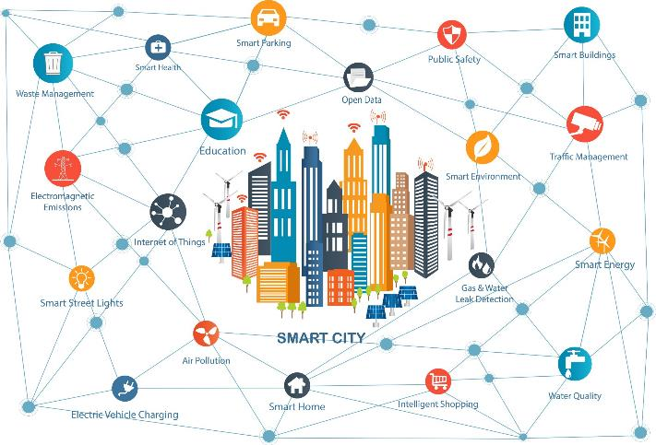
OPPORTUNITY
Technology to enable Economically Diverse and SMART Cities, Towns and Villages of the Future
Over the years, technology has revolutionized our world and daily lives. The EU’s Digital Strategy aims to make this transformation work for people and businesses and has sustainability at its core in that it is working towards a climate-neutral Europe by 2050.
Technological changes have a huge role to play in communities in terms of recycling, waste minimisation, substitution of materials, changed production processes, pollution control, more efficient usage of resources and as well as inspiring new ways of working and living
This Photo by Unknown Author is licensed under CC BY

Slide 17
European Smart Cities
The European Commission defines Smart Cities as places where traditional networks and services are made more efficient with the use of digital and telecommunication technologies for the benefit of its inhabitants and businesses.
A smart city goes beyond the use of information and communication technologies (ICT) for better resource use and less emissions. It means smarter urban transport networks, upgraded water supply and waste disposal facilities and more efficient ways to light and heat buildings. It also means a more interactive and responsive city administration, safer public spaces and meeting the needs of an ageing population.
Source: European Commission

Slide 18
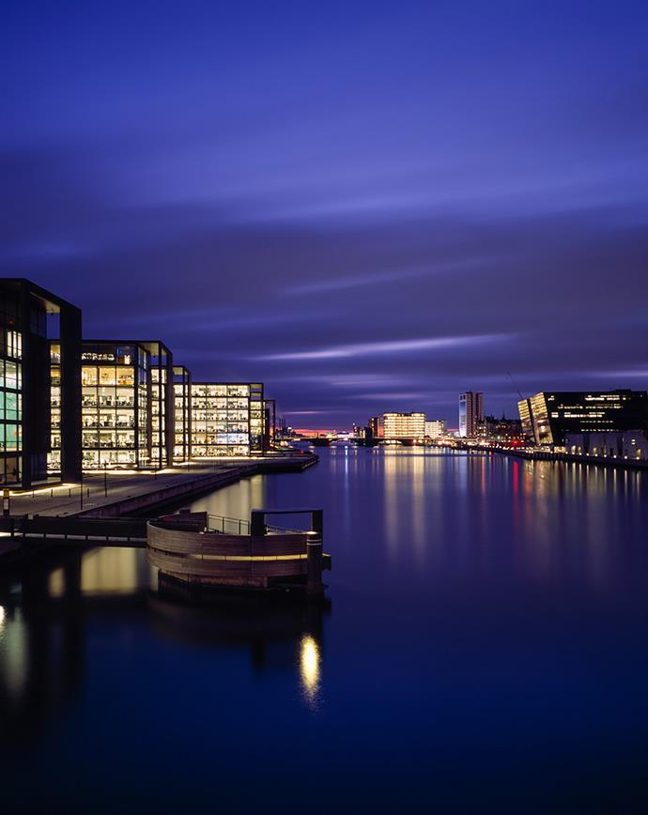
European Smart Cities are built on:
sustainable urban mobility
sustainable districts and built environment
integrated infrastructures and processes in energy, information and communication technologies and transport
citizen focus
integrated planning and management
knowledge sharing
baselines, performance indicators and metrics
open data governance
smart business models, procurement and funding

Slide 19
DELVE DEEPER…
Top 6 Characteristics to Understand the Concept of Smart City
https://ecmapping.com/2017/03/31/top-6-characteristics-to-understand-the-concept-of-smart-city/

Slide 20
Smart Villages - Revitalising Rural Services
Smart Villages, or “Villages of the Future,” are community-led initiatives that empower rural areas to overcome the digital divide between urban and rural areas through improved connectivity.
Countries around Europe are exploring ideas and initiatives around revitalising rural services through digital and social innovation.
They’re looking at how rural services – such as health, social services, education, energy, transport, retail – can be improved and made more sustainable through the deployment of Information and Communication Technology (ICT) tools.

Slide 21
‘Smart villages’ are about rural people who take the initiative to find practical solutions – both to the downsides and to the exciting new opportunities arising locally. Video created by ENRD - Contact Point.

Slide 22
OPPORTUNITY – COVID 19 ACCELERATED
RISE OF REMOTE WORKING/WORK FROM HOME
Remote working was one of the biggest trends to emerge in response to COVID19. Most businesses have pandemically reformed their work policies to allow employees to work outside the office.
Some statistics show that remote workers are 16% more productive than their in-office cohorts and are 24% happier. There are financial gains too - remote employees save between €2,000 and €7,000 per year as a result of working from home and while companies cane save up to €11,000 per remote employee.
Question – how has your community responded to this trend? Could you support or facilitate remote working more in your community?

Slide 23
Remote working benefits local communities
Many small/local economies are facing tough times right now. Small communities struggle the most to keep a solid base of businesses that can offer jobs for their residents—especially young people who may want to work in technology or similar industries.
A lack of working people in a local areas means fewer people have money to spend on local small businesses. When remote workers living in small, local communities can live where they want to live while earning a good wage and plough their income back into local businesses, it can result in a boost the economy in general.

Slide 24
LUDGATE HUB – Technology puts a small town on the map in West Cork, Ireland
ECONOMIC
SOCIAL
There are exposed beams, a high ceiling, open-plan offices, funky colours, breakout spaces and an orange kitchen. The Ludgate Hub looks for all the world like a typical startup office in Silicon Valley, but this is Skibbereen in west Cork.
Here, Ludgate Hub has become a vital resource in the local community, facilitating job and business creation/development in the Skibbereen and greater West Cork area.
It has been created by the people for the people. Developed from the “bottom up” with help from many people who believed in its mission. The motto of Ludgate Hub: LIVE THE LUDGATE LIFE - LOVE WHAT YOU DO, LOVE WHERE YOU LIVE !
Ludgate provides a space for local residents to network, expand their horizons and scale their businesses.
CASE STUDY

Slide 25
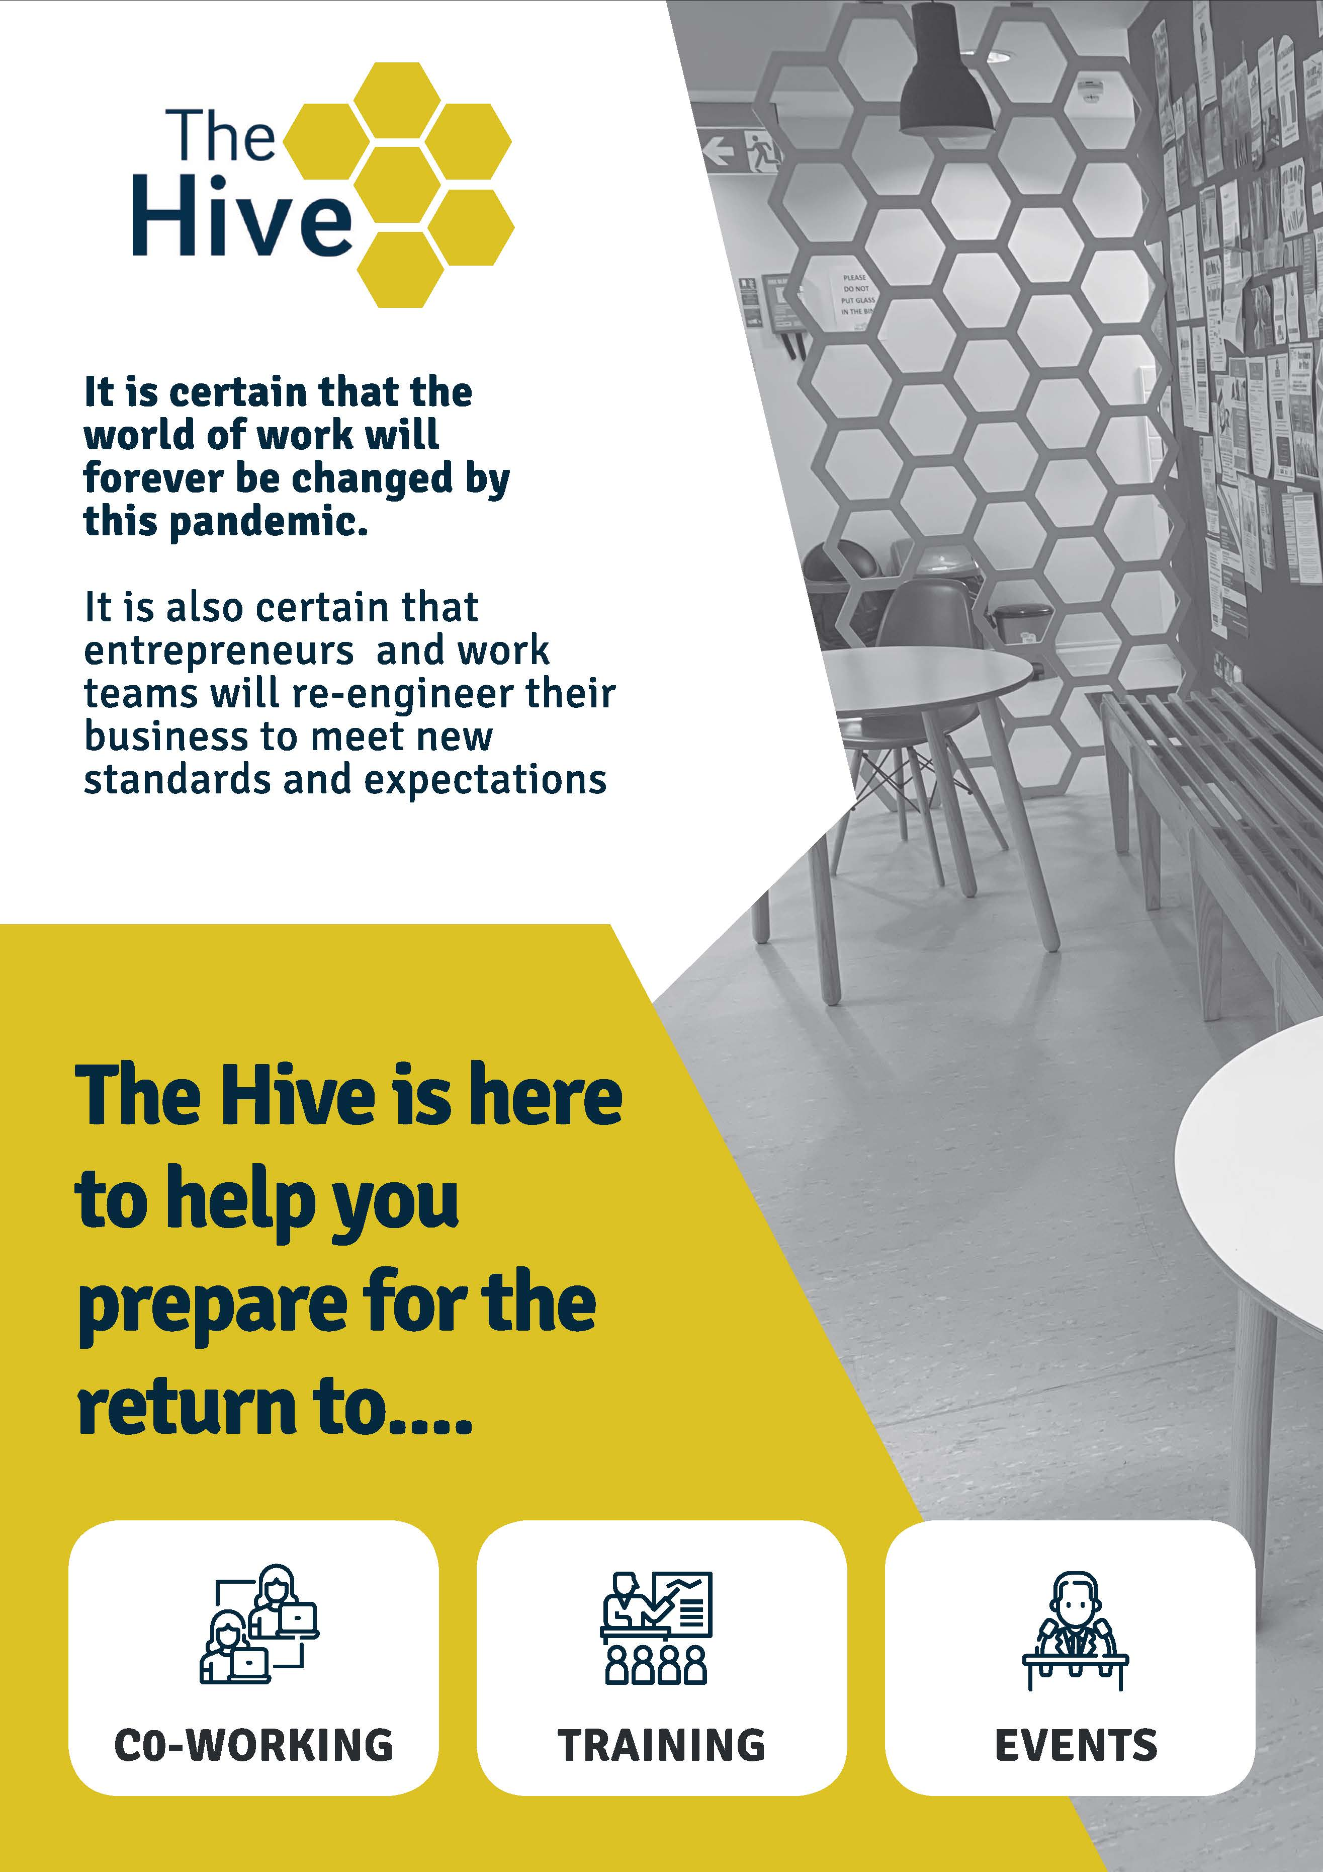
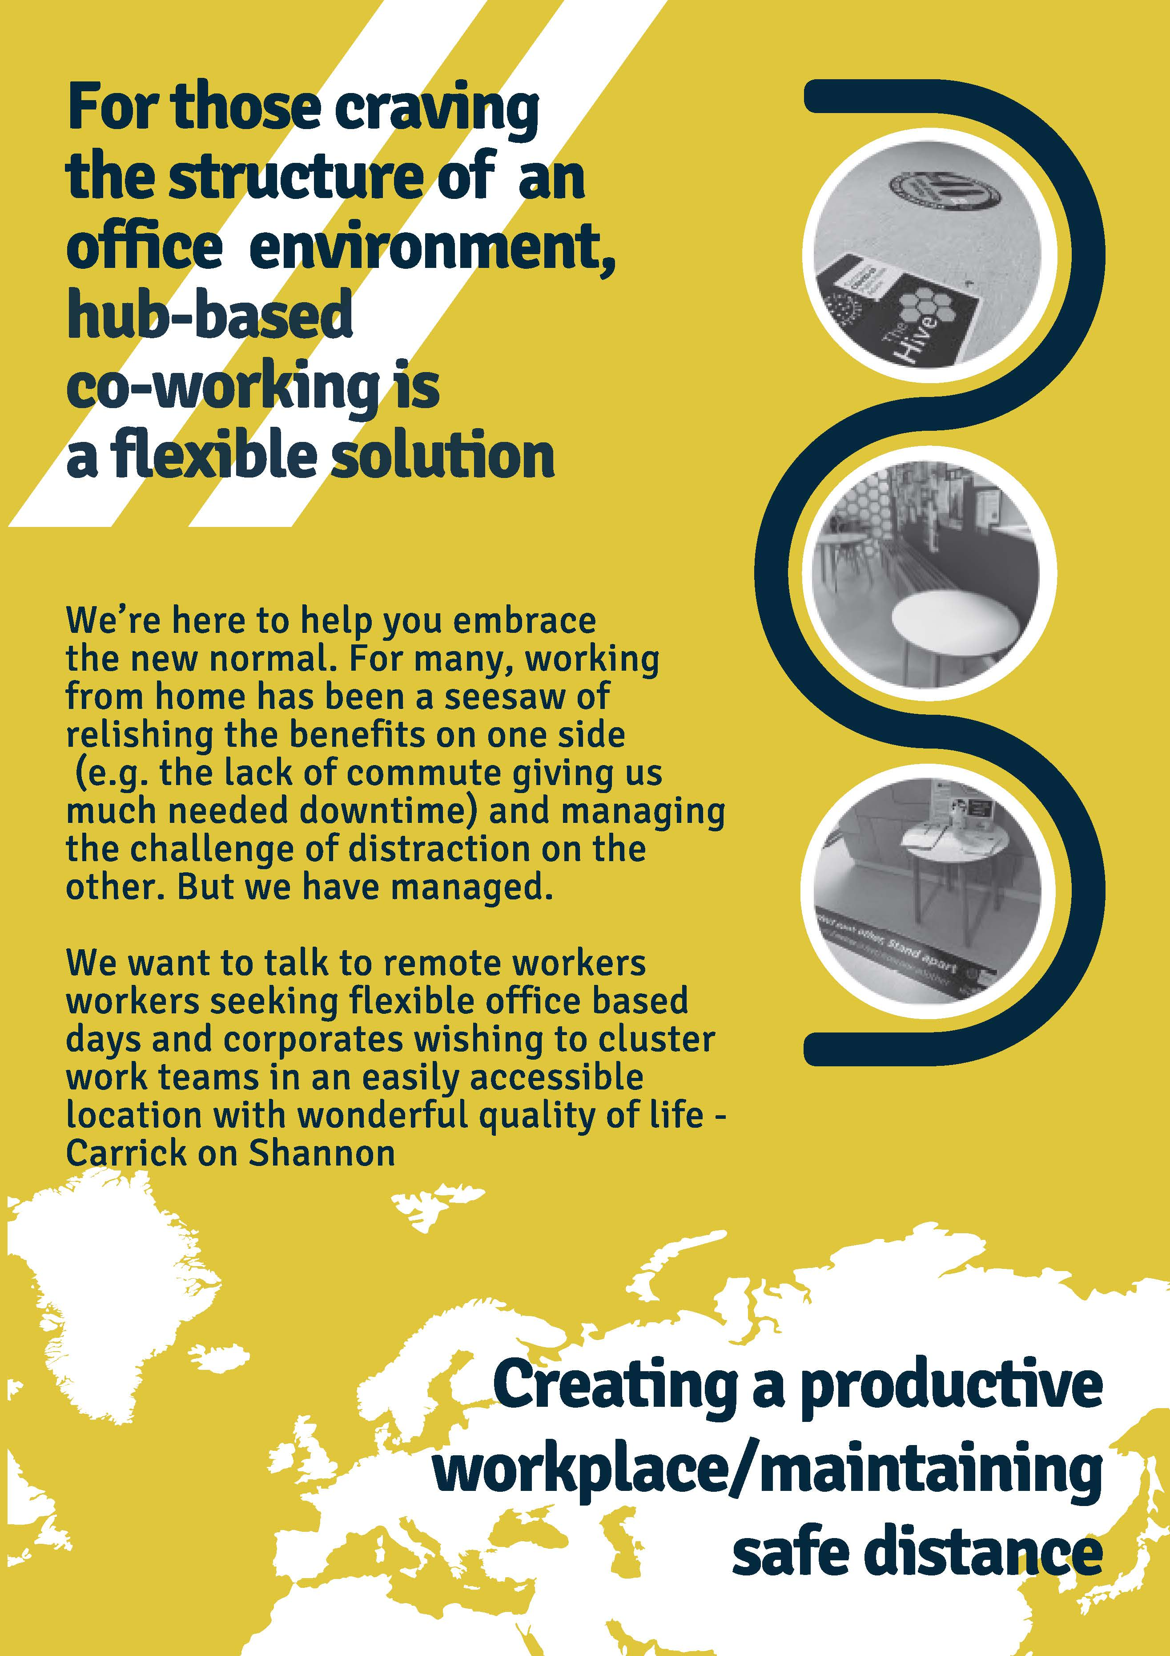
REASSURANCE of LOCAL CO-WORKING HUBS
WWW.THE-HIVE.IE IRELAND

Slide 26
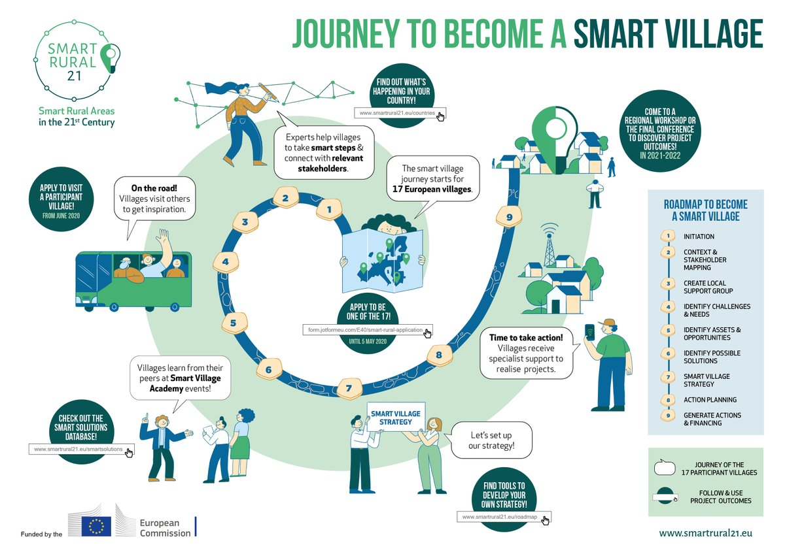
Smart Rural 21 is a two and a half-year project supported by the European Commission (DG AGRI) with the overall aim to promote and inspire villages to develop and implement smart village approaches and strategies across Europe.
Follow the journey of 17 European towns/villages as they strive to become Smart Villages
Gain insights into tried and tested Smart village approaches and strategies
Follow the Smart Rural Roadmap to replicate the journey for with your community
www.smartrural21.eu

Slide 27
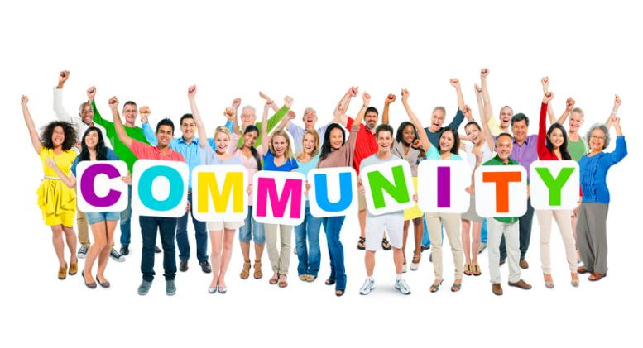
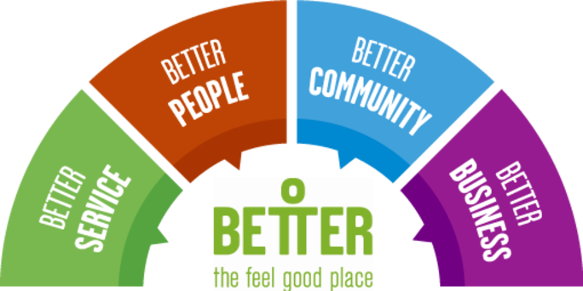
OPPORTUNITY
Power and potential of Community Social Enterprise to transform local communities
Smart Community Social Enterprise seeks to build healthy and sustainable enterprise communities which are driven and supported by a strong, resilient, local economies.
Community Social Enterprise is underpinned by:
coordinated investment into long-term equality
coordinated social enterprise activity
sustainable income generating strategies
support for marginalised cohorts to pursue business ownership or obtain better job

Slide 28
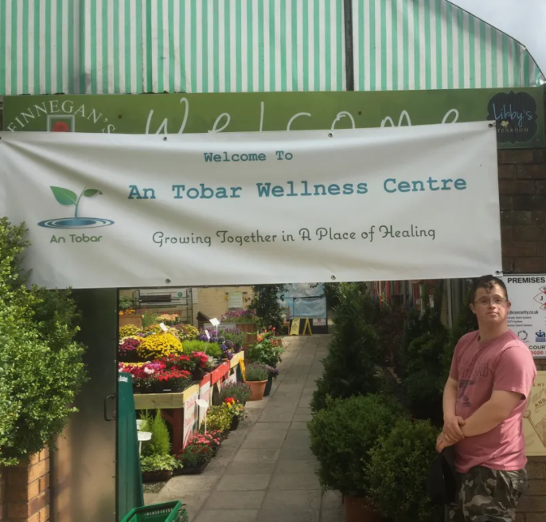
OPPORTUNITY
Power and potential of Community Social Enterprise to transform local communities
An Tobar Community Wellness Centre and Social Farm based in South Armagh, Northern Ireland. https://antobarcic.com/
They aim to inspire people to connect with each other, share their stories and grow communities together.
They offer nature-based activities to individuals and groups to improve the health and wellbeing of our community. They are also passionate about planting native trees and protecting the biodiversity of our area.
Vision: Growing together in a place of healing.

Slide 29
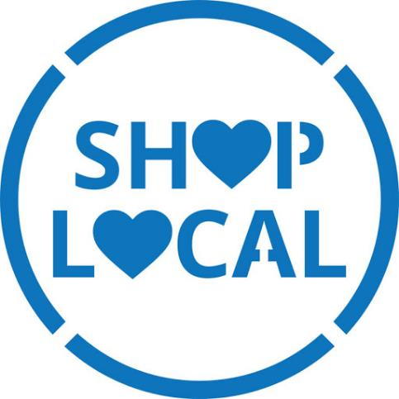
OPPORTUNITY
Hyperlocal Communities – opportunities to reconnect with local businesses
In Module one, we explored the concept of Hyperlocal – and how living, in 2k/5k/10k locked down spaces has given us a renewed understanding of importance of local communities and local businesses.
With regard to business and the economy, the shift towards hyperlocal life has increased spending locally.
A recent survey found that nearly a quarter people in the UK say they’ve shopped more in corner shops since the lockdown, while 70% of Irish adults have “made a conscious effort” to support local businesses due to the impact of Covid-19.

Slide 30
SECTION TWO: OPPORTUNITIES AND TRENDS IN ENVIRONMENTAL SUSTAINABILITY
Carbon Neutral, Circular Economy/Zero Waste , Communities powered by Green Energy,

Slide 31
Now let’s focus on Environmental Sustainability..
Environmental sustainability is the responsibility for interacting with the planet to maintain natural resources for future generations. Sustainable living works towards this by looking at:
living conditions (eco-villages, eco-municipalities, and sustainable cities)
economic sectors (permaculture, green building, sustainable agriculture) or work practices, such as sustainable architecture
new technologies (green technologies, renewable energy, etc.)
adjustments in individual lifestyles that conserve natural resources

Slide 32
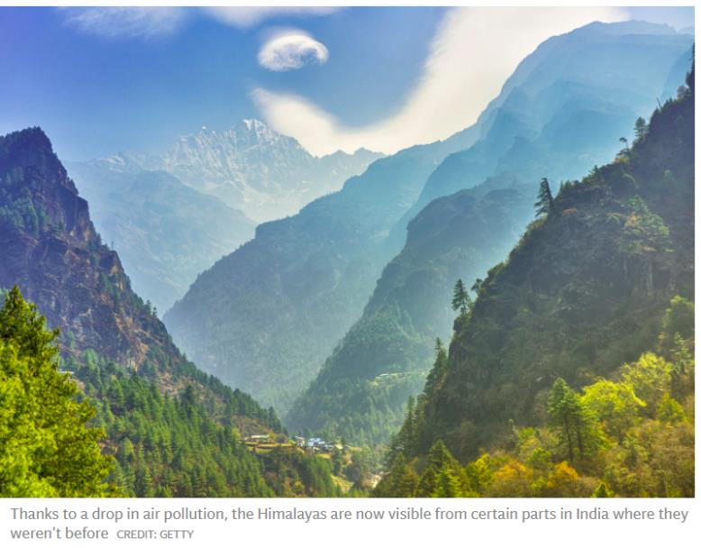
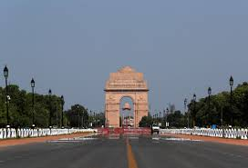
COVID19 and the Environment
A global tragedy, the COVID19 pandemic has taught us many lessons. When the world entered lock down in March-May 2020, the impact the human race became on the world became very apparent with some reports slowdown took out the equivalent of almost 1.5 billion tonnes of CO2 in China!
Coronavirus-prompted trends show what collective action could do in rapidly countering global heating caused by human activity and is already prompting the big question: to what extent recovery will be infused by green actions?

Slide 33
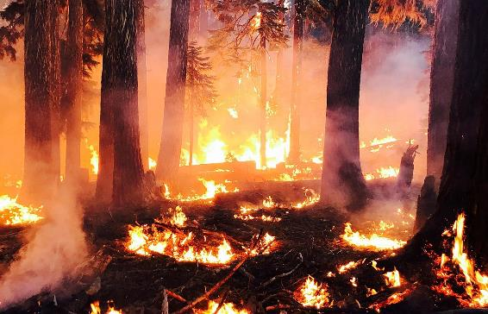
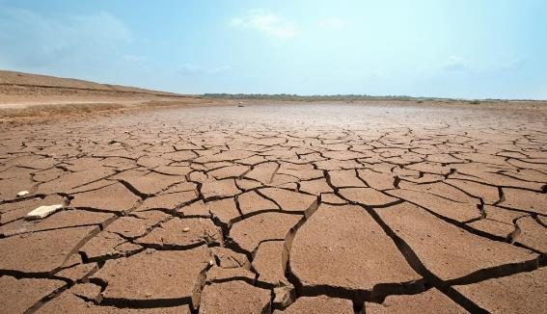
Climate Change and Extreme Weather
Extreme weather events and accompanying natural disasters (floods, droughts, heat waves and wildfires) are becoming commonplace as the effects of climate change tighten their grip on the planet. Terms like “mega fires” and “super storms” together with seemingly endless news coverage of “record-breaking” weather events are the public face of climate change.
As individuals and communities, we feel powerless to effect any meaningful change because of the sheer size and scale of the climate change and environmental impact issues and a lack of skills as to where to actually start. BUT communities have a key role to play and it is the summation of their thousands of small and local eco-innovations will create a ripple effect and affect true, powerful, sustainable change.
Source
This Photo by Unknown Author is licensed under CC BY

Slide 34
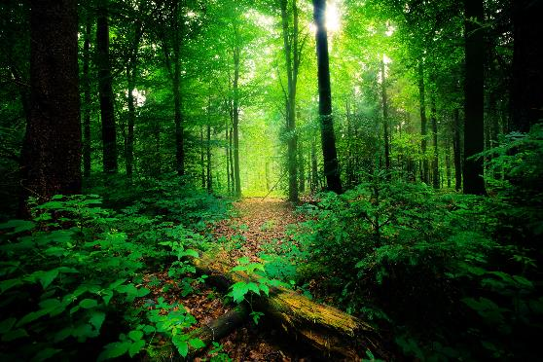
The need to bring back Biodiversity
As Europe loses its biodiversity at an unprecedented rate, it is vital that communities engage with biodiversity conservation at a local level. Biodiversity is fundamental to both planet and people. It provides us with clean air and water, food and medicines. But biodiversity is in crisis. Biodiversity loss can have significant direct human health impacts if ecosystem services are no longer adequate to meet social needs. Indirectly, changes in ecosystem services affect livelihoods, income, local migration and, on occasion, may even cause political conflict.
Only 23% of species and 16% of habitats under the EU Nature Directives are in good health. Habitat loss and fragmentation, unsustainable agriculture and climate change are leading drivers of biodiversity loss in the EU. In May 2020, the European Commission released the EU Biodiversity Strategy to 2030.
Source: World Wide Fund for Nature

Slide 35
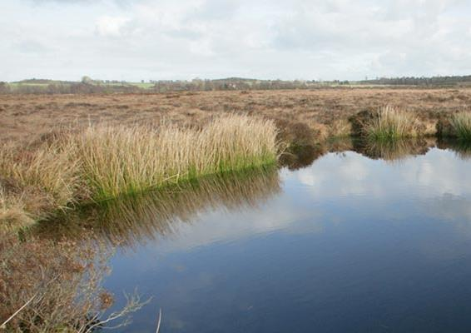
OPPORTUNITY
Interesting Project to promote Biodiversity
The Living Bog’ project is working to improve over 2,600 hectares of important raised bog habitat in Ireland. Often referred to as Ireland’s rain forest, these living bogs are of great importance for biodiversity, flood control and the control of carbon emissions. The project include physical interventions, local community co-operation, and a greater national understanding of the importance of Ireland’s raised bogs.
FIND OUT MORE: www.raisedbogs.ie
It is estimated that although bogs and peatlands cover just 3% of the world’s total surface, they store 30% of the soil’s carbon and twice as much carbon as all the forests in the world. Our raised bogs are visited by many non-native birds, stopping over and re-fuelling. Their survival is dependent on adequate wetlands such as raised bogs. As an education and tourism resource, the near-natural eco-system that is a raised bog is without equal in Ireland.

Slide 36
OPPORTUNITY
SUSTAINABLE WAYS OF LIVING: ECOVILLAGE INITIATIVES
An ecovillage is an intentional or traditional community using local participatory processes to holistically integrate ecological, economic, social, and cultural dimensions of sustainability in order to regenerate social and natural environments.
Ecovillages are communities with vibrant social structures, vastly diverse, yet united in common ecological, economic, social and cultural values and goals.
They spring from the good intentions and creativity of citizens, and their willingness to make a difference.
Source: Ecolise

Slide 37
ECOVILLAGES = LOW CARBON FOOTPRINT
Ecovillages have some of the lowest carbon footprints on planet.
Studies of carbon dioxide emissions in Danish ecovillages find they are 60% lower than the national average.
Those of German ecovillages are 35% of the national average, the Irish ecovillage in Cloughjordan has the lowest measured ecological footprint in Ireland and Findhorn Ecovillage in Scotland has the lowest documented ecological footprint of any settlement in the industrial world.
In module one, we learned about Cloughjordan, now let’s take a look at Findhorn Ecovillage, Scotland.
Source: Ecolise

Slide 38
ENVIRONMENTAL
Findhorn Ecovillage, Scotland re-designated a UN-Habitat Best Practice 20 years later
ECONOMIC
SOCIAL
The Findhorn Ecovillage is a synthesis of some of the very best of current thinking on sustainable human settlements. It is a constantly evolving model used as learning environment by a number of university and school groups as well as by professional organisations and municipalities worldwide.
Since 1985, this eco-settlement has advanced their sustainability agenda in the context of food production, energy systems, built environment, biodiversity, local economy and carbon footprint.
Now, over two decades later, Findhorn Ecovillage plays a role as a research and development centre for carbon-constrained life-styles, providing solutions to human and social needs, protecting the environment and offering an enhanced quality of life for all.
FIND OUT MORE: www.ecovillagefindhorn.com
CASE STUDY
Source

Slide 39
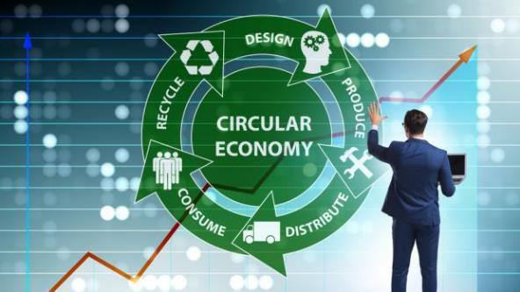
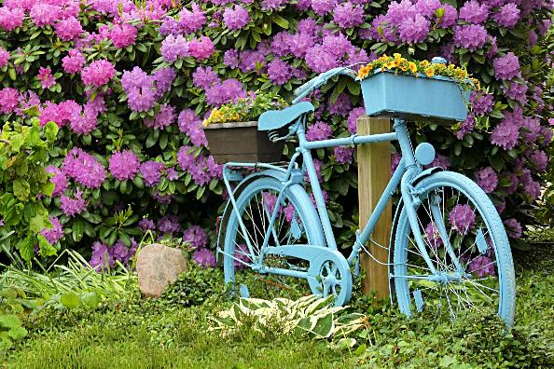
OPPORTUNITY
Zero Waste/ Circular Communities
The Circular Economy offers all of us the opportunity to redesign products and services so that they are more sustainable, equitable, and effective at meeting our humans needs without creating negative consequences to the planet.
The circular economy enables products to stay in circulation for longer through reuse, repair and innovation and prevents the creation of waste.
Circular Economy brings an array of benefits to individual, communities, businesses and more. It helps fight climate change, saves resources and reduces waste. It can save money and create jobs. It can help make businesses more resilient and it can inspire new business models and innovations.
Source: Rediscovery Centre

Slide 40
ENVIRONMENTAL
VRHNIKA, Slovenia – from landfill to recycling and zero waste in 20 years
ECONOMIC
SOCIAL
In 1994 Vrhnika’s landfill facilities were reaching their limits. Costs were rising rapidly and the local authorities were in need of new solutions. Since then Vrhnika has made to become zero waste:
plans in place for hazardous and bulky waste
residents are rewarding for recycling
home composting is promoted
educational campaign for 5 different age groups
efforts to change the public’s perception of waste as something dirty, smelly and not useful. Waste trucks are white with flower motifs, cleaned bins regularly and created an attractive entrance to collection centre, with a park featuring lawns and flowerbeds
a reuse centre founded in 2014 on its collection centre site, to upcycle waste into desirable goods and recover items that would otherwise be sent to landfill. Objects are repaired, upgraded or taken apart for useful parts to be crafted into something else, then sold to the public at affordable prices
CASE STUDY
Source

Slide 41
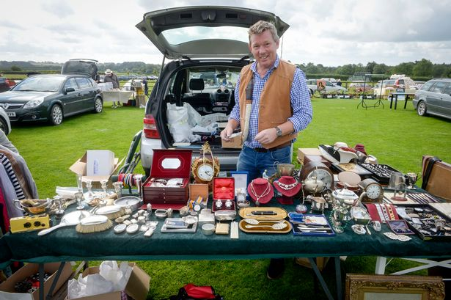
Car Boot Sales can help promote zero waste in your Community
The Car Boot Sale is a simple example but it is one that shows the circular economy and sustainability at its best! It see’s private individuals come together to sell or trade household and garden goods. One Man's Waste Is Another Man's Treasure…
While the circular economy concept is relatively new, its core practices of reuse and recycling are not. Trade in second-hand goods was once a local activity particularly in (UK/Ireland) and was conducted via car-boot sales.
For those who don’t know what they are…Car boot sales or boot fairs are a form of market in which private individuals come together to sell household and garden goods. They are popular in the United Kingdom, where they are often referred to simply as 'car boots'.

Slide 42
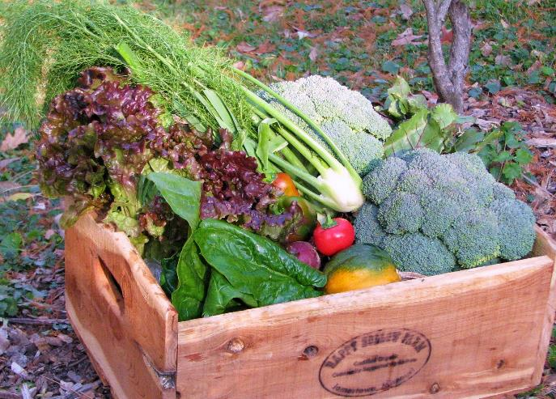
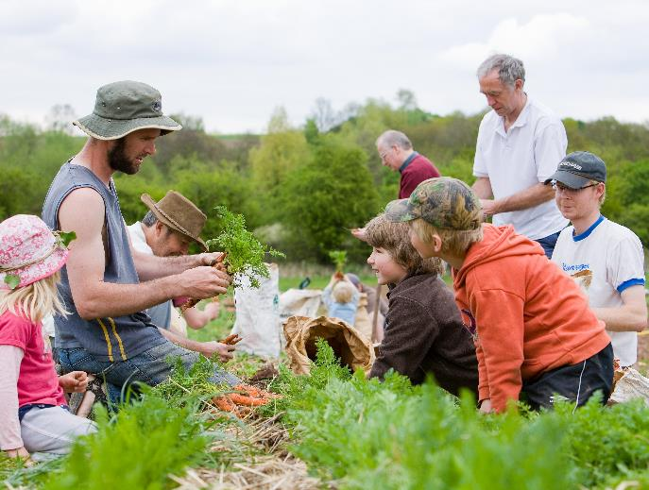
OPPORTUNITY
Community Supported Agriculture
Community Supported Agriculture creates a direct relationship between the farmers and those who consume the food produced.
How does it work? The farmers work the land and the consumers become members of the farm, committing to pay in advance a certain amount of money, for an agreed period of time.
The members’ money provides a modest income for the farmer and covers the day-to-day running costs of the farm. In return, the members receive a box of seasonal vegetables each week during our nine month season.
Source: Rediscovery Centre

Slide 43
ENVIRONMENTAL
Urban Community Farming – ØsterGRO, Copenhagen, Denmark
ECONOMIC
SOCIAL
Denmark’s first ever rooftop farm, ØsterGRO, supplies its 40 member families with ultra-local and sustainably produced eggs, honey, and vegetables. By bringing the farm to the city, the project links the farmer directly with the consumer, inspired by the concept Community Supported Agriculture.
The rooftop farm was established with support from the Copenhagen Municipality, but today the project is self-sustainable and financed through revenue educational activities and membership fees from the families involved amongst other revenue streams.
Also situated on the roof is the restaurant Gro Spiseri. As part of the experience, guests receive a tour of the farm. This is just one of the many ways in which the green urban space educates its 13,000 annual visitors about food waste and sustainable food production. At the same time, the farm contributes to climate proofing the municipality.
CASE STUDY
Source
This Photo by Unknown Author is licensed under CC BY

Slide 44
OPPORTUNITY
Community Power driving energy efficiently
All over Europe, the energy revolution is gaining momentum. Individuals, communities, cities and local authorities are at the vanguard of Europe’s energy transition and they are increasingly controlling and producing their own renewable energy, and fostering the transition to fairer, democratic and decentralised energy.
Community energy has the power to achieve an energy transformation more quickly, fairly and with added social benefits. And it has recently been boosted by new EU rights for people and communities to produce, sell and own renewable energy.

Slide 45
Community Power driving energy efficiently
The more people involved in community energy generation projects, the cheaper it can be to get them off the ground. If lots of people are keen to install a solar water heating system or wind turbine, for instance, you may be able to have the work done for less.
You can also make savings for the entire community. Installing more energy efficient measures could cut the cost of running the local community hall. Better insulation and a biomass boiler will pass on heat savings to community members who hire the hall.
Let’s take a look at some opportunities and example of community power in action!

Slide 46
Community Power is Ireland’s first community owned electricity supplier. Empowering people across Ireland to generate their own renewable energy projects – owned, operated and controlled by communities! www.communitypower.ie

Slide 47
ENVIRONMENTAL
Ireland’s first Community Windfarm – Templederry Windfarm, Co. Tipperary
ECONOMIC
Templederry is the first community owned wind farm in operation in Ireland. Templederry community is located on the northern edge of the Slieve Felim mountains. It is located between the main urban centers of Nenagh (north) and Thurles (south) in Co. Tipperary. It is suffering from population decline and there are limited local employment opportunities. Four individuals from the community completed a Certificate in Renewable Energy at the Tipperary Institute (www.tippinst.ie) and, following from this, sought to develop a wind energy project in the region.
Templederry Community Group in Co. Tipperary identifies wind energy as part of the ‘Environmental Protection’ goal within their Community Development Plan. READ MORE:
Templederry Community Wind Farm
Power to the people: is community energy the way forward?
CASE STUDY

Slide 48
ENVIRONMENTAL
Feldheim - Energy self-sufficient community
Germany’s renewable village
ECONOMIC
In Feldheim, a district in the Brandenburg town of Treuenbrietzen, one of the most spectacular overall concepts for decentralized renewable energy supply has been achieved.
The village produces electricity and heat for its inhabitants entirely by itself. Even the local businesses, private households and municipal facilities are directly supplied by the regionally produced energy from the local supply network.
Nuclear power, coal and heating oil are a thing of the past here. The present and future belong to wind, sun, maize and slurry.
Feldheim was voted the first energy self-sufficient community in Germany in October 2010 – and proudly displays the award on the village sign for everyone to see.
FIND OUT MORE: https://nef-feldheim.info/energieautarkes-dorf/
CASE STUDY

Slide 49
SECTION THREE: OPPORTUNITIES AND TRENDS IN SOCIAL SUSTAINABILITY
Renewed Rise of Volunteerism, Community Wellbeing, Active Citizenship

Slide 50
Role of Local Communities in Social Sustainability
Local communities creates social networks in the places where people live and act as a vital source of support and friendship, which is particularly important in the face of crisis like Covid19. However over the last 20 years local communities have been altered by the ways in which we work live and in some cases by the reduction of local services that results from recent period of austerity. On top of this, there are many common social problems that affect communities. Some of these are:
Social Isolation
Loneliness
Anti social behaviour
Discrimination
Poor Health
Poverty
In this section we will look at some opportunities, trends and case studies of communities who are working to redress these issues

Slide 51
EDEN Project in the UK conducted a survey in 2019 and the findings were interesting.. One key figure was that three quarters (72%) of the population don’t feel they know their neighbours well. Watch video to learn more..

Slide 52
CHALLENGE
New causes of Social Isolation
2020 amplified feelings of loneliness and isolation across communities. Cocooning, quarantine blues, social distancing and face coverings have impacted the way we communicate and connect and have amplified feeling of loneliness, isolation and disconnection.
Even the shift towards working from home which has been liberating for many people, is undoubtedly isolating too as so many of us now separated from our work colleagues. Loneliness is often linked to work - from long working hours and highly competitive environments, to added external pressures and anxieties.

Slide 53
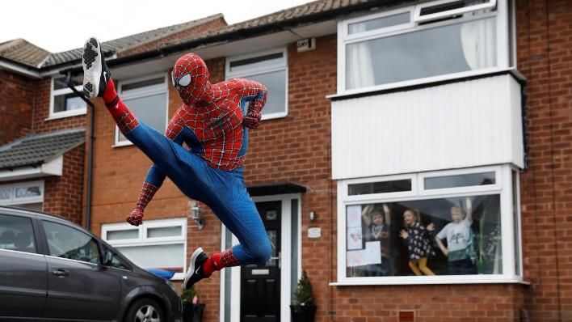
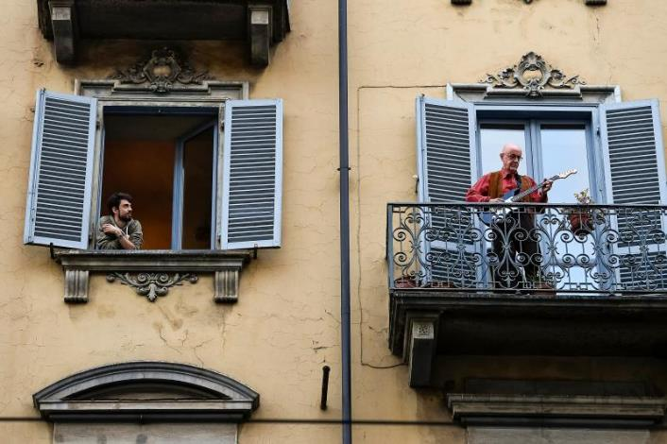
OPPORTUNITY
COVID19 – creating new ways to socially connect
How can people connect when you are in lockdown and need to keep your distance? A few months ago we didn’t know this answer but now we do… in Italy communities opened up their windows and sang and played music together. In Stockport (UK), two men dressed as Spiderman spent an hour every day in different neighbourhoods to the delight of children and families alike, while another household has brought life to their street by dressing up life-size bears in different costumes each day and arranging them in their front garden.
We’ve seen socially distanced dance sessions and even a socially distanced balcony performance of Romeo and Juliet! Covid19 keeps us apart but some communities have never been closer…

Slide 54
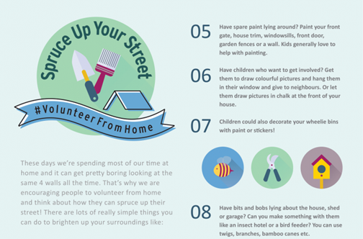
Spruce Up Your Street #volunteerfromhome
#SpruceUpYourStreet was a hyperlocal volunteer campaign was launched in Ireland during lockdown.
It asked people to get involved in some small way by doing something to brighten up their own immediate surroundings.
The infographic (part of it is left) gave lots of ideas to help get people started. And next we will see some of the results…
#spruceupyourstreet and #volunteerfromhome were two successful initiatives promoted by Volunteer Ireland during lockdown which have maintained their momentum. Find out more about these campaigns: https://www.volunteer.ie/volunteers/volunteer-from-home/

Slide 55
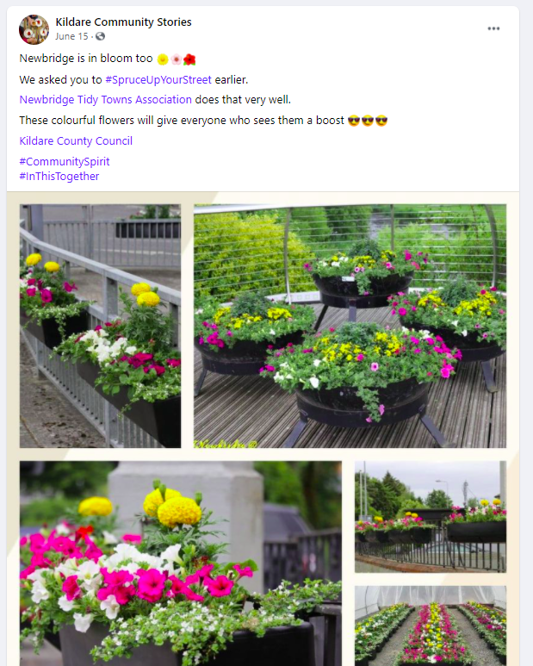
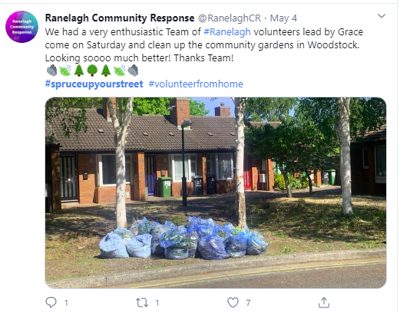
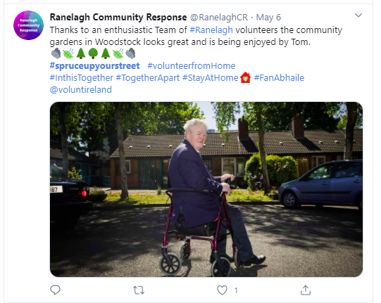

Slide 56
OPPORTUNITY
Focus on Community Wellbeing
A community with high wellbeing would be one where all people have a strong sense of belonging and identity, opportunities to work individually and together for the common good, are able to support each other through different life stages, access the services they need, live in a positive environment, and are able to participate in the making the decisions that affect them.
Community wellbeing involves considering the wellbeing of future generations as well as the present one. Community wellbeing involves considering the wellbeing of future generations as well as the present one. Community wellbeing involves us looking at the interactions and interdependencies between people, and the environment in which they live and work.

Slide 57
Men’s Sheds – an community wellbeing outlet
SOCIAL
A ‘men’s shed’ is a community based project, where men can come together to learn, share skills and make long-lasting friendships together. The men’s shed movement was first founded in Australia in the 1980’s, and have since expanded to other countries including Ireland, the UK, America, Canada, Iceland and Estonia to name a few.
Ireland has becoming one of the leading nations for men’s sheds in recent years, with Ireland having the most sheds per capita. Currently, there are over 450 sheds in Ireland, with at least 10,000 men visiting a shed every week.
All sheds are independent and self-autonomous, and the range of activities carried out by sheds differ from the next. Most sheds engage in activities such as woodwork, gardening, carpentry and community work. However, there are more special interests sheds that focus on things like music, fishing and restoration work.
FIND OUT MORE: https://menssheds.ie/about-mens-sheds/
CASE STUDY

Slide 58
Produced by the Irish Men's Sheds Association this video gives an insight into the power and potential of the Men’s Shed to reduce social isolation and improve the lives and wellbeing of thousands of men not only across Ireland but the world..

Slide 59
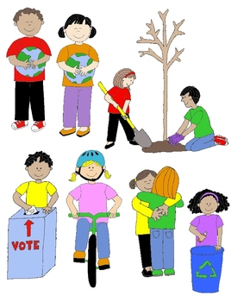
OPPORTUNITY
Rise of Community Spirit, Volunteerism and Active Citizenship
We learned in Module 1 how engaged and passionate active citizens are at the heart of great communities.
Active citizens are people who effect change and become actively involved in the life of their communities; tackling problems and bringing about change.
During and in the aftermath of Covid19, more and more people are taking the initiative to make their local neighbourhood more liveable, for instance by helping to maintain playgrounds or green spaces, engaging in voluntary work, organising litter-clearing campaigns, caring and checking in on older neighbours and more.
Question: Have you witnessed increased active citizenship in your community as a result of COVID19?

Slide 60
Active Citizenship and Connected Inclusive Communities
Promoting and encouraging active citizenship among all members of your community is important as its helps to create a more connected and inclusive community.
Connected communities bring positive changes to our everyday lives including new relationships, new opportunities and a feeling of empowerment for all community members.
Active citizenship could play a role in resolving this. Let’s take a quick look at how..
Question: Is there an individual or group in your community that may feel excluded, on the fringes or left out?

Slide 61
OPPORTUNITY
Empowering refugees and migrants to become active citizens and community leaders
Refugees and migrants can benefit greatly from becoming active citizens in their communities.
By engaging in community groups, refugees and migrants learn more about their host countries, local people and customs.
They can lay the foundations for friendships with natives of the community and empower themselves to be changemakers effecting positive actions in their new found homes.
Active Citizenship can negate “Othering” which can stem from ethnic/racial differences/ identities and/or treatment by society/host community

Slide 62
Let’s meet: Active Citizen and Migrant Community Champion
Sajjad Hussain was born in Pakistan but has lived in Ireland for almost 20 years. He originally came to Ireland on a work permit and has made Roscommon his home.
In 2018, he was one of four people from the Ballaghaderreen to accept a Community People of the Year award in recognition of the town’s response to the arrival of the refugees from Syria.
An active citizen in his community, Sajjad has been involved in the Tidy Towns committee, the youth organisation Foróige and he also founded the local cricket club
In 2019, Hussain contested the local Roscommon election.
Promoting active citizenship among adult migrants and refugees is key the integration process as it gives back a sense autonomy and control of their lives and futures in their host countries.
More info: https://www.irishtimes.com/news/politics/barber-hopes-to-emerge-a-cut-above-in-roscommon-council-election-1.3797201

Slide 63
Why empower refugees and migrants to become active citizens and community leaders?
Emerging communities need a diversity of leaders. With diverse leadership, our communities will grow stronger.
Migrant and refugee community members have a point of view that the community would like to hear and a set of skills that is unique and valuable.
Diversity of Leadership creates opportunities for respectful dialogue and collective problem solving.
Anyone can learn to be a community leaders. Leadership skills are built step-by-step.
You can include Refugees and Migrants in the Community Planning/Regeneration Process by:
Facilitating community collaboration and intercultural dialogue
Planning events that bring people (refugee, host communities and other ethnic groups) together in a community

Slide 64
Finding the Right Opportunity for Your Community – useful exercises and templates
Key Action Pack 2
The SDG Project Canvas
Smart Rural 21 Roadmap Toolbox
These exercises/resources will help you apply what you have learned in Module 2 to your community and help you get ready to start regeneration project planning. Please complete these before moving on to Module 3.

Slide 65
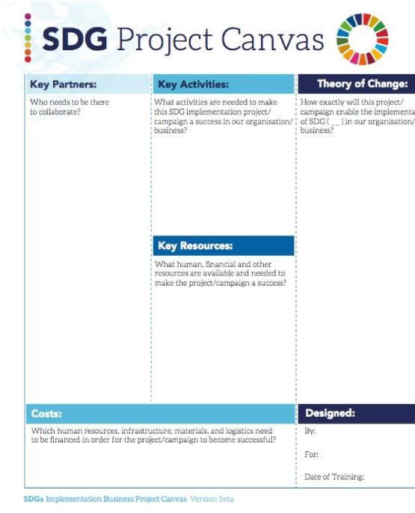
Useful Resource: The SDG Project Canvas
The Smart The ‘SDG Project Canvas’ offers an additional tool to support an even more detailed process of co-conceiving and then co-designing an integrative SDG implementation project with a particular location, community, business or organization in mind.
The ‘SDG Project Canvas’ was inspired by the ‘Business Model Canvas’ . It has been adapted to help people think through key partners and key activities, define how their project will implement a series of SDGs, how widespread participation will be stimulated, who it will impact, what resources will be need and can be drawn from, what policies might enable or hinder successful implementation, and how investment or funding might be raised.
Learn more about the Canvas

Slide 67
Useful Resource: Smart Rural 21 Roadmap Toolbox
The Smart Rural 21 Roadmap Toolbox is a key resource which will provide key tools for each step of the ‘smart village journey’.
Practical tools (including guidance, explanatory videos, questionnaires, templates, etc.) aim to help villages to develop and implement smart village strategies.
Practical tools will be soon uploaded to the toolbox: www.smartrural21.eu/roadmap

Slide 68
MODULE 2: KEY TAKEAWAYS - OPPORTUNITIES FOR COMMUNITY REGENERATION
In Module 2 we explored some opportunities and trends in economic, environmental and social sustainability. So what did we learn?
17 UN Sustainable Goals are a great founding stone for community regeneration projects
While we looked at opportunities and trends in economic, environmental and social sustainability, as we saw in the case studies there was and is quite often a cross over. Something that starts as a solution to a social problem (e.g Men’s Shed) can often bring economic value (products can be made and sold and profit reinvested in the group or the community)
Continuing from Module 1, we were reminded of the importance of a community led approach and the value of all community members. In module 2, we looked in particular at what refugees and migrants can bring to the community regeneration process

Slide 69
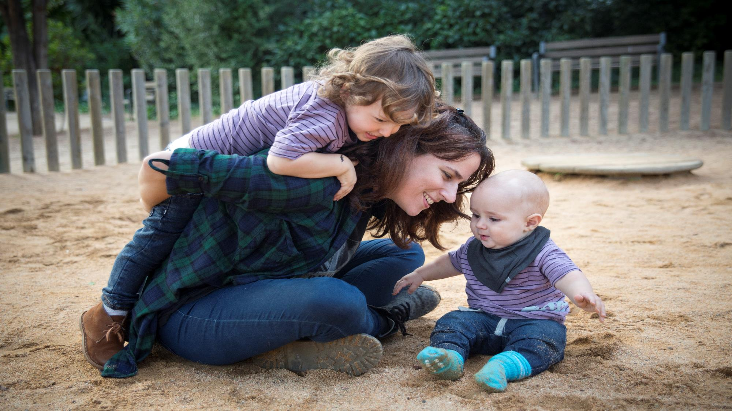
NEXT UP: Module 3
Placemaking – A Powerful Tool for Community Regeneration
In Module 3, we will explore the four main types of placemaking and the application of these to community regeneration

Slide 70
Zero Waste Europe
Key references for Module 2

