Slide 1


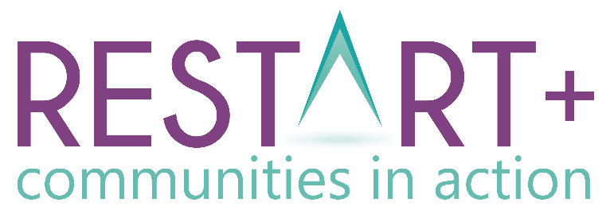

Module 1
Introduction to Building Sustainable Communities
www.restart.how
This project has been funded with support from the European Commission. This publication [communication] reflects the views only of the author, and the Commission cannot be held responsible for any use, which may be made of the information contained therein.

Slide 2
Intro
Communities post COVID/post crisis – Is your community in need of regeneration?
MODULE 1 OVERVIEW
01
What is a Sustainable Community? Let’s explore.
In Module 1, you will explore community regeneration in the context of building a sustainable community challenged by decline/crisis.
We break down the concept of a sustainable community and look at causes of community decline, the importance of building a strong team and some regeneration case studies which showcase key learnings.
In our final section, we provide you with a pack of useful exercises and templates to assess your community before planning your new regeneration project.
02
Barriers to Sustainability. Spotlight on Common Causes of Community Decline
03
Community Assets, Skills and Competencies for Regeneration
04
Building a Strong Team – empowering Stakeholders, Community Champions and Active Citizens in Community Development
KEY ACTION PACK 1:
Getting Started with Building your Sustainable Community – useful exercises and templates

Slide 3

INTRODUCTION:
Communities post COVID/Crisis
Is your community in need of regeneration?

Slide 4
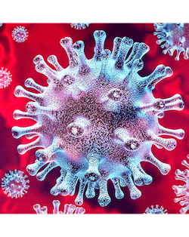
Community regeneration has never been so important
In times of hardship, uncertainty and fear, we rely on those around us for solidarity, support, guidance, information and empathy.
In 2020, the concept of community has never been more important and building/living in strong, vibrant, local communities is a must for us all.
When a large part of our world locked down (during Spring 2020), a sea change occurred that drastically changed how we live and work in our communities.
Let’s explore some of the changes that occurred…

Slide 5



Some of the ways COVID19 has impacted some of our daily/personal lives..
Enforced lockdowns encouraged us to focus on Hyperlocal (small geographical communities/neighbourhoods) rather than regional, national or global outlooks
Change in how we communicate/interact (distance, face coverings)
Huge shift towards “life online” – from exercise, socialising, working
Rise in remote/agile working and working/learning from home
Worries about increased pressure on small business/economy/health sector
Increase in community spirit and sense of community (care of elderly, vulnerable). Communities mobilise assistance responses
Increased need for meaningful connections to combat loneliness/isolation and improve wellbeing
Increased interest in self sufficiency and traditional life skills - cooking, growing, gardening
This Photo by Unknown Author is licensed under CC BY-NC-ND

Slide 6
Some key takeaways from 2020:
Hyperlocal – living, in (2k, 5k, 10k) locked down space has given us a renewed understanding of importance of local communities.
We will approach the remainder of this RESTART Communities course with a hyperlocal focus
Technology has increased in importance as has the need for smart communities, towns and villages.
We will explore this in module 2
Agile Thinking is the ability to consciously shift your thinking when and how the situation requires it. 2020 taught us about the importance of agile thinking.
Individuals, businesses and communities need to be able to adopt agile thinking approaches now and in the future. We will explore Agile Thinking and Diversification in Module 2
Community spirit soared in 2020. Huge surge in volunteers to look after the needs of vulnerable community members with home deliveries and much more.
Harnessing this renewed sense of community spirit will be key to regenerating your community in the coming months and years.

Slide 7

Each single word in this definition of development is significant:
Creating sustainable communities is an absolute priority for us all, for those in authority and those living and working in areas and communities that we want to be the very best that they can be.
Comprehensive and integrated vision and action which leads to the resolution of urban/rural/ social problems and which seeks to bring about a lasting improvement in the economic, physical, social and environmental condition of an
area that has been subject to change

Slide 8
IS YOUR COMMUNITY IN NEED OF REGENERATION/THIS COURSE?
START
Is your community in a bad or good place at the moment?
Good we’ve got a strong community
Bad, we are in decline
Are the causes of decline evident?
Yes we know the causes
Yes we do have issues to solve
Does your community have any issues to solve at the moment?
Yes sustainable solutions are evident
No issues to solve right now
No we don’t know the causes
Are sustainable solutions evident?
No sustainable solutions are not evident
Does your community know how to implement these solutions?
Sounds like you are doing a great job.
Sounds like you need to do a community audit and some new knowledge
Sounds like you need some guidance or inspiration
Yes we have a plan
No we are stuck
You can still benefit from this course by gaining new and fresh insights and approaches to community regeneration from across Europe
YES COMMUNITY REGENERATION IS NEEDED.
You will greatly benefit from this course

Slide 9
WE ADVOCATE THAT IN ADDITION TO PROACTIVE LOCAL GOVERNMENT, LOCAL COMMUNITIES NEED TO BE AT THE HEART OF PLANNING + THE BIGGER PICTURE. WHY ?
Gaps often found in the field of community development/regeneration: form national government policy to local government priorities to local people, the business community & NGOs, there can be a disconnection between opinions of what is needed.
Participatory approaches facilitate the best results development of an effective and relevant community regeneration plan.
For the purposes of our RESTART modules, we use the word ‘community’ to reflect the group, area or region in focus.

Slide 10
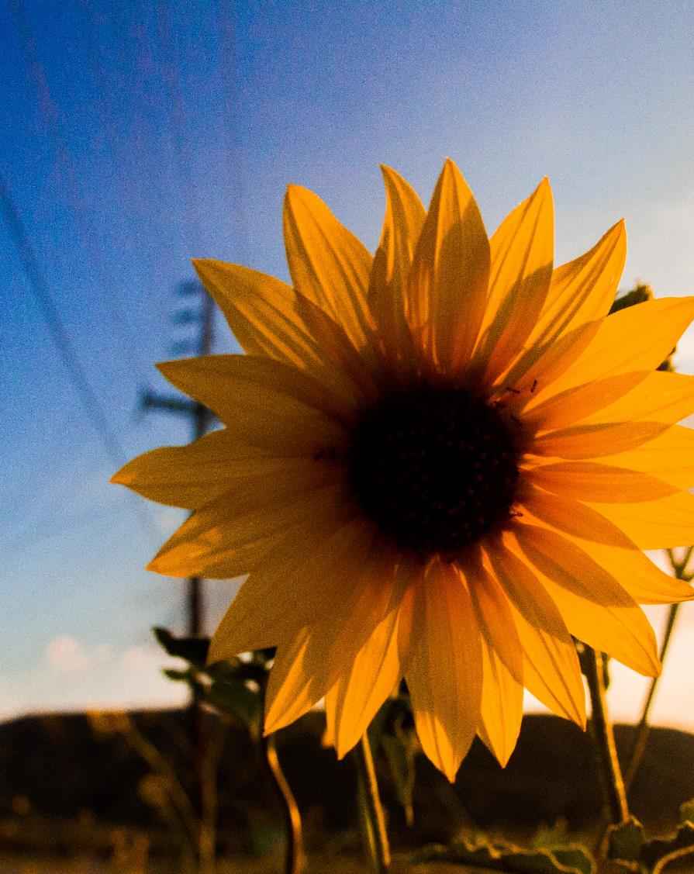

Why a sunflower icon? Sunflowers represent positivity and hope and in the context of Restart+, a vibrant community restart!
STRONG FOCUS ON RESTART+ REGENERATION CASE STUDIES
Throughout each of our 6 modules, you will learn about some European communities that have reinvented and restarted in a sustainable way.
Our three key themes run through these case studies. Keep an eye out for our case study (sunflower) icon and our sustainability tags:
SOCIAL
ECONOMIC
ENVIRONMENTAL
Sustainable communities weave together the social, economic and environmental dimensions that are all needed to create a sustainable and successful plan, with an inclusive and entrepreneurial outlook.

Slide 11

SECTION ONE: SUSTAINABLE COMMUNITIES
Getting Started: What makes a Great Community?
b) What is Sustainability? Spotlight on Social Sustainability, Economic Sustainability and Environmental Sustainability
c) Why (re) build a Sustainable Community?

Slide 12
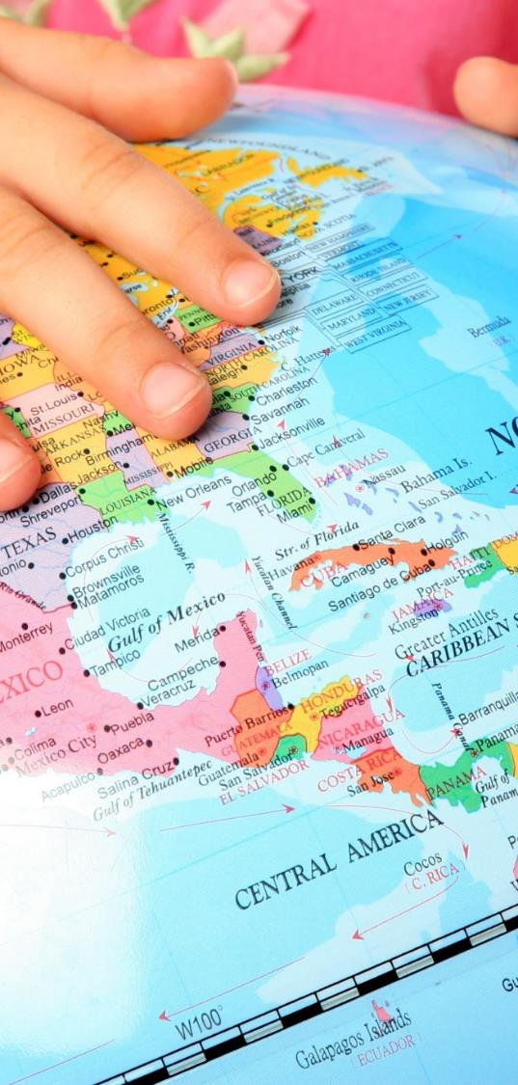
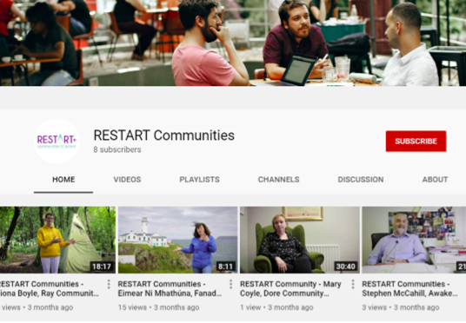
DEVELOPING SUSTAINABLE COMMUNITIES
What does a sustainable community look like ?
Successful development planning weaves together the social, economic and environmental dimensions that are all needed to create a sustainable and successful plan, with an inclusive and entrepreneurial outlook.
We have found many inspirational and sustainable communities on our travels in RESTART.
Take a browse through our YouTube channel

Slide 13
Getting Started: What makes a Great Community?
Great communities combine a balance of social, economic and environmental components
SOCIAL
Sense of belonging/pride of place
Cohesion/Inclusion and Equality
Active Citizenship: Participation and local democracy
Health, quality of life/ well-being
Social Order and a Feeling of Safety
Cultural fulfilment, a sense of heritage
ECONOMIC
Opportunities for enterprise and employment
Opportunities for education/ training
Housing and vibrant neighbourhoods
ENVIRONMENTAL
Community Infrastructure and Amenities
Air/Water Quality
Pollution Management (noise/waste)

Slide 14
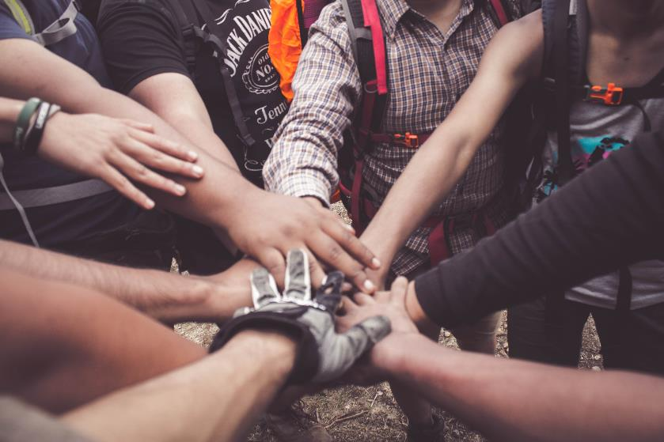
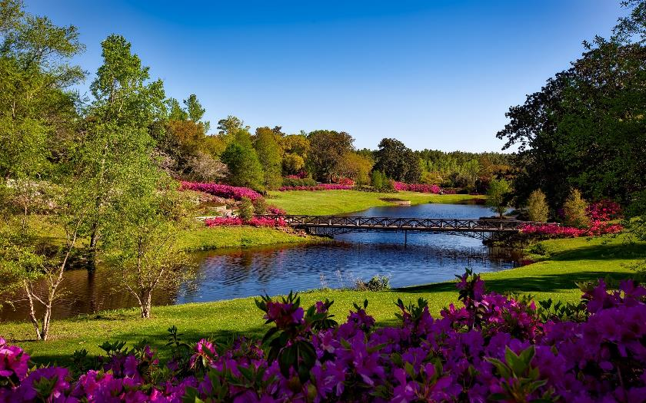
Characteristics of great communities
Community Spirit/Pride of Place
Community spirit manifests itself in the individual or group activities (voluntary work, favours and gestures of goodwill) which members of a community choose to engage in for the benefit of that community.
Pride of place relates to the activities community members engage in together to shape, change and enjoy all that is good about their area
Great communities have community spirit in abundance and the people living there are very proud of their homeplace. A strong sense of community spirit is not only important to retaining current residents, but attracting new ones as well.
SOCIAL

Slide 15
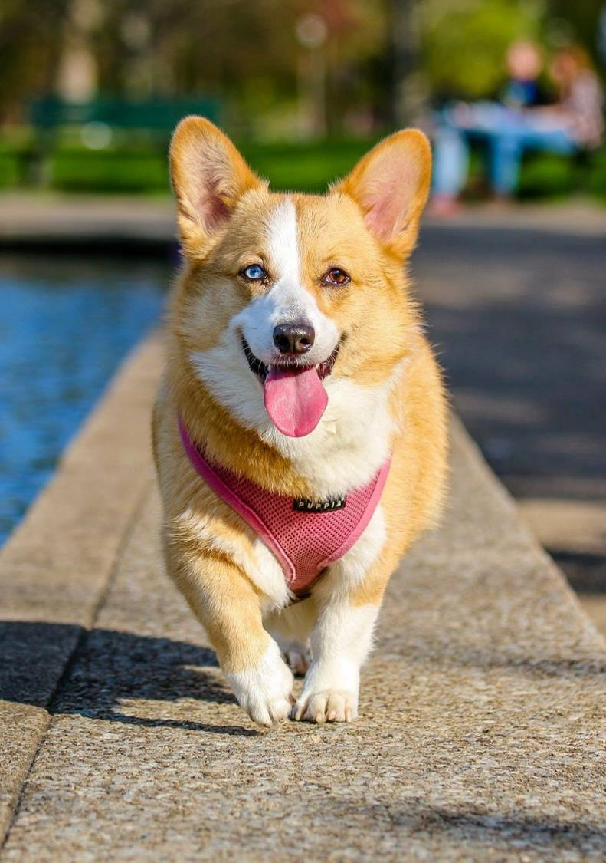
Characteristics of great communities
Sense of belonging – a place for everyone
A welcoming and inclusive community is a community where its citizens and members feel safe, respected, and comfortable in being themselves and expressing all aspects of their identities. It is a place where each person shares a sense of belonging with its other members.
A sense of belonging is a human need, just like the need for food and shelter. Feeling that you belong is most important for all members of a community.
Great communities recognise that a sense of belonging is important to one's quality of life and they strive to make everyone feel at home.
SOCIAL

Slide 16
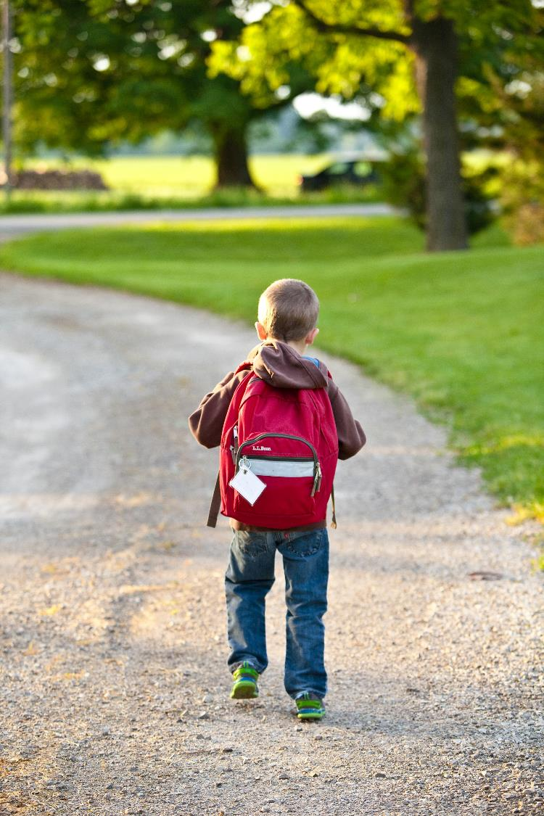
Characteristics of great communities
A feeling of safety
Community safety is a concept that is concerned with achieving a positive state of well-being among people within social and physical environments.
Not only is it about reducing and preventing injury and crime, it is about building strong, cohesive, vibrant, participatory communities.
Community Safety includes a wide range of things such as crime prevention, road safety, safer public places, water safety and outdoor/sports safety.
Community safety is a key factor in making a great community as people need to feel safe where they live, work or spend their leisure time.
SOCIAL

Slide 17
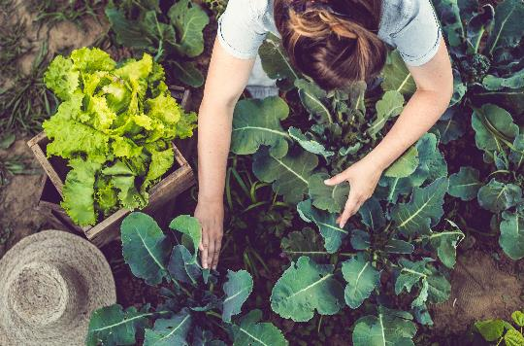


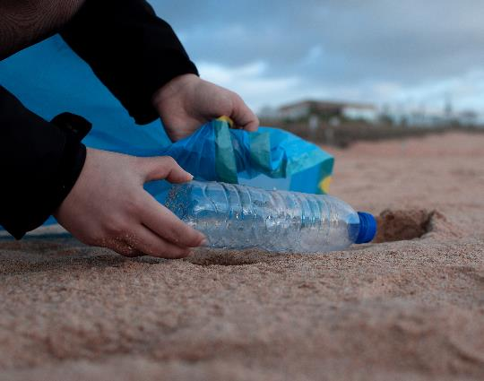
Characteristics of great communities
Strong Community Leaders or Champions
A community champion is a changemaker who takes responsibility for the well-being and improvement of their communities.
Typically, they are key to mobilizing communities for a common cause to design and champion courses of action to overcome specific community challenges. This role could be paid for or voluntarily, most are volunteers.
Great communities are usually driven by one or two or even a team of community champions.
SOCIAL
The Role of the Community Champion work is part education, part inspiration, part motivation and part mobilization.

Slide 18
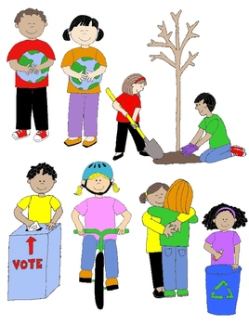
Characteristics of great communities
Active Citizens/Engaged Community Members
Not everyone has to be a leader or champion. For communities to really work, they also need a strong sense and commitment to Active Citizenship. Active Citizenship is used to describe the involvement of individuals in public life and community affairs.
Active citizens are people who effect change and become actively involved in the life of their communities; tackling problems and bringing about change.
Engaged and passionate active citizens are at the heart of great communities.
SOCIAL

Slide 19
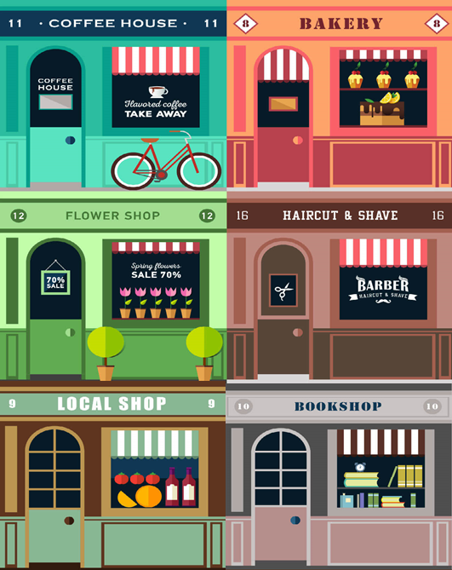
Characteristics of great communities
Viable Local Businesses which Contribute to Communities by:
providing local people with jobs and a very valuable asset to the local community
contributing to a communities identity and help give it its unique character and charm
Often play a key role in the community development initiatives and provide sponsorship
Clusters of small businesses have environmental benefits as they reduce automobile use and traffic congestion, resulting in better air quality and things like urban sprawl.
Great communities are those that get behind, support and promote their local businesses.
ECONOMIC
Source

Slide 20

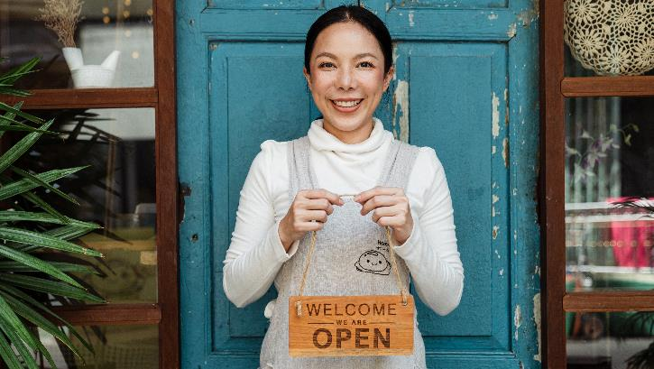

Characteristics of great communities
A Place to Work – Creating Opportunities for Employment
There are a number of key drivers of employment and growth in communities, these are
natural resources and environmental quality,
the sectoral nature of the economy,
quality of life and cultural capital and
Infrastructure, accessibility.
Talent skills pool
Across Europe, great communities are proactively fighting back when employment opportunities dwindle. Later in this module, we’ll meet a few (such as Drumshanbo Community Council, Ireland) and learn about their journey to success.
ECONOMIC

Slide 21

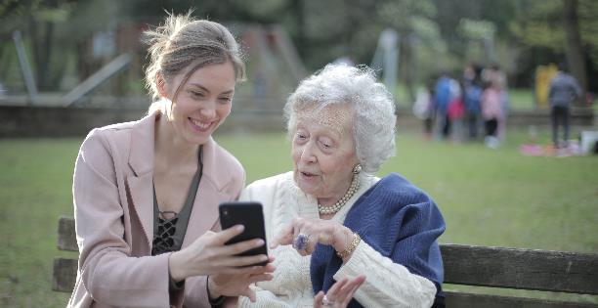

Characteristics of great communities
Opportunities for Learning and Education
The Right to Education is one of 30 declared Human Rights and it is important for everyone to make the most of their lives. Education makes us better citizens by teaching us how to conduct ourselves through life by following rules and regulations and giving us a sense of conscience. It also makes us more confident to go out there and achieve things
When people move to a community the availability of good schools and opportunities for learning and education is often a major factor influencing their choice.
Great communities recognise the importance of education as a tool to enhance progress and make the world a better place and they strive to promote and encourage learning and education for all their community members.
ECONOMIC

Slide 22
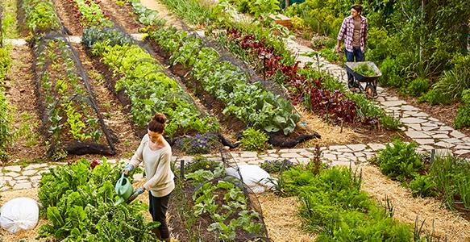
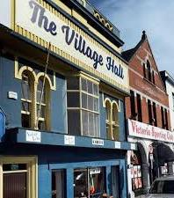
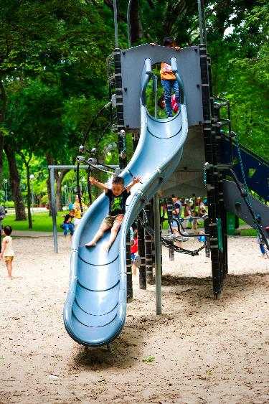
Characteristics of great communities
Community Infrastructure /Amenities/Spaces
A community space is somewhere for local people to gather and connect, to do things together and pursue shared interests or activities; both serious and fun.
This can mean a community space could be a wide range of places – indoors or outdoors, new or old and in-between or even just an idea for something they would like to develop. This can mean they are a local hub or hall, a garden, allotment, sports or pastimes space for example.
Warm and welcoming open spaces accessible to all are key to a fulfilling community.
ENVIRONMENTAL

Slide 23
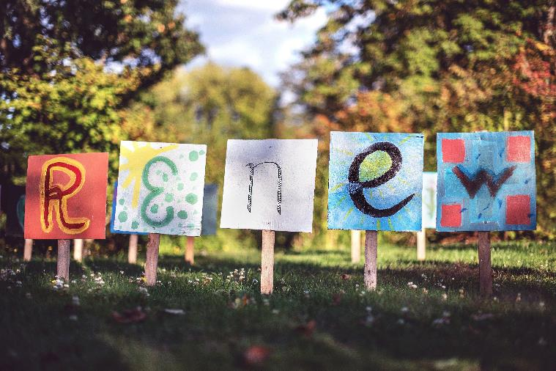
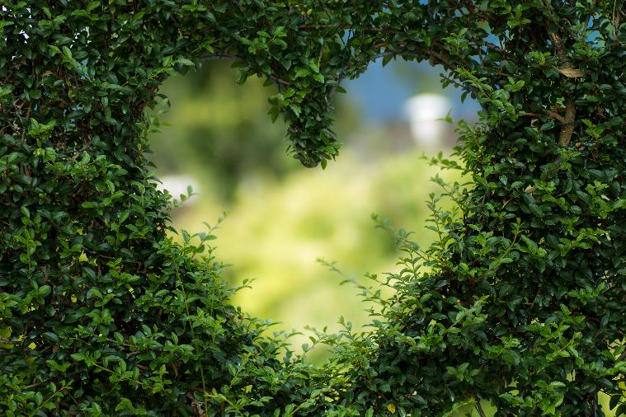
Characteristics of great communities
Local Environment Quality
There is a close relationship between our quality of life and the environment. People's lives are strongly affected by the health of their physical environment.
Environmental quality also matters intrinsically because most people value the beauty and health of the place where they live and care about the depletion of its natural resources
Great communities proactively improve and maintain their local environment by taking into consideration air quality, water quality and things like pollution (noise, waste) management.
ENVIRONMENTAL
Sources – EPA Ireland ScienceDirect

Slide 24

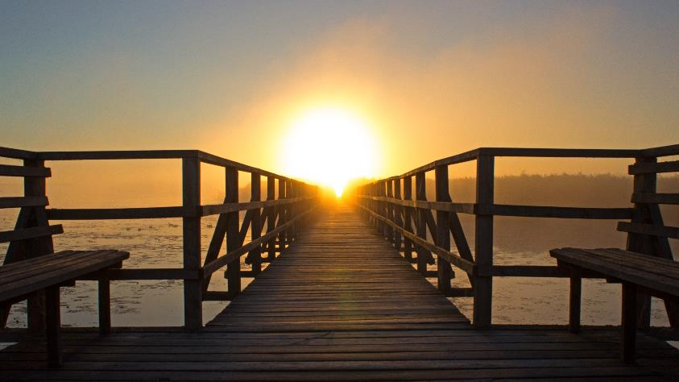
Characteristics of great communities
Know their Strengths and have a Sustainable Vision/Plan for the Future
Every community is different. No two are the same. Each has different demographics, different community assets and each faces different challenges and it is this uniqueness and difference that makes each community special. Great community groups, leaders and members recognise and celebrate this.
Great communities know their strengths and opportunities and how to combine these to create a sustainable vision or plan for the future. Great communities don’t just happen overnight, they need to be developed, nurtured and regularly improved on to meet the growing and changing needs of those who live in them.
SOCIAL
ECONOMIC
ENVIRONMENTAL

Slide 25
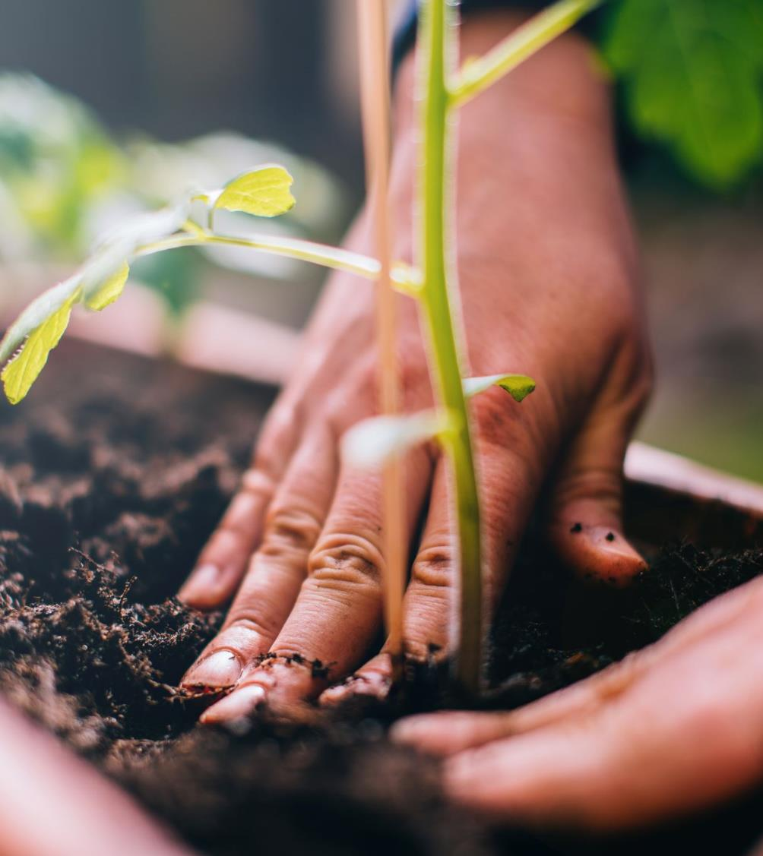
What is a Sustainable Community?
Sustainability is a focus on meeting the needs of the present without compromising the ability of future generations to meet theirs.
Sustainable communities tend to focus on their long term sustainability across three main pillars
Social Sustainability
Economic Sustainability
Environmental Sustainability

Slide 26

1. Social Sustainability
Social sustainability is about people’s quality of life, now and in the future.
Social sustainability is a process for creating sustainable successful places that promote wellbeing, by understanding what people need from the places they live and work.

Slide 27
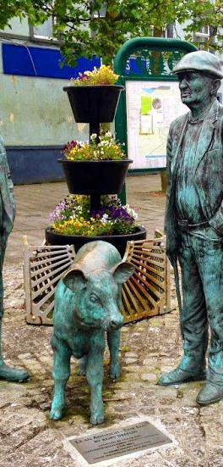
EMBRACING DIVERSITY to combat depopulation and economic decline - BALLYHAUNIS, Co. Mayo, Ireland
SOCIAL
ECONOMIC
Ballyhaunis, Ireland is a tremendous example of a multi-ethnic diverse community, living, working and co-operating together to create an inclusive place for people to live and bring up families.
It is now Ireland’s most ethnically diverse small town, and is home to a diverse community of people from a migrant background who have integrated well with the Irish community.
This cultural diversity is a source of pride in Ballyhaunis and is seen as a strength of the town which has enabled it to face and overcome the challenges of rural depopulation and economic decline in recent years. READ MORE:
Diversity in an Irish Town
Ballyhaunis Celebrating Diversity- Our Future Together Report
Pitching Up – GAA in Ireland’s most ethnically diverse town
CASE STUDY

Slide 28
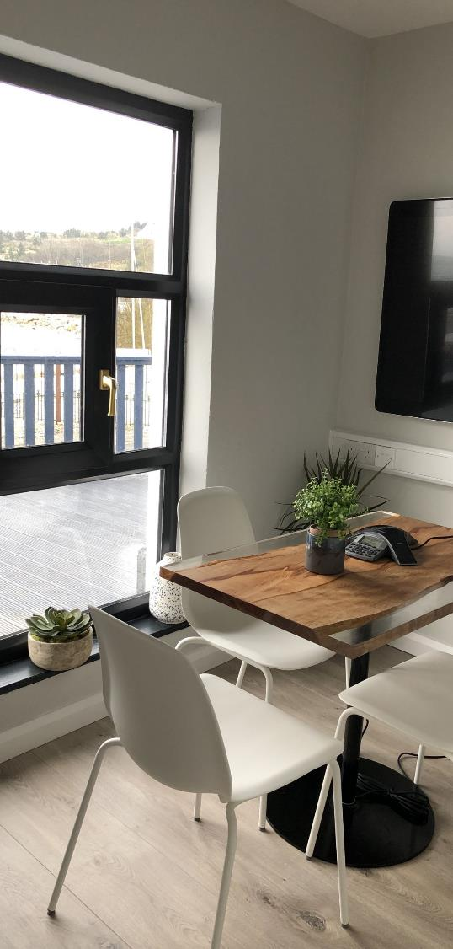
A SMART MOVE TO COMBAT DEPOPULATION
MODAM - Arranmore, Donegal Coast, Ireland
SOCIAL
ECONOMIC
Located on the beautiful of Árainn Mhór Island (Arranmore), Ireland three miles off the Donegal coast on the Wild Atlantic Way, MODAM is Ireland's first offshore shared digital workspace with onsite accommodation, 11 desks and a dedicated meeting space. MODAM has been designed to suit both short and long term rental for remote work, projects or just a change of scenery.
MODAM is an initiative led by Arranmore Island Community Council in partnership with Donegal County Council, The Department of Rural and Community Development, Three Ireland and Grow Remote. Arranmore Island Community Council is a democratically elected committee working to promote the sustainability of the island. Modam is a key initiative designed to entice people to visit and move back to Island.
CASE STUDY

Slide 29
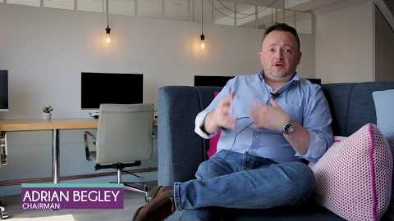
Watch our RESTART video case study - MODAM Arranmore

Slide 30
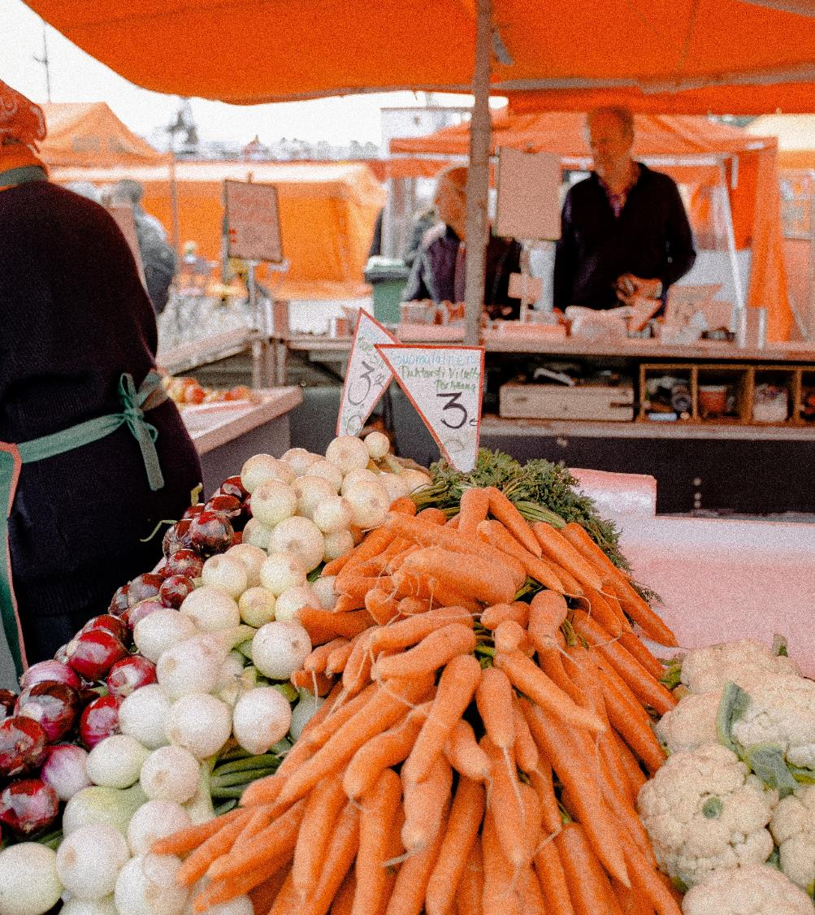
2. Economic Sustainability
Economic sustainability refers to long-term economic growth which doesn’t negatively impact social, environmental, and/or cultural aspects of the community.

Slide 31
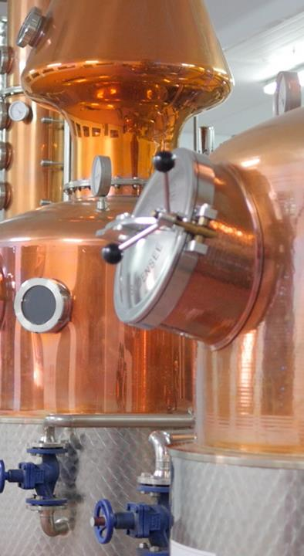
STIMULATING LOCAL ECONOMY
The Food Hub, Drumshanbo, Ireland
ECONOMIC
In 1998, the small community of Drumshanbo lost over a 100 jobs in their town when their major food manufacturer employer closed. The premises lay idle for decades underscoring a lack of employment growth and economic development in the area.
In 2004, the not for profit community activist group Drumshanbo County Council insightfully took the opportunity to restore the premises as an state of the art food specific enterprise centre of 14 individual food business units offering world class food production facilities, not only unique to the area but as one-of-its kind in the country. Now home to famous Drumshanbo Gunpowder Gin, the Food Hub provides employment for over 120 people. READ MORE:
CASE STUDY
The Food Hub Website
€3m Visitor Centre at Shed Distillery, The Food Hub

Slide 32
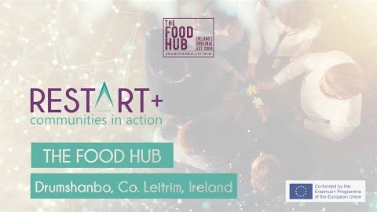
CASE STUDY
Watch our video case study on The Food Hub – click to play

Slide 33
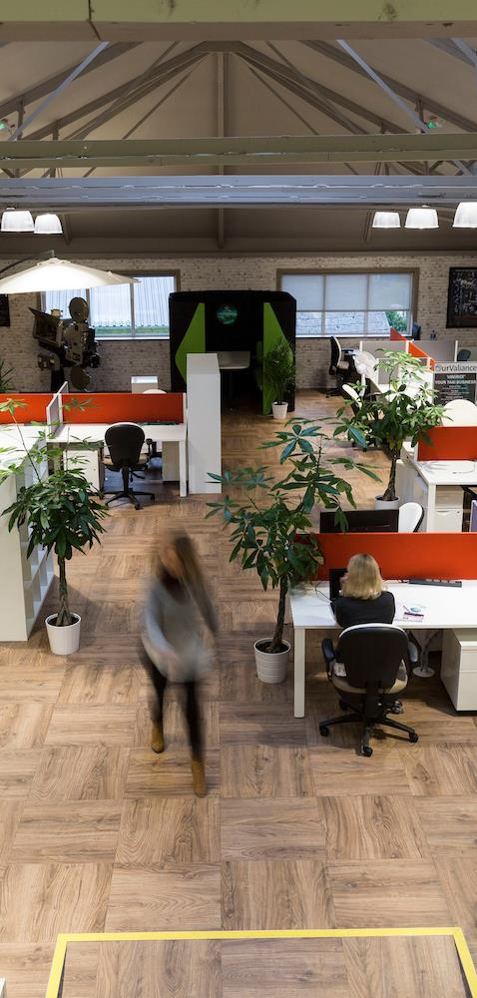
LUDGATE HUB – Technology puts a small town on the map in West Cork, Ireland
ECONOMIC
SOCIAL
There are exposed beams, a high ceiling, open-plan offices, funky colours, breakout spaces and an orange kitchen. The Ludgate Hub looks for all the world like a typical startup office in Silicon Valley, but this is Skibbereen in Eest Cork, Ireland.
Here, Ludgate Hub has become a vital resource in the local community, facilitating job and business creation/development in the Skibbereen and greater West Cork area.
It has been created by the people for the people. Developed from the “bottom up” with help from many people who believed in its mission.
The motto of Ludgate Hub: LIVE THE LUDGATE LIFE - LOVE WHAT YOU DO, LOVE WHERE YOU LIVE ! Ludgate provides a space to network, expand your horizons and scale your business.
CASE STUDY

Slide 34
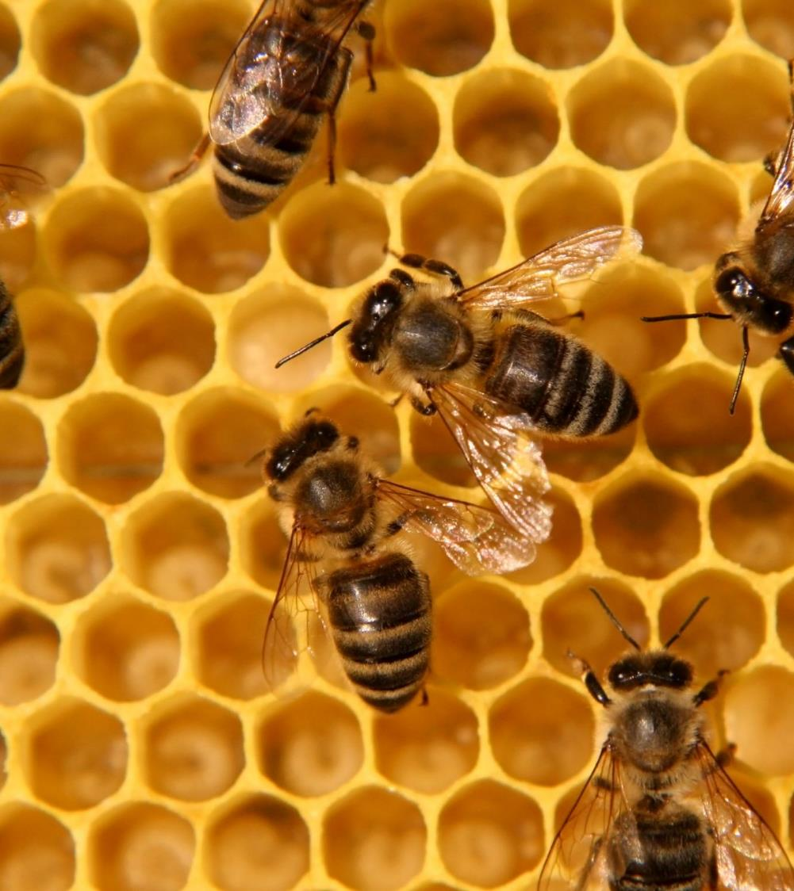
3. Environmental Sustainability
Environmental sustainability is defined as responsible interaction with the environment to avoid depletion or degradation of natural resources and allow for long-term environmental quality.

Slide 35
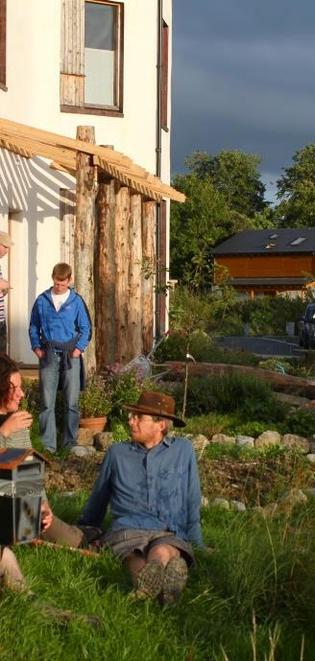
Cloughjordan Eco Village – how Cloughjordan got on the ‘Best Place to Live’ List
ENVIRONMENTAL
SOCIAL
The Cloughjordan Ecovillage brings together a diverse group of people creating an innovative new community in Tipperary. They are doing this a way that is democratic, healthy and socially enriching while minimising ecological impacts. Their 67-acre site includes beautiful and fertile land where they grow their own food, and plants and trees to promote biodiversity.
» More than 50 low energy homes and work units so far
» A solar- and wood-powered community heating system
» 50 acres of land for allotments, farming and woodland
» A green enterprise centre and hi-spec broadband
» An eco-hostel for visitors
» A nearby train station and community farm
FIND OUT MORE: www.thevillage.ie/
CASE STUDY

Slide 36
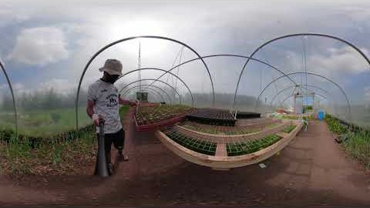
Take a 360-degrees stroll around Cloughjordan Ecovillage. You navigate the screen by using the arrows at the top left to move around the landscape as each presenter talks.

Slide 37
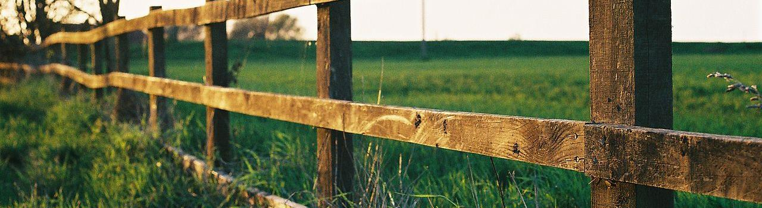
SECTION TWO: BARRIERS TO SUSTAINABILITY
Spotlight on some causes of Community Decline – Emigration/Depopulation, Decline in Employment or Service, Environmental Issues and Lack of Community Leadership

Slide 38
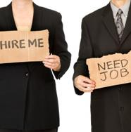
Decline in Employment or Loss of an Industry
Loss of an industry or key community employer can have a devastating impact on a community. For example, we learned earlier how the closing of the food factory in Drumshanbo, Ireland in 1998 resulted in over 100 job losses which decimated the small town.
Over dependence on one employer or industry should be a cause for concern for any community. Economic diversification is an important way to mitigate losses from a loss of industry. We will explore economic diversification in detail in Module 2.

Slide 39
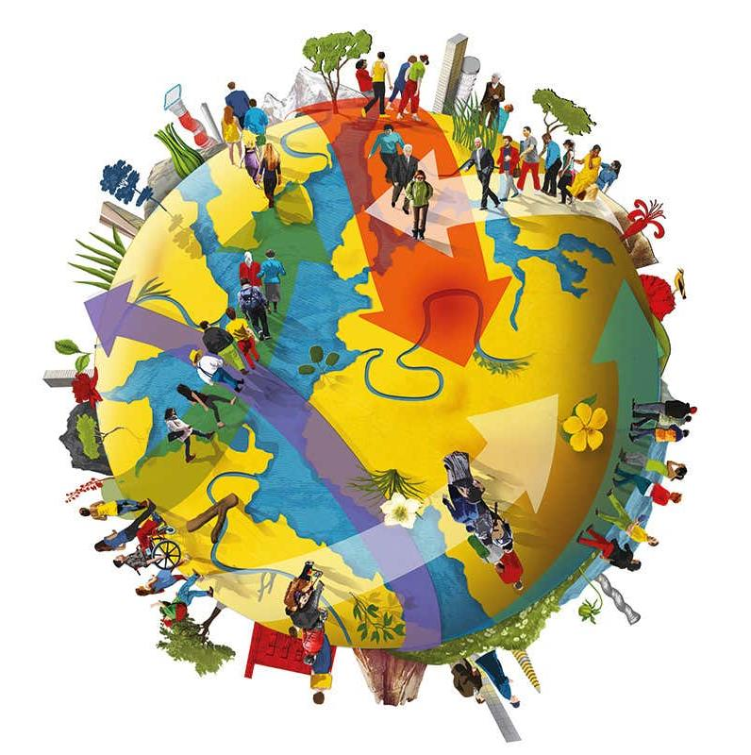
Emigration/Depopulation (or Brain Drain)
Brain drain, the out-migration of young, college-educated graduates/workers from a local community or region, poses a serious threat to the social and economic vitality of that communities.
Whether it moving to local cities or abroad in search of opportunities, the result is often a permanent migration which has serious negative impact on small, rural communities.
For communities to have a sustainable future, they need young people engaged and active in their ongoing development and future planning.

Slide 40
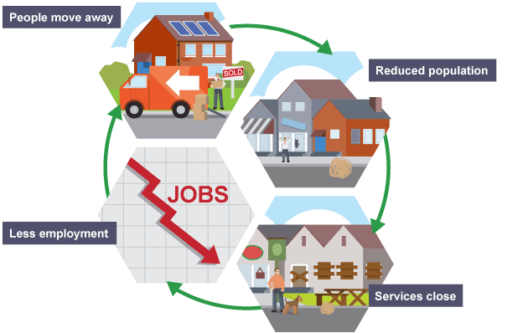
Decline in Services due to depopulation
The depopulation of communities can means that local services decline. Independent stores and post offices become less profitable because of depopulation. Public transport may decline leaving the community cut off.
The changes in the less accessible (remote) rural areas leads to a cycle of decline. This can also happen in challenged urban areas also.
Source: BBC

Slide 41
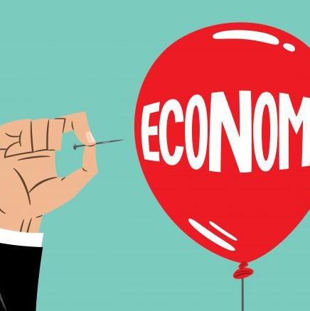
Impact of Economic Crisis/Recession
In both the 1990/91 and 2008/09 recessions, unemployment increased drastically across Europe. By mid 2009, most local authorities had experienced increased demands for services as a result of the recession but local councils (20% in the UK) like every other employer had no choice but to make compulsory redundancies; a further third had introduced voluntary redundancies or job freezes.
Many communities therefore faced a ‘double whammy’ of job losses and service cuts. Economic crisis and recession has a huge impact on communities and is a key cause of decline.

Slide 42
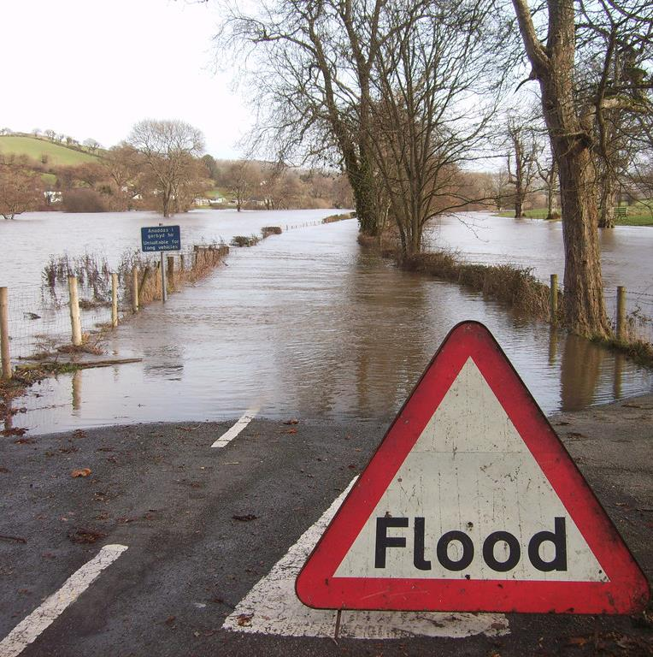
Environmental Problems
Examples include
Climate change accelerating extreme events e.g. floods, droughts.
Urban sprawl results in land degradation, increased traffic, environmental issues and even health issues.
The ever-growing demand for land, the seesaw of too much/not enough housing supply.

Slide 43
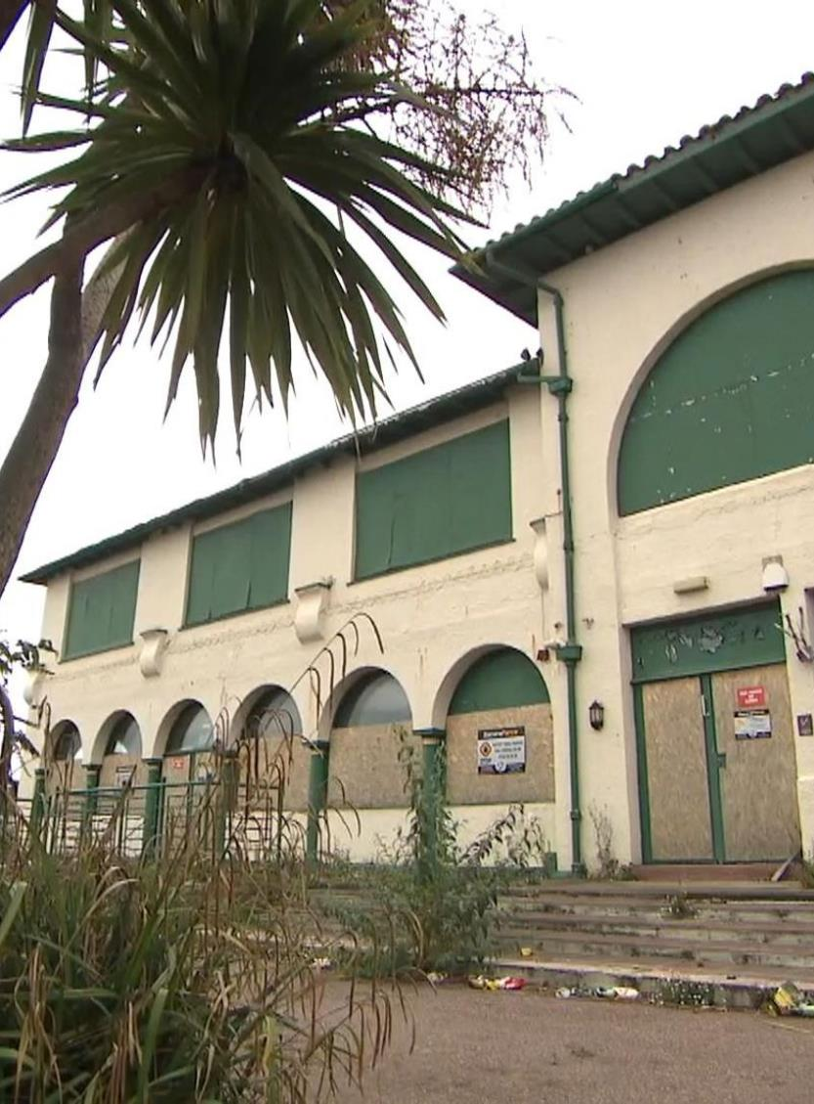
UK Coastal Communities in Decline
A lack of investment, employment and transport links are putting the UK's coastal towns at risk. SMF chief economist Scott Corfe, said a lack of local job opportunities and poor transport links contribute to badly-performing economies.
“We do need greater investment in our coastal communities; it's meaningful jobs, less seasonal work - all-year-round work - introduce and improving broadband to keep future generations in our coastal areas.
There are issues around meaningful employment, growth, things for people to do, tapping into the ambitions of young people in particular is important - and not letting communities slide."
CASE STUDY
Source BBC

Slide 44


Lack of Community Leadership
Strong community leaders champion the successful development of community projects. Earlier we learned that strong community leaders are a key characteristic of great communities so it may be of little surprise that a lack of community leadership can lead to decline or community stagnation.
In section 4 of this module, we will look at community leadership in more detail, we will meet some community leaders and learn how to empower them.

Slide 45

Lack of Sustainable Investment/Local Maintenance
Lack of investment and maintenance are two key reasons for community decline and this is where sustainability comes in. Too often projects are created, developed and delivered with little or no framework in place for how they will be sustained in the long term. Who will be responsible for the initiatives daily up keep?
Creating a sustainable action plan for your community regeneration projects is key. We will guide you through the process of creating a sustainable action plan in Module 5.

Slide 46

Problem designing sustainable solutions
Problem solving in a community setting can be difficult as a host of different demographics with varying wants, needs and ideas vie for the best way to do things all come together in one place. Designing sustainable solutions that all can get behind can be tricky and daunting.
Designing solutions that break the mould of what is currently being done in the community (or has always been done) can also be tricky. Solutions that maintain the status quo though are going to do just that though.. maintain the status quo. As you go through this course though, you will learn new approaches to get support and backing for regeneration projects.

Slide 47

Section Three: COMMUNITY CAPACITY, ASSETS, SKILLS AND COMPETENCIES FOR REGENERATION
The first step towards writing an effective Community Regeneration Plan requires an understanding of the demographics, physical assets and human assets within your environment and group.

Slide 48

YOUR COMMUNITY DEVELOPMENT DNA
What has been the historic evolution of the area and the outcomes of previous initiatives/projects?
What problems did these projects solve? What was the particular challenge that your community was facing?
Did the project/solution (e.g. economic or cultural renewal, physical infrastructure transformation) have the desired outcome?
What relationship does your community have with others (local council, grant agencies, banks etc.)?
Exploring these questions will help you uncover past successes and failures. Both will help you to a strong foundation on which to build future projects

Slide 49
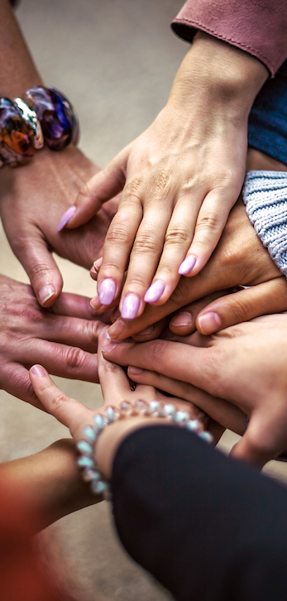
What Capacity, Assets, Skills or Competencies does your Community have?
Each community boasts a unique combination of assets upon which to build its future. When planning any new community regeneration project, conducting a thorough map/ inventory of the communities assets including the gifts, skills and capacities of the community's residents is key.
Person by person, group by group, building by building, you will discover a vast and often surprising array of individual talents and productive skills, many of which can be mobilised for community-regeneration purposes.
When doing this exercise, it is essential to recognize the capacities of all. For example, those who are mobility challenges, or of those who are marginalized, socially or economically, have a role to play as contributors to the community-building process.
Source: Assets Based Community Development

Slide 50

What sort of skills/competencies should you be looking for?
1: CONNECTIVE SKILLS
The practices, attitudes, values and relationships that enable people to work collaboratively, to merge community objectives and to recognise the need for shared responsibility in order to ensure successful delivery of projects. There are a number of skills in the connective set of skills, these are:
Leadership
Partnership
Communication
Team building
Visioning
Enabling
Consensus building
Brokerage/Conflict resolution
Community engagement
Client/customer focus
Source: Regeneration Skills A Consideration of Current and Future Requirements

Slide 51
What sort of skills/competencies should you be looking for?
2: DELIVERY SKILLS
Delivery skills are those which are needed to turn a vision into a successfully completed project. These skills bring together and unify the contributions of a wide range of community members, agencies and actors. The skills in this set are:
Project design
Funding and financing
Analysis and decision-making
Project management
Procurement
Supply chain development
Local employability development
Monitoring and evaluation
Reportage and dissemination of good practice
Source: Regeneration Skills A Consideration of Current and Future Requirements

Slide 52
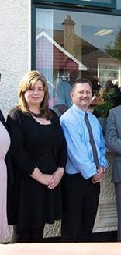
Better Together – the Story of how the Exchange Community Centre in Donegal, Ireland was born..
ECONOMIC
SOCIAL
The Exchange is a voluntary-run social enterprise, community and cultural centre in Buncrana, Co Donegal, Ireland. The organisation was founded by a group of like minded individuals, social entrepreneurs and community groups in 2012. A lack of community and cultural space and a similar lack of support for the development of start up and small businesses led to the formation of the partnership.
In her Linkedin article series, Ruth Garvey-Williams one of the founding members tells the story of the exchange. “We organised an outing to tour the shabby building, complete with its boarded-up windows and government-issue carpet tiles. That first sight was not encouraging. We were embarking on a journey together and the destination was so much more than a building. When does a shared idea become a shared vision? For us, it was walking through those rooms and describing a different future.”
READ MORE: www.linkedin.com/pulse/better-together-story-exchange-part-two-ruth-garvey-williams
CASE STUDY

Slide 53

Section Four: Building a Strong Community Regeneration Team
How to assess your skills, knowledge and community regeneration capacity? How to form a project team or community council?

Slide 54
WHY IS A COMMUNITY TEAM NEEDED?
As we learned earlier, strong community leadership is key. True change can not happen in communities from the top down, it needs to be bottom up. Community ownership, responsibility and pride can have significant transformational impact on an area and importantly, on how it is perceived by local residents and visitors. In this respect, local community engagement has a key role to play. A strong community team can:
Increase resources for community activities
Lead to more economic opportunities (such as social enterprises)
Improve community heritage and other community assets
Have more of a collective influence on local and regional public services
Enable deeper connections with people inside and outside your community
Infiltrate and break down barriers to change from the inside

Slide 55




Potential key players in your community regeneration projects
COMMUNITY
CHAMPIONS
ACTIVE CITIZENS/ VOLUNTEERS
WIDER COMMUNITY
MEMBERS
EXTERNAL STAKEHOLDERS/
SUPPORT NETWORK
They take responsibility for the wellbeing and improvement of their communities. The champion in your community might be the chairman of your committee or maybe you have a team of champions?!
This group are actively involved in community life and work on implementing solutions and bringing projects to life.
For regeneration to happen it needs to have the support of the wider community (residents, businesses, . To get their buy in you will need to engage them and sell them the benefits of the work you are doing/planning and why.
Good intentions and good community projects can sometimes happen in isolation but most need some for of external support (funders, local council) to make them a reality. Leveraging the right support can be a challenge. In Module 4, we will introduce you to some tried and tested ways of attracting external support.

Slide 56
KNOWLEDGE, SKILLS, PASSIONS OF YOUR COMMUNITY TEAM
This Mind Map or Spoke Diagram is a useful tool to assess the skills and knowledge of your community team.
  OUR TEAM
.
Let’s see a filled in example…

Slide 57
SAMPLE: Community
Development Team
TOM skills/knowledge in community safety and wellbeing, RETIRED POLICE PERSON
JOHN
over 20 years hands on community development experience
SARAH
STUDENT youngest member who gives insights from younger perspective
JULIE
JOE/ANN
Interested in developing tourism potential of the village, LOCAL BUSINESS OWNERS
  OUR TEAM
MARY
new community member brings fresh eyes to the committee, interested in digitisation
TEACHER
.
LIAM
Grew up in the village, moved away then moved back, ACCOUNTANT
KATE
Passionate about local history and heritage, ARTIST AND SCULPTOR, teaches art

Slide 58
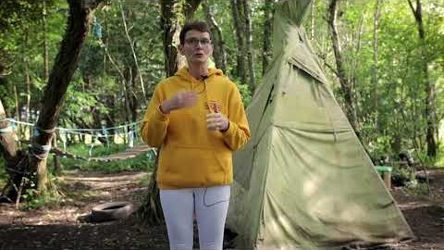
In this video, Fiona Boyle tells us about the path to developing Ray Community Centre. With regard to building a regeneration community team – she talks about the importance of empowering the youth, tapping into the skills of the community and the importance of keeping your committee fresh

Slide 59
BUILDING A COMMUNITY REGENERATION TEAM:
COMMUNITY CONSULTATION PROCESSES
Some methods include:
Honesty, politeness and clarity: Be transparent about what your value and interests are, what you want to work on and what commitment is needed from everyone involved
Align your value and interests with those of your community (you can do this quite easily having conducted a walk about and community survey)
Carefully construct your communication messages (see Module 5 topic marketing and communicating for communities)

Slide 60
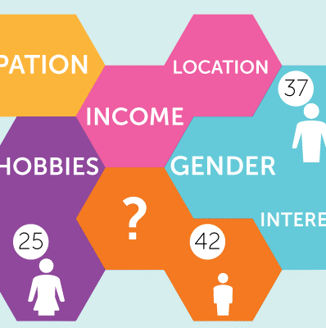
Why demographics matter?
Population growth, population ageing and decline pose challenges but they can also provide important opportunities for more sustainable development
Migration can be an important enabler of social and economic development. Higher population density enables governments to more easily deliver essential infrastructure and services in concentrated areas at relatively low cost per capita.
Liveable and sustainable towns and cities have knock-on effects in terms of providing rural populations with greater access to services such as education and healthcare, while also empowering them economically.
Source: Sustainable Development and Population Dynamics

Slide 61
DEMOGRAPHICS: KNOW YOUR AREA
Profile
Male, female, age, education, status retired or students or working, health
Population (numbers)
Economic circumstances (income levels, local industries)
Geographical location
Physical Assets
Transport infrastructure
Buildings
Environment/Amenities
Facilities/Land
Connectivity/ Internet
Human Assets
Skills
Time
Experience

Slide 62
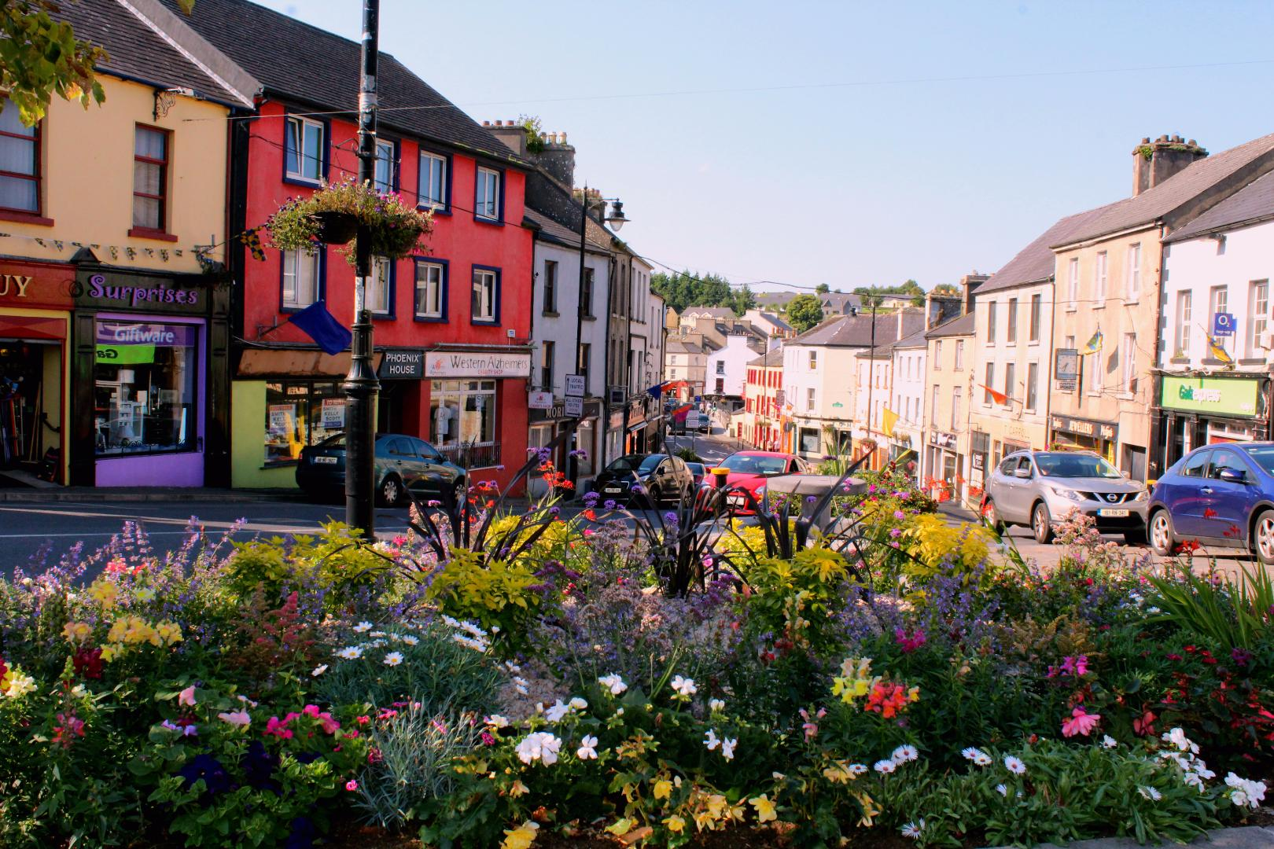
TOWN TEAMS, ROSCOMMON, IRELAND
ECONOMIC
SOCIAL
In 2014. Town Teams were established by Roscommon County Council, retailers, consumers, citizens and communities to energise and reinvigorate their towns with the support other agencies and service providers.
The Rationale and Vision
We aim to create jobs, facilitate start-up businesses and above all re-instil the pride we all should have for our towns. Effective change will come from within. The people of County Roscommon will know best what is needed by the people of County Roscommon.
The people of Co. Roscommon want our communities to have towns to be proud of, towns that cater for their needs so that they don’t have to look elsewhere. Spaces that are destinations - somewhere you want to spend your time and money. Somewhere that inspires, encourages and helps new entrepreneurs and supports the established businesses. Somewhere that both locals and passersby want to stop and enjoy when they drive through the county; places that people hear about and make a point of going to. Somewhere that has a long term sustainable future.
‘
CASE STUDY

Slide 63
TOWN TEAMS, ROSCOMMON, IRELAND
ECONOMIC
SOCIAL
The project was initiated by Roscommon County Council, as part of the new enhanced role for Local Authorities in the areas of economic & enterprise development, as envisaged under the Local Government Sectoral Strategy to Support Economic Recovery and Jobs and the Action Programme for Effective Local Government (2012).
The Town Teams act as a catalyst for new innovations, which will have a regenerating impact on the town and the teams and take a leading role in securing funding for collective actions. The Town Teams lead the development and delivery of initiatives and are the driving force behind proposals to secure funding.
CASE STUDY

Slide 64
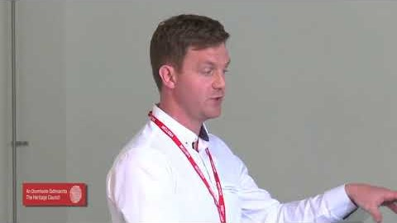
TOWN TEAMS, ROSCOMMON, IRELAND
WATCH:
ECONOMIC
SOCIAL
CASE STUDY
WATCH - Roscommon's Town Teams: the story so far - Colm Kelly, Roscommon County Council 2017

Slide 65
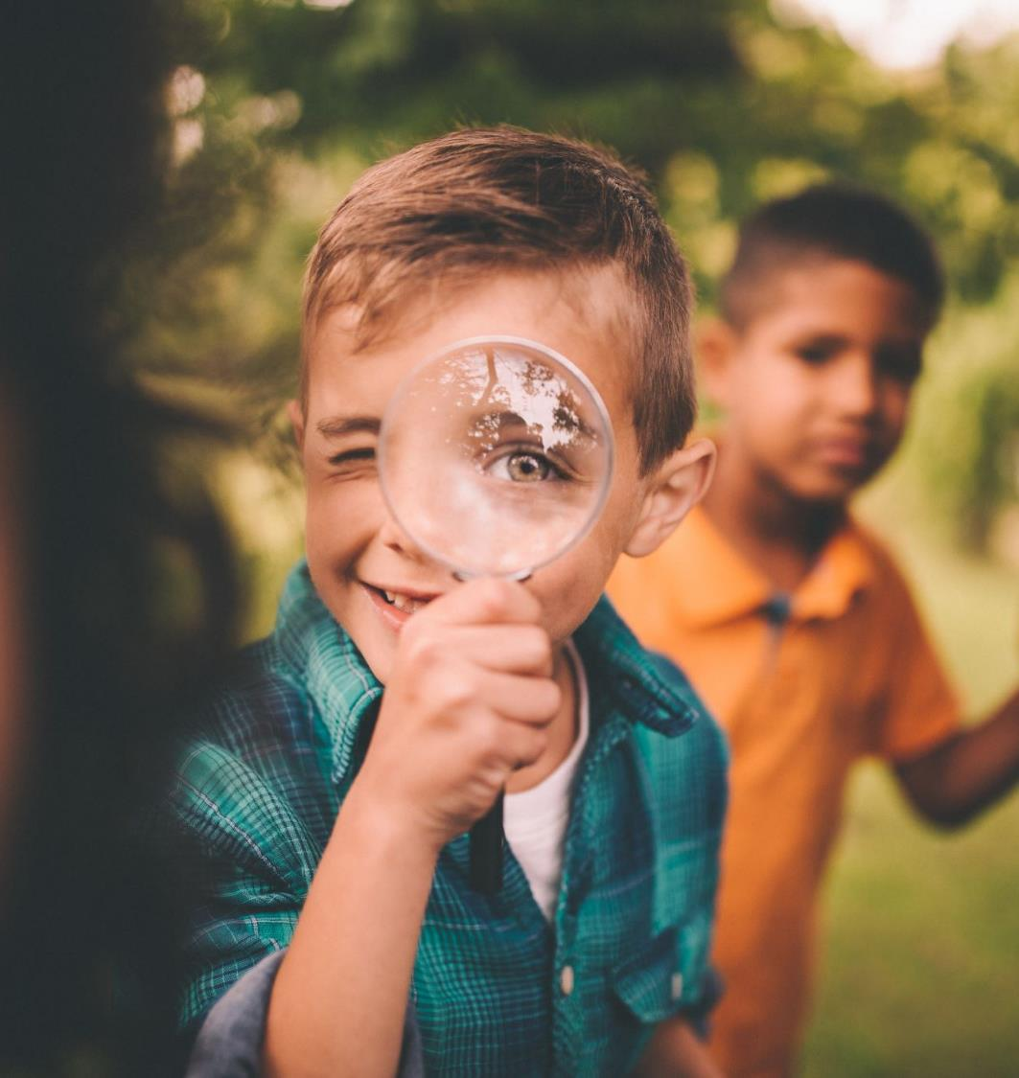
Getting Started with Building your Sustainable Community – useful exercises and templates
Key Action Pack 1
Check list – characteristics of a great community
Radar chart – where are your social/economic/environmental community strengths/weaknesses
Knowing your community – demographics/community audit and mapping exercise
Skills/Competencies Audit of your Regeneration Team
Articulating Challenge – focus on your community causes of decline
The Town Teams Charter
These exercises will help you apply what you have learned in Module 1 to your community. Please complete these before moving on to Module 2.

Slide 66

1: Check list – how many great community characteristics does yours have?
SOCIAL
Sense of belonging/pride of place
Cohesion/Inclusion and Equality
Active Citizenship: Participation and local democracy
Health, quality of life/ well-being
Social Order and a Feeling of Safety
Cultural fulfilment, a sense of heritage
ECONOMIC
Opportunities for enterprise and employment
Opportunities for education/training
Housing and vibrant neighbourhoods
ENVIRONMENTAL
Community Infrastructure and Amenities
Air/Water Quality
Pollution Management (noise/waste)

Slide 67
2: Chart your Community Development Strentghs Using a Radar Chart (or similar)
Take a time period e.g 20 years and review/rate how your community met its needs/goals for social, economic and environmental development.
Hindsight it an important factor in community regeneration as you need to assess what work well, when and why and as a result where are the areas for improvement.

Slide 68
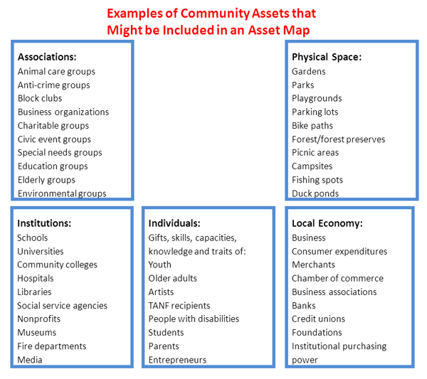
3: Audit the Assets of your Community
Asset Mapping is a process of cataloguing key services, benefits, and resources within the community, such as individuals’ skill sets, organizational resources, physical space, institutions, associations, and elements of the local economy.
These assets can be used by your program to overcome barriers to health. Asset mapping can help to:
Identify community assets and strengths
Ensure the intervention’s relevance to community needs
Obtain buy-in from the community
Source

Slide 69
4: Skills/Competencies Audit of your Regeneration Team
Use or recreate this simple spider map diagram to assess and chart the skills and knowledge of your community team.
  OUR TEAM
.

Slide 70
5: ARTICULATING COMMUNITY CHALLENGE
Articulating your challenge in 100 words or less will provide a precise focus for your community development plan
What are the biggest challenges facing you in achieving social, cultural or environmental improvements?
What is the impact of those problems & challenges?
Try and capture challenges under each of the particular headings.
Area problems: Brain drain and depopulation, business unit vacancies, retail wilderness through changing patterns of shopping and movement, and lack of employment opportunities to retain population.
Cohesion Problems: disparate communities leading to fragmented social cohesion

Slide 71
Community Challenge EXAMPLES
Social problems: The increasingly complex nature of poverty and social exclusion caused by the impact of unemployment or poorly paid employment, lack of opportunities and cuts to services and supports for people on low incomes, unemployed, dependent on welfare and those in debt.
Fundraising problems: Increased competition for resources – within the community and voluntary sector and between community and voluntary sector and other sectors.
Environmental problems: persistent local flooding
Personnel: Lack of leadership in local community

Slide 72
5: Practical Challenge Table Template
Core Challenge | 100 words
 | Economic | Social | Environmental
Difference
Challenge
Impact

Slide 73
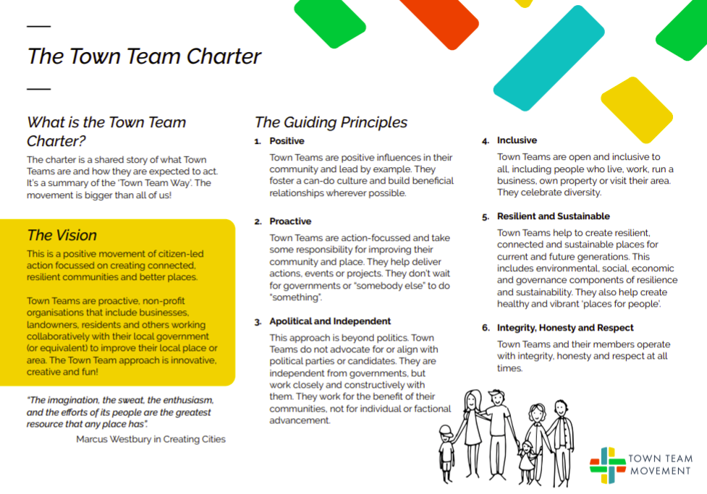
6: Towns Team Charter
Consider adopting the Town Teams Charter

Slide 74
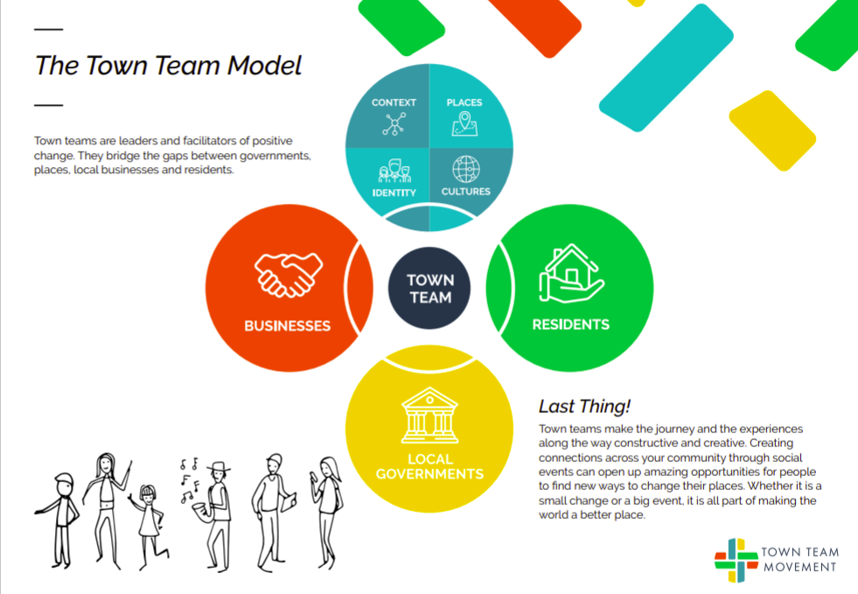
6: Towns Team Model
Consider adopting the Town Teams Charter and Model
Click for more information on the Town Teams Movement

Slide 75
MODULE 1: KEY TAKEAWAYS - CREATING SUSTAINABLE COMMUNITIES
Some approaches and strategies that have been proven to work..
Create an entrepreneurial culture which celebrates innovation and challenge, allowing room for development and new ways of doing things.
Focus on practical projects that support a ‘learning by doing’ attitude and encourage direct and active participation with real outcomes.
Grow involvement organically, allow originality to shine through, give time and space for communities to form.
Build partnerships with business and the public sector, seek out the opportunities that can mutually benefit business, enterprise and communities.
Emphasis on quality, continually insist on high standards and longevity throughout the work.

Slide 76
MODULE 1: KEY TAKEAWAYS - CREATING SUSTAINABLE COMMUNITIES
Some approaches and strategies that have been proven to work..
Tell a clear story, use honest, clear and consistent messages to help manage expectations and be realistic about what can and can’t be done.
Build on what works, learn from mistakes in the past and use models that are proven to work.
Embed diversity and equality, an inclusive approach that promotes fairness across the board.
Develop strong relationships and real lasting partnerships

Slide 77
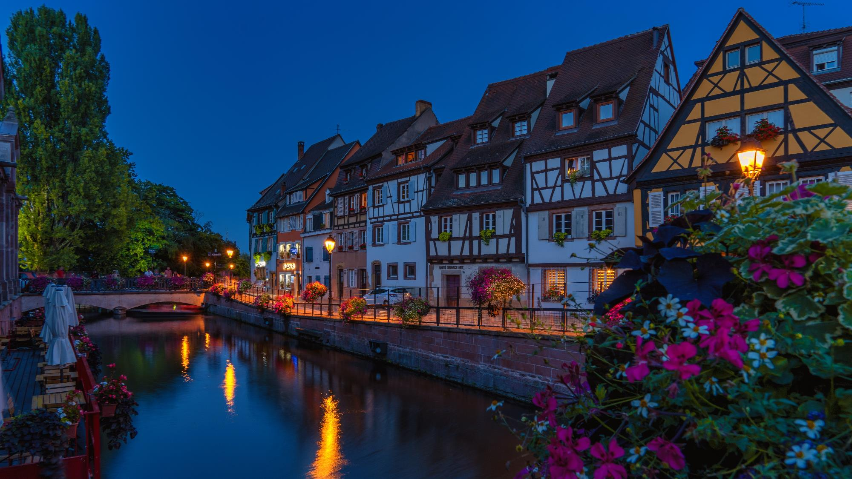
NEXT UP: Module 2 Opportunities for Community Regeneration
A shared vision is not an idea. It is, rather, a force in people’s hearts.
In Module 2, we hope to inspire a new vision for your community.
Source

Slide 78
Key references for Module 1
Building Communities from the Inside Out
Urban Regeneration: A Comprehensive Strategy for Creating Spaces for Innovative Economies
Regeneration Skills A Consideration of Current and Future Requirements

